Slide 1
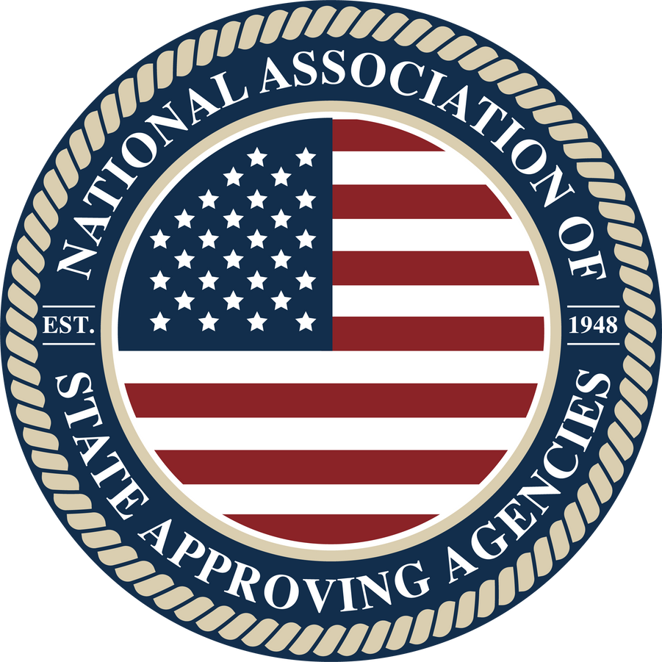
State Approving Agencies
Updates
WAVES Annual Conference
July 7, 2025
Rebecca Ryan
President, NASAA

Slide 2
NASAA: Origin Story
1944: Congress passes the GI Bill® of Rights into law
1947: Congress creates State Approving Agencies- to be overseen by the states but funded by the federal government.
  Became the primary source of assuring institutional accountability with specialized authorization to approve, disapprove, and monitor education and training programs for veterans.
1948: National Association of State Approving Agencies is formed to:
  Create professional and ethical standards
  Exchange ideas
  Represent mutual interests
  Protect schools and veterans from fraud, waste, and abuse
  ‘‘GI Bill® is a registered trademark of the U.S. Department of Veterans Affairs (VA). More information about education benefits offered by VA is available at the official U.S. government Web site at http://www.benefits.va.gov/gibill."
NATIONAL ASSOCIATION OF STATE APPROVING AGENCIES

Slide 3
The Key Players
U.S. Department of Veterans Affairs
State Approving Agencies
Schools and School Certifying Officials
State Licensing Bodies
Dept. of Education
FAA
Dept. of Labor
Accrediting Bodies
NATIONAL ASSOCIATION OF STATE APPROVING AGENCIES

Slide 4
Role of the SAAs
Approvals
  Evaluate educational programs for approval
  Provide written evaluations and approvals to the VA and the schools
Inspections, Supervisory Visits, and Risk Based Surveys
  Visit and inspect each active educational institution
  Supervise GI Bill actions at approved institutions
  Confirm compliance for approved courses and programs
Technical Assistance
  Respond to institutional and veteran requests for information and assistance
Outreach
  Engage with local, state, and federal partners to promote the use of GI Bill benefits and education and training opportunities for veterans and their families.
NATIONAL ASSOCIATION OF STATE APPROVING AGENCIES

Slide 5
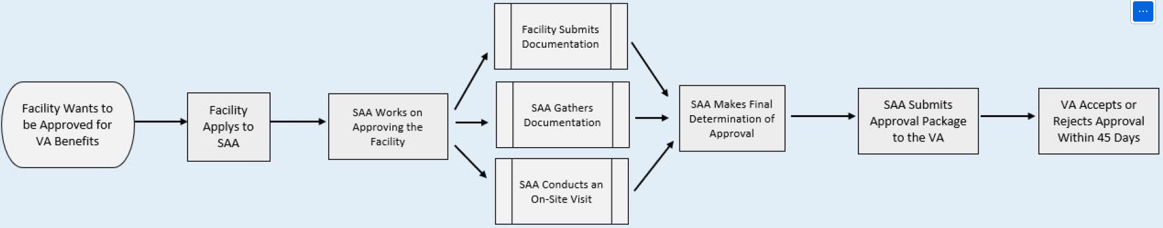
Approval Process:
Workflow
NATIONAL ASSOCIATION OF STATE APPROVING AGENCIES

Slide 6
Uniform Application
38 USC 3672A Uniform Application
  Required specifically for new programs
  SAA discretion if you are not submitting a new program
  Also SAA discretion to request additional information per state requirements
Two Forms:
  22-10287 Institutions of Higher Learning
  22-10288 NCDs and “Everything Else”
Program List Form
  Standard “a” forms as published by VA or SAA can use their own to collect program specific information
NATIONAL ASSOCIATION OF STATE APPROVING AGENCIES

Slide 7
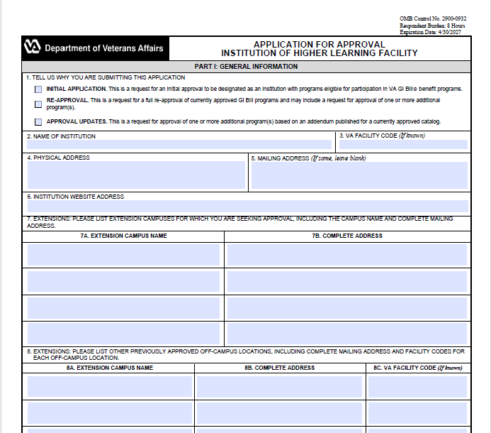
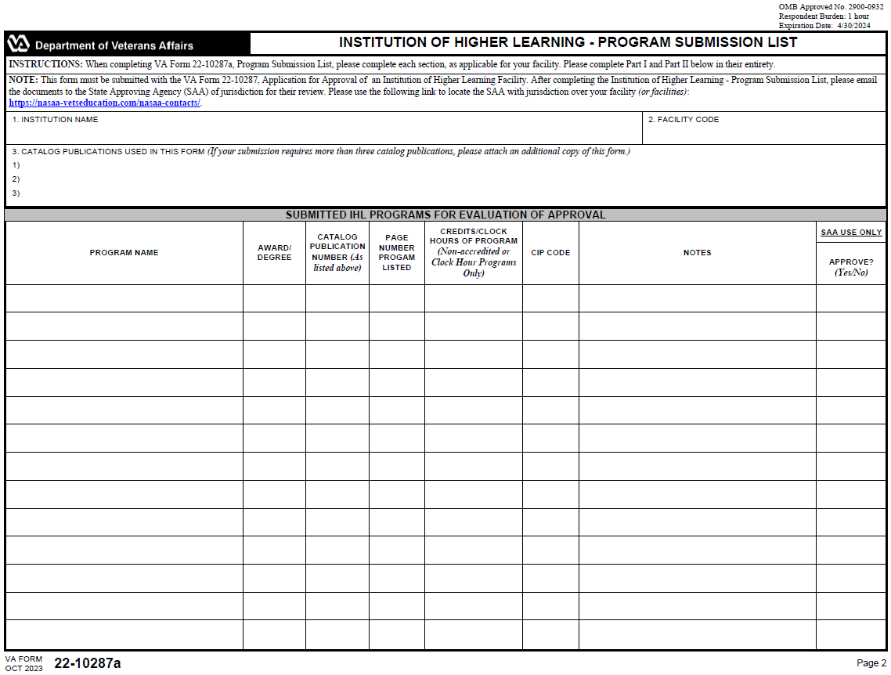
VA Forms 22-10287/10288
and 22-10287a/10288a
NATIONAL ASSOCIATION OF STATE APPROVING AGENCIES

Slide 8
Uniform Application
Current Version is dated April 2024
Pending Updates:
  Continued grammatical and format edits
  Addition of Dole Act provisions
NATIONAL ASSOCIATION OF STATE APPROVING AGENCIES

Slide 9
The Dole Act
Senator Elizabeth Dole 21st Century Veterans Healthcare and Benefits Improvement Act
  Effective January 2, 2025 (date of enactment)
  Education provisions include:
    Expansion of Fry benefits
    Expansion of Title IV waivers
    Full time MHA payment in final semester
    Remove two-year rule requirement for branch campuses of CDL schools
    Electronic CoEs
    Digital Transcript Requirement
    Restoration of Entitlement for closed schools
    Extension of VET-TEC pilot program
    90-day implementation period for new VA policies/guidance
NATIONAL ASSOCIATION OF STATE APPROVING AGENCIES

Slide 10
The Dole Act: Sec. 206
  Requires an educational institution to agree to notify the SAA if an institution becomes subject to a government action or event such as:
    Institution is placed on Heightened Cash Monitoring Level 2 (HCM2)
    Provisional certification status from Department of Education
    Notice of punitive action for misconduct or misleading marketing practices by:
      U.S. Attorney General
      Federal Trade Commission, or
      Other Federal agency
NATIONAL ASSOCIATION OF STATE APPROVING AGENCIES

Slide 11
The Dole Act: Sec. 206
  (Cont’d) Requires an educational institution to agree to notify the SAA if an institution becomes subject to a government action or event such as:
    Notice of punitive action taken by a state against an institution
    Notice of action taken by an accrediting body due to:
      Loss of accreditation
      Risk of losing accreditation:
        Probation
        Suspension
        Show cause related to institution’s academic policies and practices, financial stability, revocation of accreditation.
NATIONAL ASSOCIATION OF STATE APPROVING AGENCIES

Slide 12
The Dole Act: Sec. 206
  Educational institution must notify VA or the SAA not later than 30 days after the date that the institution becomes subject to such action or event.
  Failure to notify could result in the SAA taking the following actions:
    Submit a recommendation that VA publish a warning on the VA website about the school;
    Suspend the approval by disapproving new enrollments
    Revoke the approval disapproving all enrollments.
NATIONAL ASSOCIATION OF STATE APPROVING AGENCIES

Slide 13
The Dole Act: Sec. 207
  Amends 38 U.S.C. § 3675(b) to require educational institutions to make available to each eligible person or Veteran a copy of their official transcript in digital format.
  What types of schools/programs are impacted?
    Accredited programs at the degree or certificate level
    Non-accredited degree programs
  What does “make available” mean?
  Effective August 1, 2025
  Applies to any quarter, semester, or term commencing on or after the Effective Date
NATIONAL ASSOCIATION OF STATE APPROVING AGENCIES

Slide 14

Types of School Visits
Conducted by SAAs:
  Risk Based Surveys
  Supervisory Visits
  Inspection Visits
  Technical Assistance
  Outreach
Conducted by VA/St. George:
  Compliance Surveys
Conducted by Both SAAs and VA:
  Targeted Risk Based Reviews
NATIONAL ASSOCIATION OF STATE APPROVING AGENCIES

Slide 15
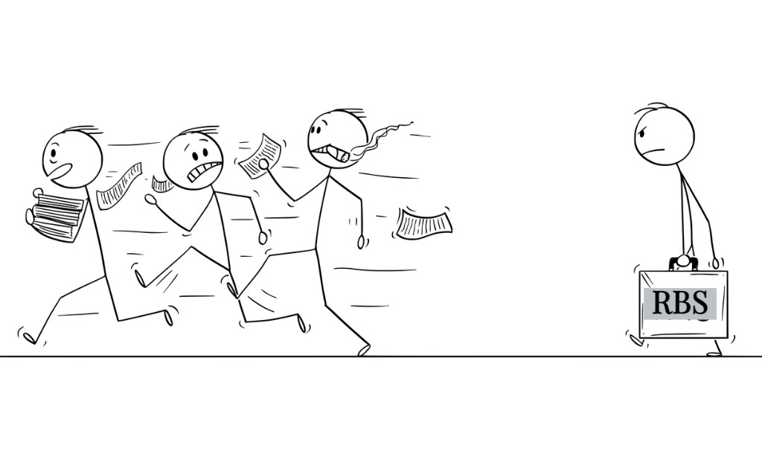
Risk Based Surveys
Public Law 115-48 Harry W. Colmery Veterans Educational Assistance Act of 2017
  Required VA to utilize SAAs to conduct RBS
Public Law 116-315 Johnny Isakson and David P. Roe, M.D. Veterans Health Care and Benefits Improvementt Act of 2020
  Further outlined and defined risk factors
NATIONAL ASSOCIATION OF STATE APPROVING AGENCIES

Slide 16
Risk Based Surveys
Data Driven RBS (38 USC § 3673A)
Notice of Government Action RBS (38 USC § 3673)
SAA Determined RBS (38 USC § 3696(k))
NATIONAL ASSOCIATION OF STATE APPROVING AGENCIES

Slide 17
  Data Driven RBS:
  Legislative Risk Factors
    Rapid student population increase
    Rapid tuition and fee payment increase
    Volume and severity of validated student complaints
    85/15 rule violation
    Veteran completion rates
    Financial stability
    Advertising and marketing practices
    Federal or State government actions in court
NATIONAL ASSOCIATION OF STATE APPROVING AGENCIES

Slide 18
  Data Driven RBS:
  Other Legislative Risk Factors
    Conversion from a for-profit educational institution to a private nonprofit or a public educational institution
    Requires an RBS for 3 consecutive years following the conversion, no exception.
NATIONAL ASSOCIATION OF STATE APPROVING AGENCIES

Slide 19
RBS: Notice of Government Action
38 USC §3673(e): SAAs will conduct surveys within 60 days after receipt of notice of government action
Types of triggers:
  Institution is placed on Heightened Cash Monitoring Level 2 (HCM2)
  Provisional certification status from Dept. of Education
  Notice of punitive action for misconduct or misleading marketing practices by:
    U.S. Attorney General
    Federal Trade Commission, or
    Other Federal agency
NATIONAL ASSOCIATION OF STATE APPROVING AGENCIES

Slide 20
RBS: Notice of Government Action
Types of triggers (cont’d):
  Notice of punitive action taken by a state against an ETI
  Notice of action taken by an accrediting agency or association due to:
    Loss of accreditation
    Risk of losing accreditation:
      Probation
      Suspension
      Show cause related to institution’s academic policies and practices, financial stability, revocation of accreditation
NATIONAL ASSOCIATION OF STATE APPROVING AGENCIES

Slide 21
  SAA Determined RBS
    38 USC § 3696(k) allows for RBS to be conducted at an educational institution if the SAA considers it appropriate for oversight purposes.
    Can be based on SAA assessment of risk.
NATIONAL ASSOCIATION OF STATE APPROVING AGENCIES

Slide 22
What to Expect if You’re Expecting
a Risk Based Survey…
SAA will contact school prior to visit with a Pre-Survey List of Required Items
  Typically includes student records requests, advertising and marketing materials, financial documentation (except at a public institution), and review of student complaints.
Pre-Survey time will vary based on risk level and SAA schedules.
Upon receipt of documents, SAAs will review items and schedule an on-site visit.
On-site visit will include interviews with school officials and students, tour of facility, classroom observation, and additional record review.
SAA will take action in accordance with survey findings and institution will receive a final report of the survey findings.
NATIONAL ASSOCIATION OF STATE APPROVING AGENCIES

Slide 23
RBS: Possible Outcomes
Expansion of student files
  Up to 25 by the SAA or referral to VA for follow up compliance.
Submit referrals
  Will instruct an SCO to submit certification corrections through Enrollment Manager onsite (when appropriate)
Follow-up requests
  Are any additional documents needed to determine risk level?
Approval issues
  May take program suspension or disapproval action if necessary. SAA will provide notice to school, VA, and other SAAs if the school has locations in multiple states.
NATIONAL ASSOCIATION OF STATE APPROVING AGENCIES

Slide 24

Supervisory Visits
Purpose of a Supervisory Visit:
  Review approval requirements
  Discuss differing roles and responsibilities of the SCO, SAA, and VA
  Identity solutions to problems and provide guidance as needed
  Provide intervention in cases of non-compliance
  Establish and maintain professional relationships and foster ongoing, positive communication
Changes in FY25:
  Expansion to IHLs, NCD, Vocational Flight, Non-Registered Apprenticeships, and OJTs
NATIONAL ASSOCIATION OF STATE APPROVING AGENCIES

Slide 25
Supervisory Visits (cont’d)
Scheduling:
  Generally, will not visit schools with more than 17 VA beneficiaries
  Generally, will not schedule in back-to-back years
Exceptions to Scheduling:
  Complete turnover of SCOs within the last 60 days
  Facility recently became active again and approval is out of date
  Follow up to RBS
  Change of ownership that does not involve a change in profit status
  **SAA has received a supervisory visit request from the ETI**
NATIONAL ASSOCIATION OF STATE APPROVING AGENCIES

Slide 26
What to Expect if You’re Expecting
a Supervisory Visit…
  2-4 week notice
  Should receive an agenda in advance
  Student Files: 3 VA beneficiaries, 1 Non-VA beneficiary
  On-site visit may take anywhere from one hour to one day depending on your facility’s needs (most will likely fall into a 2-3 hour time frame)
NATIONAL ASSOCIATION OF STATE APPROVING AGENCIES

Slide 27
Supervisory Visit: Possible Outcomes
School will receive a report of the visit which will outline any areas of concern (if applicable) and provide any additional actions or follow-on items required.
Possible Findings:
  85/15 Updates
  Approval Updates
  Technical Training (i.e. certification reminders)
Rare Findings:
  Approval issues leading to suspension or withdrawal
  Certification issues leading to referral to VA for compliance action follow up.
NATIONAL ASSOCIATION OF STATE APPROVING AGENCIES

Slide 28
Legislative Updates
H.R. 1965 “Veterans Education Assistance Adjustment Act”
  Would increase the book stipend from $1,000 to $1,400 per year under PGIB and would provide an annual COLA increase on the stipend.
H.R. 3387 “Enhancing the Transitioning Servicemember’s Experience (ETS) Act”
  Would strengthen the existing Transition Assistance Program by requiring minimum periods for counseling, allowing repeat attendance, extending eligibility period, and providing additional services.
“Expanding Access for Online Veteran Students Act”
  Discussion draft phase- would increase MHA for strictly online students to the full national average.
NATIONAL ASSOCIATION OF STATE APPROVING AGENCIES

Slide 29
Questions?
NATIONAL ASSOCIATION OF STATE APPROVING AGENCIES

