Slide 1
Army National Guard Overview and GI Bill® Updates
Presented by:
Casey Buse
ARNG Education Support Team
GI Bill® is a registered trademark of the U.S. Department of Veterans Affairs (VA). More information about education benefits offered by VA is available at the official VA Web site at http://www.benefits.va.gov/gibill.

Slide 2
Agenda
Army National Guard Overview
GI Bill Program Overview
MGIB-SR / Chapter 1606 & Kicker
MGIB-AD / Chapter 30
Post-9/11 GI Bill / Chapter 33
Transfer of Education Benefits (TEB)
GI Bill Application Process
Payment Process Flowchart
Other Programs/Benefits

Slide 3
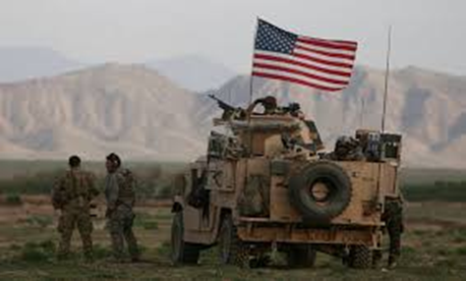
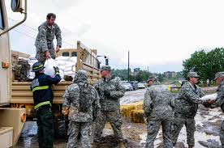
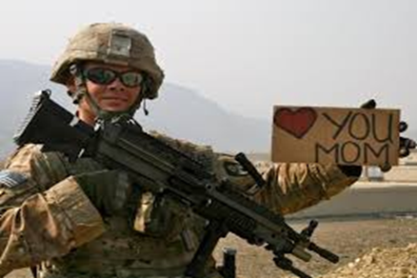
Army National Guard Overview Established in 1636
Since 1636, each state has had its own militia, oldest US military force
Comprised of ~325,000 Citizen-Soldiers from all 54 states and territories
Serve a minimum of 39 days a year, one weekend a month and 2 weeks in the summer
Receive same training as active-duty Army and can mobilize at anytime (state or federally)
“Always Ready, Always There”
Notes:
Talking points: We’re different

Slide 4
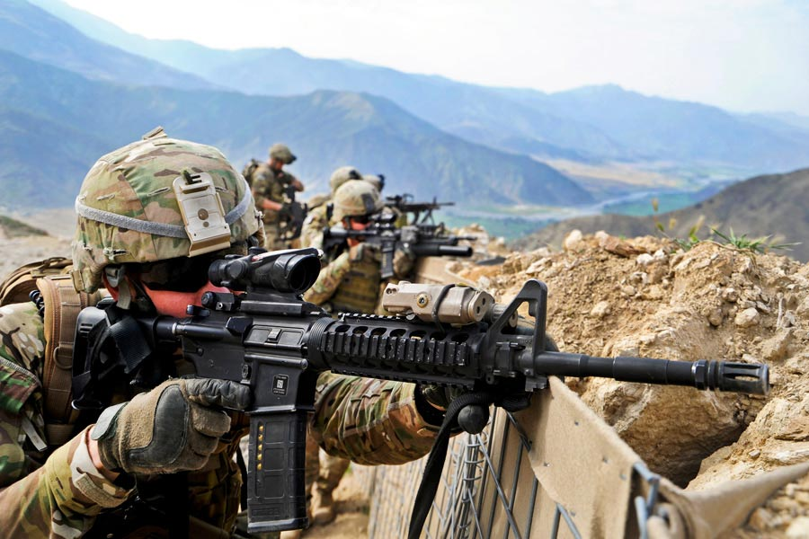
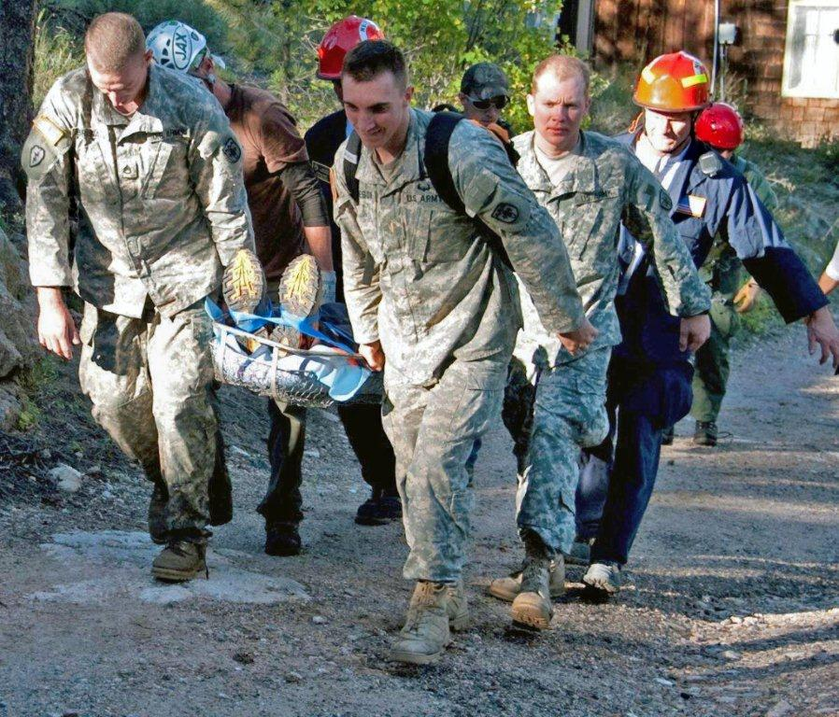
Army National Guard Overview Dual Mission
Federal Mission: To provide trained units available for active duty in time of war or national emergency, and at such other times as the national security may require.
Globally employed
America’s first military responder
State Mission: To provide military support to civil authorities and respond to state emergencies; to provide support to law enforcement in counter-narcotics.
Notes:
Troops are deployed with the consent of the Governor.
Under Title 10, troops are federally funded for missions commanded by the President.
Under Title 32 and State law, troops are funded either by the federal government or by their respective states for missions commanded by state governors.
Due to the flexibility afforded by this dual mechanism for funding and control, the NG is the first military responder for requirements within the USA’s borders whether Homeland security, natural disaster or other threats. Each Governor can immediately mobilize state assets to meet their needs or those of a neighboring state (via Emergency Management Assistance Compacts already in place) and utilize them prior to or during the submission of a request for federal assistance.
The Guard’s dual mission requires a disciplined balance between persistent readiness to defeat threats to our nation and its vital interests, and constant availability to help our communities and states.

Slide 5
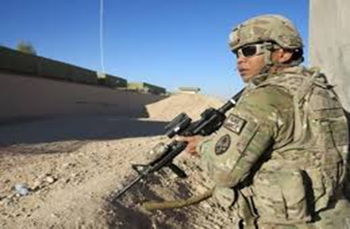
Army National Guard Overview Active vs Guard
Active Duty Soldiers
Live on or near Active Duty base
Military is their full-time job
Can be deployed at anytime
Deployment does not disrupt job
Can focus on one career
ARNG Soldiers
Live, work and drill in your communities
Can be deployed at anytime
Drill one weekend a month/two weeks per year
Must balance civilian and military career
Notes:
Mention additional stressors Guard College Students have that traditional students don’t
– weekend drills cut into study/homework time
Possible deployments interrupt progress toward degree
State missions can come up suddenly
When there’s an emergency: “Call out the Guard!”

Slide 6
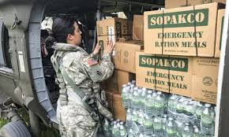
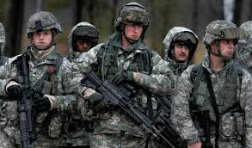
Army National Guard Overview
Types of Service
When under state control, the Army National Guard operates under Title 32, USC and applicable state laws
When under Federal control, the Army National Guard is an Operational Reserve of the United States Army and operates under Title 10, USC

Slide 7
Army National Guard Overview Service Categories
Title 32 M-Day (Drilling)
Title 32 M-Day (Annual Training)
Title 32 Military Technician – Dual Status
Title 32 Military Technician – Non-dual Status
Title 32 FTNGD
Title 32 AGR
Title 10 ADOS / ADSW
Title 10 AGR
Title 10 Mobilized Active Duty
Important! During service in the ARNG, a Soldier may be eligible or become eligible for both Reserve and Active-Duty GI Bill programs
Notes:
This is the ‘We’re Complicated, but We’re Worth It’ slide.
No need to explain each duty status, it’s an example of the complexity of the Guard

Slide 8
GI Bill Programs Overview
GI Bill Programs are statutory entitlements that are administered by the military services and the Department of Veterans Affairs (VA)
Soldiers may receive up to 36 months in any one GI Bill program and a maximum of 48 months of combined benefits if eligible for two or more GI Bill® Programs
Notes:
SCOs might know this info, but might not have assisted someone eligible for more than one benefit under the 48-month rule.

Slide 9
MGIB-SR/Ch1606 & MGIB-SR Kicker
Overview:
Title 10 program managed by the DoD, paid by the VA
For Service members actively serving in the Selected Reserve (SR)
Eligibility:
Possible to establish and maintain eligibility throughout an entire career
Also possible to gain and lose very quickly
Managed by use of database codes fed from DoD to the DVA
Payment: (FY25)
$481 per month (for full time enrollment)
Can be used with FTA if ½ time or more enrolled

Slide 10
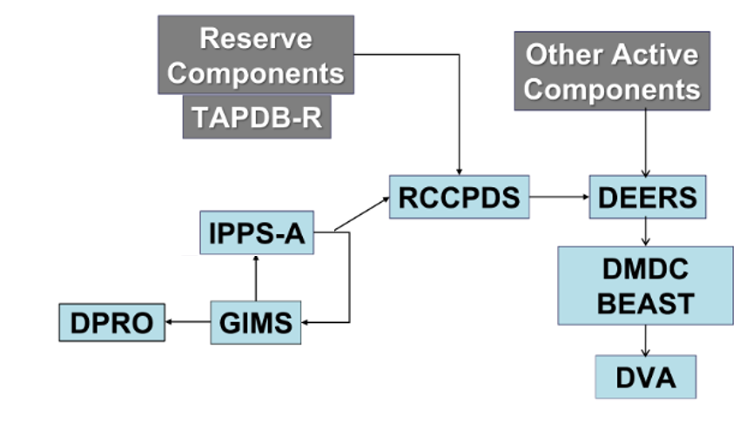
MGIB-SR / Kicker Dataflow

Slide 11
MGIB-SR Notice of Basic Eligibility
Notice of Basic Eligibility (NOBE) is:
A Service Component counseling document notifying a Service member they are eligible for the MGIB-SR
A NOBE is NOT:
A guarantee of Service member MGIB-SR eligibility
Once eligible for MGIB-SR, a Service member’s eligibility may be Suspended or Terminated due to changes in their duty or participation status.
Needed by a school before enrollment certification is completed (VA RPO verifies eligibility)
Notes:
Eligibility statuses change.
Mention Suspension reasons – why NOBE may not be accurate after issuing
Unsat Participant
IRR/ING
ROTC
The VA does not require a SM to submit a NOBE. Eligibility is determined using DoD data

Slide 12
MGIB-SR Kicker Incentive
Overview:
The MGIB-SR Kicker is an educational ‘incentive’ used to encourage qualified applicants to enlist, reenlist, or extend into skills or units to meet ARNG readiness requirements
Eligibility Requirements:
MGIB-SR or MGIB-AD eligible
Agree to serve in a skill or unit with a critical shortage
Eligibility is normally terminated on separation from SR
Payment: (FY25) (Based on current ARNG VolEd policy)
$350 for a critical skill or unit (NPS, PS, or Reenlistment/Extension)
$350 for Officers and Officer Producing Programs (i.e. WOC, OCS, ROTC)
Notes:
Kicker amounts will vary depending on annual policy in place when the SM contracts
Like 1606, Kicker may also be suspended

Slide 13
Steps to MGIB-SR/Kicker Success
Step 1: Contact State Education Office or ARNG Education Support Team (EST)
Verify all eligibility documents are on file:
Interactive Personnel Electronic Records Management System (iPERMS)
Verify MGIB-SR and Kicker (if applicable) are coded as eligible within:
Guard Incentive Management System (GIMS) & Benefits for Education Administrative Services Tool (BEAST)
Note: Eligibility is normally terminated on separation from SR
Step 2: Enroll/Apply
Student enrolls in VA approved courses and applies for benefits on gibill.va.gov
Step 3: Certify
Ensure School Certifying Official (SCO) certifies enrollment
Step 4: Verify enrollment/Receive payment
Required monthly; Payment is paid to student
Notes:
Kicker amounts will vary depending on annual policy in place when the SM contracts
Like 1606, Kicker may also be suspended

Slide 14
MGIB-AD / Chapter 30
Overview:
Title 38 program managed and paid by the VA (DoD initiates enrollment)
Eligible upon completion of 2 yrs Active Duty through 10-year delimiting date
Eligibility:
Served minimum of 2 years Active Duty or AGR
Contributed $1,200
Received an Honorable Discharge
Payment: (FY 25)
3 or more years of AD service: $2,438 per month (Full-Time)
Less than 3 years of AD service: $1,978 per month (Full-Time)

Slide 15
MGIB-AD/Kicker Steps to Success
Step 1: Contact State Education Office or ARNG Education Support Team (EST)
Verify all eligibility documents are on file:
Interactive Personnel Electronic Records Management System (iPERMS)
Verify MGIB-AD and Kicker (if applicable) are coded as eligible within:
Benefits for Education Administrative Services Tool (BEAST)
Step 2: Enroll/Apply
Student enrolls in VA approved courses and applies for benefits on gibill.va.gov
Step 3: Certify
Ensure School Certifying Official (SCO) certifies enrollment
Step 4: Verify enrollment/Receive payment
Required monthly; Payment is paid to student
Notes:
Kicker amounts will vary depending on annual policy in place when the SM contracts
Like 1606, Kicker may also be suspended

Slide 16
Post-9/11 GI Bill / Chapter 33
Overview:
Title 38 program managed and paid by the VA (DoD validates eligibility)
Eligible after 90+ days qualifying service through:
Eligibility expires 15 years from last day of qualifying service if last day is before January 1, 2013
Eligibility never expires if last day of qualifying service is on or after January 1, 2013
Eligibility:
Service in any active component or Service under Title 10 qualifying USC ‘s
Title 32 AGR OR Title 32 USC, Sec 502(f) qualifying service under a National Emergency declared by the President and authorized by the President or Secretary of Defense;
Noble Eagle, Sep 11, 2001 – May 31, 2002
Southwest Border, Feb 15, 2019 – Jan 21, 2021
COVID-19 Response, Mar 20, 2020 – Jul 1, 2022
Capitol Police, Jan 14, 2021 – May 23, 2021

Slide 17
Post-9/11 GI Bill Restrictions
Attended a Service Academy
First five years of service
Received a ROTC Scholarship (Title 10 USC Section 2107)
First four years of service
Received Active Duty Student Loan Repayment
First three years of service
Any qualifying service performed during the service obligation is not counted toward cumulative service.
Notes:
Highlight the new qualifying periods (SWB, COVID, SCP)
Mention that all of these missions are ongoing, but only service during these time periods qualify
COVID has a future end date and could be extended
Remember, we’re complicated…..

Slide 18
Post-9/11 GI Bill Payment Schedule
Payment Tiers
Payments for all three benefits (Tuition and Fees, Book and Supply stipend and Monthly Housing Allowance) are pro-rated based on eligible percentage tier
Qualifying Service | Percentage Tier
At least 36 cumulative months (1,095 days +), Purple Heart, Med discharge, Sole Survivorship | 100%
At least 30 cumulative months (910-1,094 days) | 90%
At least 24 cumulative months (730-909 days) | 80%
At least 18 cumulative months (545-729 days) | 70%
At least 6 cumulative months (180-544 days) | 60%
At least 90 cumulative days (90-179 days) | 50%
Pays tuition and fees; books and supplies stipend, and a housing allowance

Slide 19
ARNG Transfer of Education Benefits (TEB)
Overview:
Transfer of Education Benefits (TEB) requests are reviewed/processed by the ARNG Education Support Team (EST)
Eligibility Requirements:
Must be currently serving in the ARNG and be eligible for the Post-9/11 GI Bill
Must have completed 6-years of qualifying military service
Must commit to serving a 4-year service obligation period
Must not be flagged*
Dependents must be listed in DEERS
TEB Issues:
Contact the State Education Office or the ARNG EST
Notes:
Mention that these are Army requirements. Other services may have different or additional requirements

Slide 20
TEB Payments
Dependents (Spouse and child)
Receive the same payment tier as Service member who transferred education benefits to them
Spouse
May use benefits immediately
NOT eligible for the MHA if transferring SM is Active Duty/AGR, or serving other qualifying Service
Has the same delimiting date as the transferring Soldier
Children
Cannot use the benefit until transferring SM has completed 10 years in the Armed Forces
IS eligible for the MHA regardless of the transferring SM’s duty status
May begin using the benefit on their 18th birthday or upon HS graduation, whichever comes first
Eligibility ends on their 26th birthday unless earlier end date is specified
Notes:
Child includes natural, step, adopted, ward, foster child

Slide 21
Post-9/11 / TEB Steps to Success
Step 1: Contact State Education Office or ARNG Education Support Team (EST)
Verify all eligibility documents are on file:
Interactive Personnel Electronic Records Management System (iPERMS)
Verify TEB (if applicable) is coded as eligible for each dependent within:
Benefits for Education Administrative Services Tool (BEAST)
Step 2: Soldier/Veteran/Dependent must enroll/Apply
Student enrolls in VA approved courses and applies for benefits on gibill.va.gov
Step 3: Certify
Ensure School Certifying Official (SCO) certifies enrollment
Step 4: Verify enrollment/Receive payment
Required monthly
Note: Tuition and Fees paid to the school; Books & Supplies and Housing paid to the student
Notes:
Kicker amounts will vary depending on annual policy in place when the SM contracts
Like 1606, Kicker may also be suspended

Slide 22
Post-9/11 & TEB Payment Timeline
Semester Format / Housing Payments are distributed the beginning of following month
½ Housing
+ Books
½
Housing
New Term
½ Housing
+ Books
Full
Housing
Full
Housing
Full
Housing
Aug
Sep
Oct
Nov
Dec
Jan
Keys to success:
- Students Register for classes Early
- Schools certify in VA Once early
- Education Counselors Brief students on the process

Slide 23
Troubleshooting an ARNG Denial of GI Bill Benefits
Reverse VA Inquiry
Send Certificate of Eligibility (CoE) denial to the ARNG Education Support Team (EST): arng.esc@army.mil
EST will:
Research case
Update any eligibility discrepancies within GIMS/BEAST
Send a Reverse VA Inquiry to applicable VA Regional Processing Office (RPO)
Typically, the VA will process the Reverse Inquiry within two weeks
After VA verifies GI Bill eligibility the student will receive an updated Certificate of Eligibility (CoE)
Notes:
This is mainly for the new SCOs who are assisting a Soldier who hasn’t applied yet.
Need to confirm with a VA rep that they are sending CoE in email now

Slide 24
Payment Process Flowchart
Approved Denied Appeals Process
Soldier completes
enrollment verification
each month
DVA
Issues
Payment
Soldier / Dependent is
Eligible For MGIB Benefits
Semester
Cycle
New Semester
DVA Notifies
Soldier of
Determination
Benefit
Approved
APPLY FOR BENEFIT
- Soldier or dependent applies on VA.gov
- VA determines eligibility, sends CoE
School submits
Enrollment
certification
Benefit
Denied
ARNG ESC
Researches Eligibility
Responds to DVA
Soldier Either
- Agrees with
Determination
OR
- Takes Corrective
Action and files
appeal with DVA
Benefit
Approved
Benefit
Denied
Soldier files
Appeal to DVA
DVA Files
Formal Inquiry
with ARNG
Notes:
This is to explain what may happen during the course of application and during a semester. Start with ‘Eligible’ and walk through approval process and semester cycle

Slide 25
Other Programs/Benefits
Federal Tuition Assistance
Up to $4,500/FY up to $250 per credit hour
https://www.armyignited.army.mil/student/public/welcome
State Tuition Assistance
Programs vary by state
https://nationalguard.com/select-your-state
Credentialing Assistance
Up to $2,000/FY, one credential per year, 3 per 10 years of service
https://www.cool.osd.mil/army/index.html
Student Loan Repayment Program
Up to $50K for 6 years of service
https://nationalguard.com/tools/student-loan-repayment-program
CLEP/DSST
Soldiers eligible for free exams through DANTES
https://www.dantes.mil/
Notes:
This is mainly for the new SCOs who are assisting a Soldier who hasn’t applied yet.
Need to confirm with a VA rep that they are sending CoE in email now
Soldiers will sometimes come to the SCO without having applied for benefits first. Schools may require a CoE if they wish.

Slide 26
Contact Information
ARNG Education Support Team
1-866-ARNGEDU (276-4338)
arng.esc@army.mil
State Education Services Officer (ESO)
https://nationalguard.com/select-your-state
Mr. Don Sutton, ARNG GI Bill Program Manager
donald.e.sutton.civ@army.mil, 520-672-0414

Slide 27
Visit us on Social Media!
https://www.facebook.com/arngeducation
https://www.instagram.com/arngeducation
https://www.twitter.com/arngeducation
https://www.linkedin.com/company/arngeducation
https://youtube.com/@ARNGEducation

Slide 28
Questions???

