Slide 1
Enrollment Manager
Veterans Benefits Administration
Education Service
Spring 2025

Slide 2
Agenda
01
Digital GI Bill (DGIB) overview
02
EM outcomes
This presentation provides an overview of Enrollment Manager (EM) updates and helpful resources for School Certifying Officials (SCOs).
03
New EM features and enhancements
04
EM tips
05
Navigating EM: Updated resources and FAQs
06
Additional resources
07
Q&A

Slide 3
Digital GI Bill (DGIB) overview
The U.S. Department of Veterans Affairs (VA) is on a mission to modernize GI Bill® systems and processes. Enhancing the Enrollment Manager experience is an important part of that mission. As is optimizing the beneficiary application and payment process.
Transform
DGIB is a major modernization effort to transform GI Bill operations into a digital platform.
Improve
We are on a mission to improve education benefits and customer service delivery.
Support
DGIB impacts nearly one million GI Bill students each year, and the thousands of staff who support them, like you.

Slide 4
Enrollment Manager Outcomes

Slide 5
Enrollment Manager By the Numbers
31,283+
Cumulative count of distinct users who have accessed the Digital GI Bill system. 99.9% of users who have attempted to log in are in the system.
11,519,348+
Enrollment certifications for all chapters have been submitted since Enrollment Manager go live.
938+
Active Enrollment Manager internal users (VA)
98%*
Of SCOs have completed at least one online training.
*Based on the assumption of 20,000 total active SCOs
19,031+
Institutions have submitted enrollments.
23,506+
Active Enrollment Manager external users (SCOs and other users with distinct roles)
Data as of May 27, 2025

Slide 6
New Enrollment Manager
Features and Enhancements

Slide 7





Iterative improvement starting day one
This timeline presents key Enrollment Manager system updates since March 2023.
Enhancements to the View Details tab, including the ability to see the Objective, Program, Benefit Type and Enrollment ID on the View Details page without going to the Print page​​.
SCOs can select the correct amendment reason when amending an enrollment with a future begin date.
Added an inactivity
warning message two minutes prior to SCOs’ EM session expiring.
Introduced the ability to discard draft enrollments.
Made enhancements to Student Profile and Benefits Tab.
Alphabetically sorted the Students Tab filter dropdown fields.
Data security enhancements.
Migrated historical enrollments data at extension campus from VA-ONCE to EM.
Introduced ability to switch between CH35 benefit type sources.
Expanded capabilities for updating student academic information.
Introduced the ability to
save, edit and delete a new Student ID on students’ profiles​.
Ability to submit amendments with term dates that start in the future.
Introduced Enrollment Manager.
Pre-populated the facility dropdown with associated schools.
March 6, 2023
March 8, 2023
March 11, 2023
March 18, 2023
March 25, 2023
April 8, 2023
May 21, 2023
June 17, 2023
July 15, 2023
August 19, 2023
October 8, 2023
November 4, 2023
November 17, 2023
December 16, 2023

Slide 8
Enrollment Manager System Updates (cont.)
This timeline presents key Enrollment Manager system updates since March 2023.
Introduced VBA remark for NCD along with improved student search features and enhanced tab displays on the menu.
Updated the Programs Tab, enabled the option to decline SCO Assistant Drafts, and allowed special characters to be included in the Notes section.
Added the ability to deactivate students no longer at your Facility, Updated the Preset Terms page
Updated field names for clarity, Removed error message for overlapping terms.
Benefits tab
clarifications.
Conducted data population effort for actual birth dates for students with default birth date of 01/01/1900.
Updated functionality to remove SCOs ability to edit previously submitted enrollments along with removing the student ID once a new program card is added for all facility types.
Removed error message that claimed SCOs "cannot have two objectives in the same enrollment period" to allow for proper certification.
Fixed an issue with spaces in name in the "Search My Students" tab.
Future updates will continue to be introduced, incorporating your feedback and improving the Enrollment Manager experience.
February 3, 2024
February 4,
2024
July 8,
2024
August 10, 2024
September 28, 2024
October 12, 2024
December7, 2024
February
1, 2024
March 22, 2025

Slide 9
Enrollment Manager Updates
Release 6.1 (September 21, 2024)
  SCOs can change the status of a student within Students Tab (Active/Inactive)
  SCOs can terminate all future enrollments at one time
  SCOs can print all documents from an enrollment period at once
  The Preset enrollments page was updated to include:
    A School/Facility code column
    Checkboxes
    Update term status button
  VBA Remark updates
    Dual degree (Student is in a Dual Degree/Major – XXXXXX)
To view the full list of recent system updates, see the Enrollment Manager System Updates.

Slide 10
Enrollment Manager Updates
Release 7.0 (December 7, 2024)
  Changed the routing of new non-chapter 33 documents from ECAP to Benefits Manager
  Added a “Return to Landing Page” link to go back to the EM login page
  Updated the header of EM documents to be consistent with the current version of EM
  Added an automated change reason for non-chapter 33 when tuition and fees, dates, or both are changed
  Updated field names for clarity
    Parent Facility -> Parent Facility Name
    STEM -> STEM Scholarship Student
To view the full list of recent system updates, see the Enrollment Manager System Updates.

Slide 11
Release 7.0 | Integration with new Processing System
These updates were made to prepare for the introduction of Benefits Manager (BM), the claims processing system for Veterans Claims Examiners (VCEs) for NEW non-33 (CH1606, 30, 35) beneficiary claims.
Release 7 Enrollment Manager Updates
Student enrollment information in EM is coming from both BDN and BM as claims begin to be processed in BM
Awards table updates:
  The Award status column will no longer display in EM
  The Begin and End dates will display as monthly awards if award information came from BM
  The Begin and End dates will display full term awards if award information came from BDN
  The Training type and the Training time will be spelled out instead of using codes, if the award data came from BM
The VET Rep Listing for non-33 awards will decrease as claims begin to be processed in BM

Slide 12
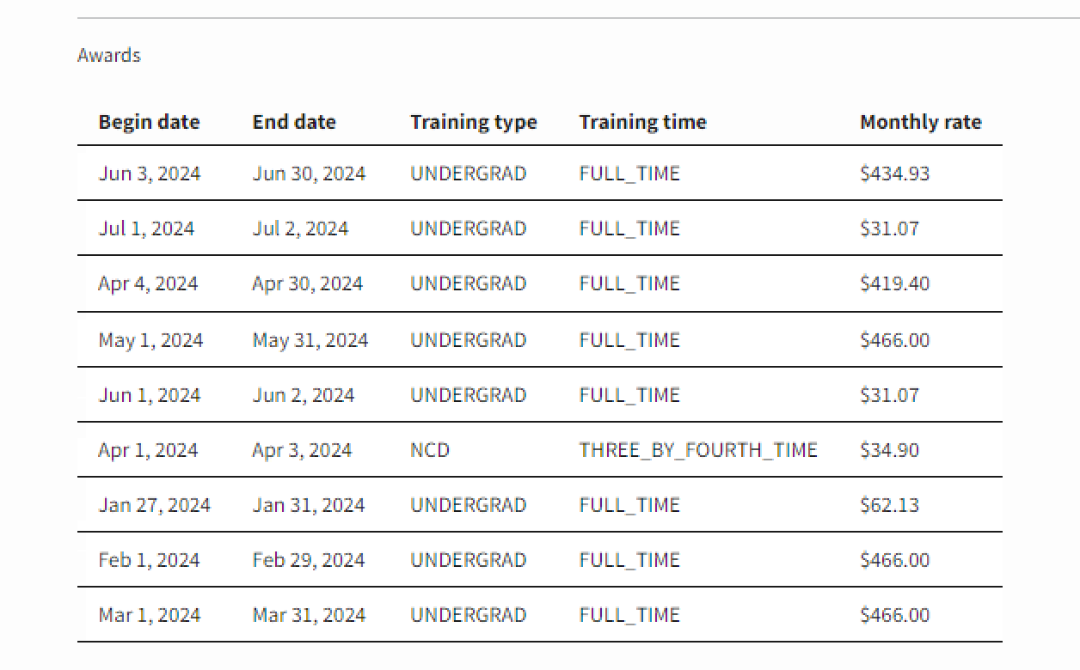
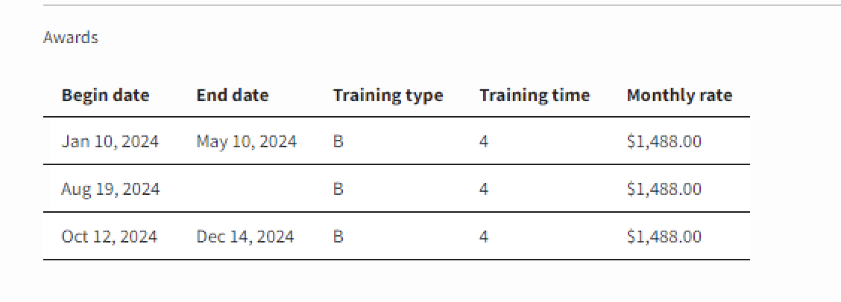
Release 7.0 | Awards Table Updates
Enrollment Information from BDN
Enrollment Information from BM
  The Award status will no longer display in EM.
  The Begin and End dates will display as monthly awards if award information came from BM.
  The Begin and End dates will display full term awards if award information came from BDN.
  The Training type and the Training time will be spelled out instead of using codes, if the award data came from BM.

Slide 13
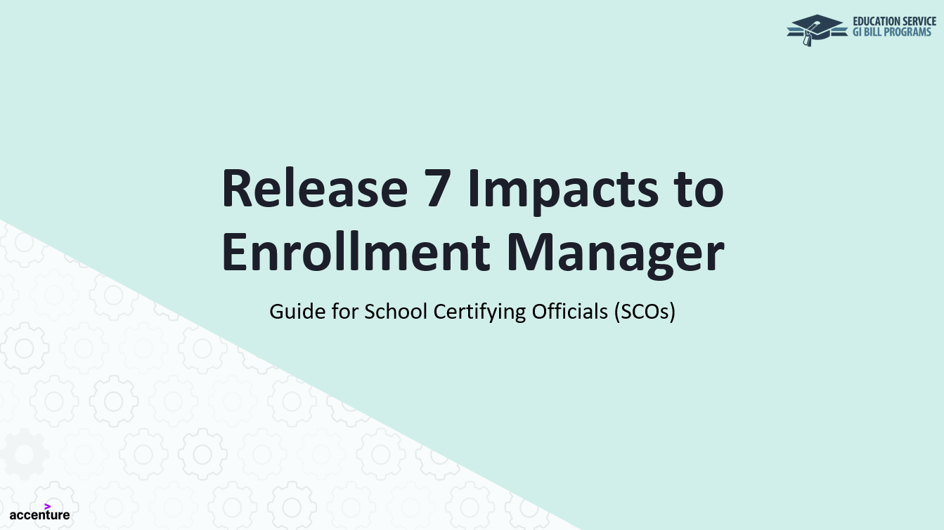
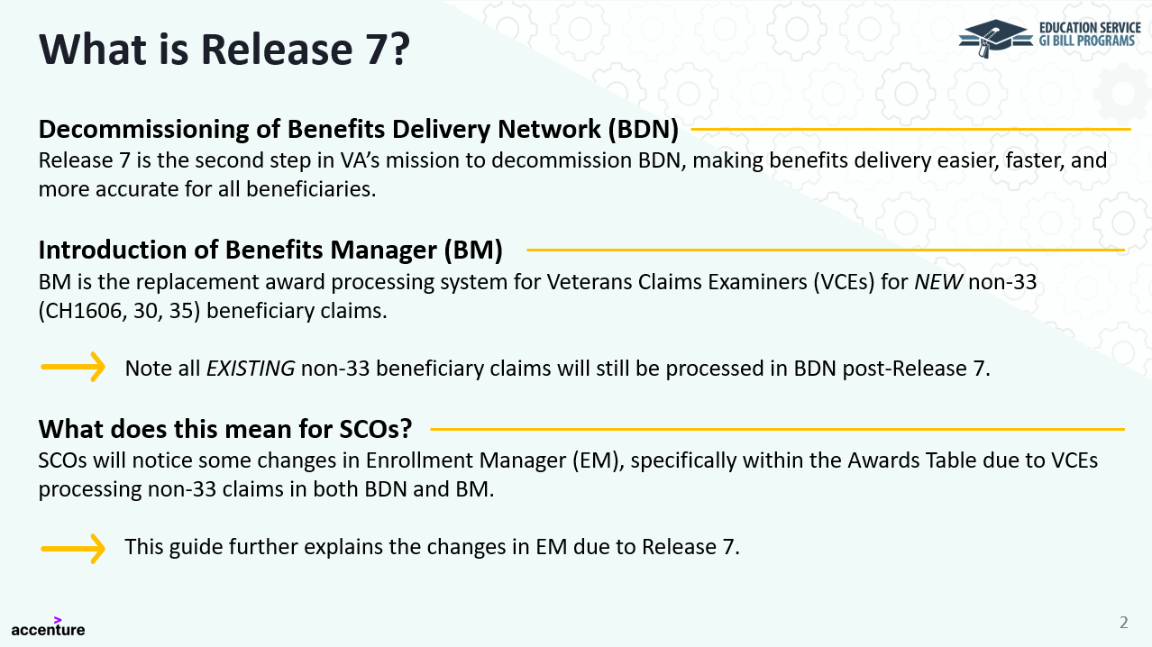
Release 7 |Guide for SCOs
For more information on how Release 7 and BM impacts to EM, visit the Release 7 Impacts to Enrollment Manager Guide for SCOs released in December 2024.

Slide 14
Release 7 | Enrollment Verification Updates
New non-33 beneficiaries who have a claim processed in BM will be able to verify their enrollment via text or email, in addition to existing options.
Beneficiary Status
Existing non-33 Beneficiaries
New non-33 Beneficiaries
CH1606 and 30 starting February 2025; CH35 starting Spring 2025
Claims Processing System
Benefits Delivery Network (BDN)
Benefits Manager (BM)
Enrollment Verification Options
Online: Verify Your Enrollment (VYE)
(Replacement for WAVE. For CH1606 and 30 only)
Text or Email (DGI)
By Phone (IVR)
Online: Verify Your Enrollment (VYE)
(Replacement for WAVE. For CH1606 and 30 only)
AskVA (AVA)
AskVA (AVA)

Slide 15
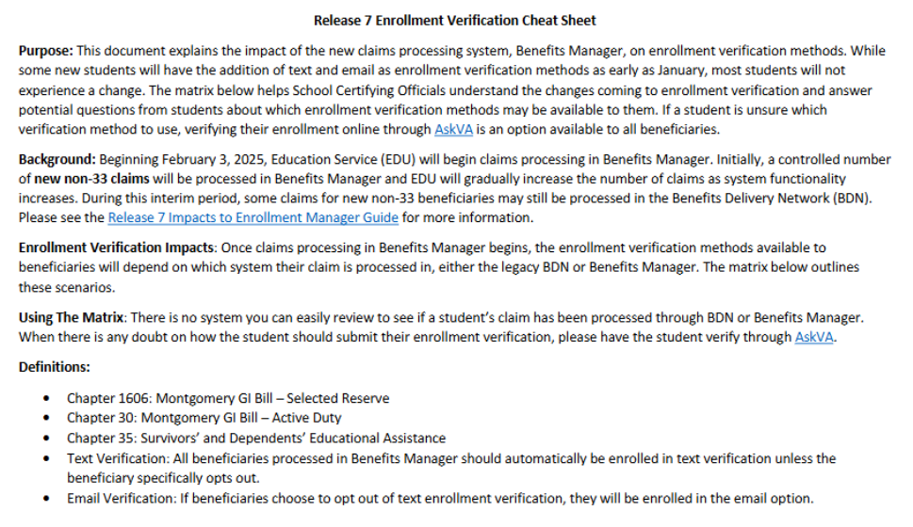
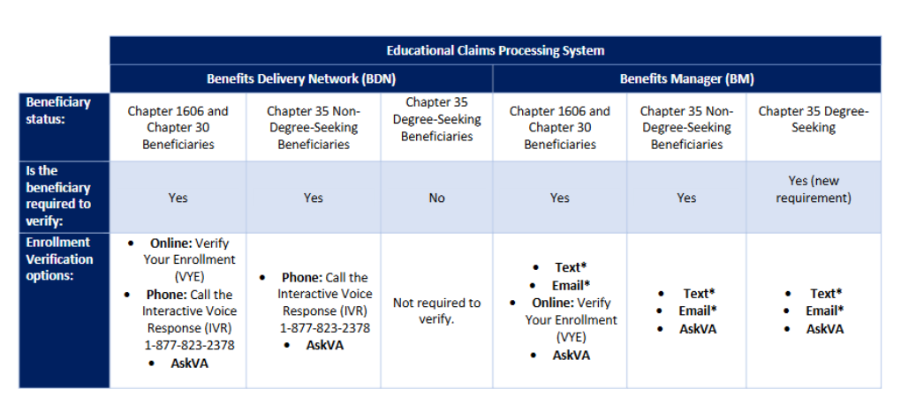
Release 7 | Enrollment Verification Cheat Sheet
To better understand the enrollment verification updates, please visit the Benefits Manager Enrollment Verification Cheat Sheet.
Matrix showing enrollment verification options available depending on benefit chapter and claims processing system.
Background context to better understand Benefits Manager claims processing and associated enrollment verification changes.

Slide 16
Enrollment Manager Updates
Release 7.0.1 (February 2025)
Users can find students in the “Search My Students” tab when they put a space in the first or last name field.
An issue which was preventing certifications from being received and status of enrollments from being updated has been resolved.
The edit for overlapping periods with different programs has been removed (again). This was causing issues. Note: Claimants can only receive benefits for one program at a time.
To view the full list of recent system updates, see the Enrollment Manager System Updates.

Slide 17
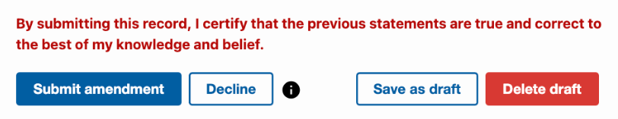
Enrollment Manager Most Recent System Updates
Release 7.1 (March 22, 2025)
Major revisions to the Programs tab
  Ability to easily identified all terms certified under each program
  Adds a field to easily update Student ID for a related Facilities
  Added the ability to select a program from the dropdown on the Add Enrollment and Add Multiple Enrollments pages
    Alleviated problems when student returns to a previous major
  Provides the ability to Decline SCO Assistant Drafts
  Combined into one button the “Save and Submit” for student’s academic information
  Re-enabled the ability to use special characters (ex. B+ or %) in the Notes section
To view the full list of recent system updates, see the Enrollment Manager System Updates.

Slide 18
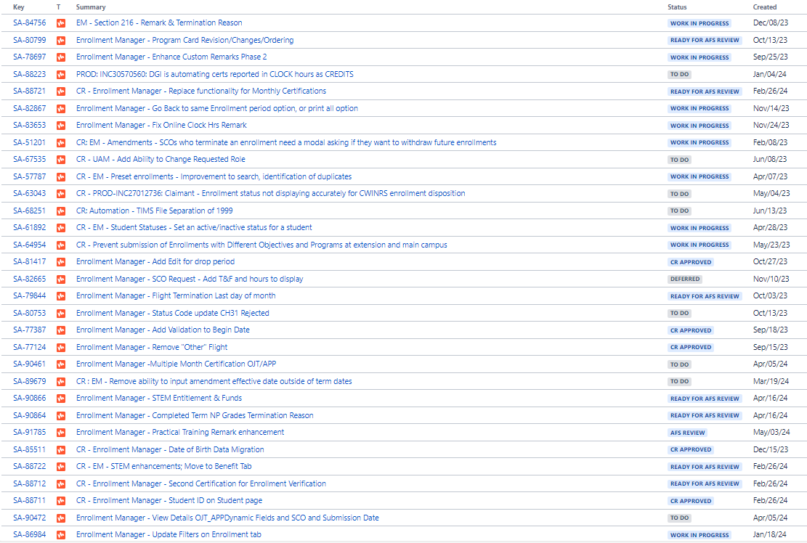
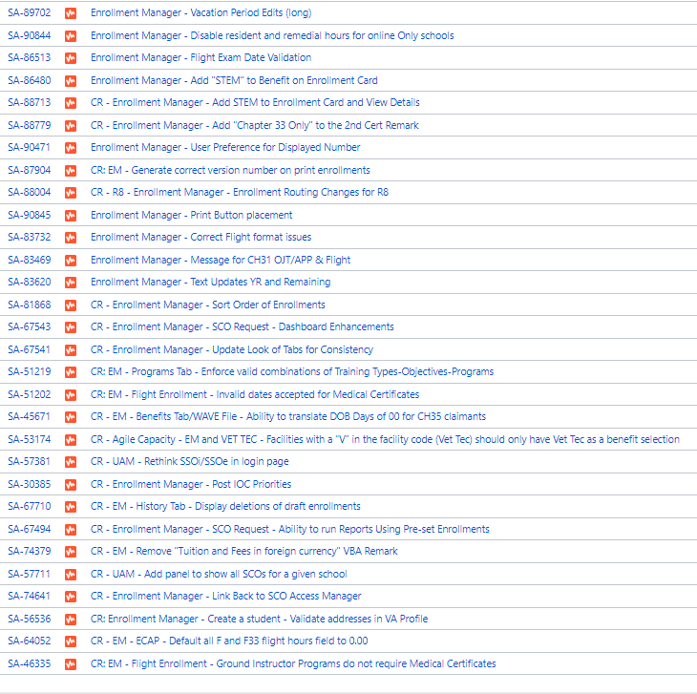
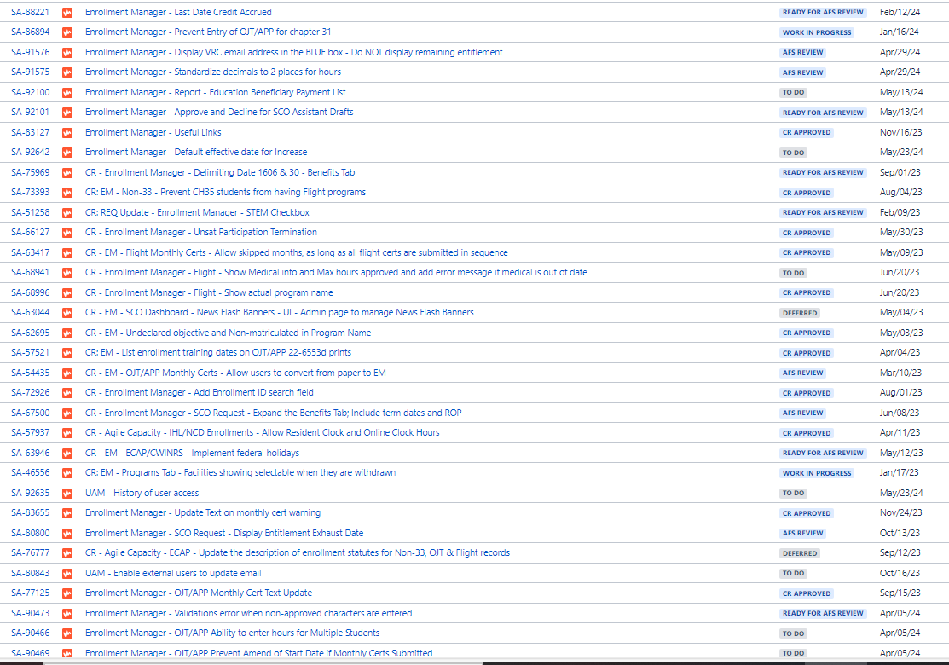
Future Updates
The following is a list of all updates in our backlog – 108 as of 5/27/25
Notes:
95 as of 2/24/25

Slide 19

Future Updates
These are legislative and SCO requests that we’re giving high priority.
Vet Tec 2.0 – Dole Act
Ability to go back to same Enrollment Period
Removal of chapter 35 Payee Numbers
Adding STEM to the Enrollment Card and display entitlement &
  funds remaining
Adding an “ALL” to the Dashboard
Display the VR&E Counselor email all the time while utilizing
chapter 31
Displaying Parent Facility on the Programs tab

Slide 20



Known Bugs
These are (SOME of the) bugs we are aware of and that we are working on.
Program name updates in WEAMS not showing in EM
Flight “out of bounds” errors for Monthly Certifications
Enrollments showing on the History, but not on the Enrollment Tab
Chapter 35 source name not being pulled
Chapter 33 delimiting date not shown
Issues certifying Yellow Ribbon when chapters have changed

Slide 21
Enrollment Manager Tips

Slide 22
EM Tip #1: Student Search & Identification
The Student Search and Identification EM Microlearning is featured in the February 2024 Office Hours recording.
Indicators for verifying a student’s identity
Tips to find students in EM
If you are unable to locate a student in EM, even when you are certain they are in the system, widen your search through the following:
  Search for a student without the Date of birth field *only for Search all students.
  Use 01/01/1900 in the Date of birth field.
  Remember to search by both maiden and married last names.
Once you have found a student, there are several indicators you can use to confirm the student’s identity:
  Date of birth
  Previous schools
  Email
  Mobile or home phone number
  Mailing address
  SSN on previous enrollments

Slide 23

EM Tip #2: T&F Debts
When submitting enrollment information in Enrollment Manager, the following sequence of events must occur to minimize Tuition and Fee (T&F) debts:
  If T&Fs are known, submit the actual net cost for in-state tuition and fees for each term
  If T&Fs are unknown, submit the term dates, credits and enter $0.00 for these charges
Once T&Fs are determined (including any applicable aid that must be deducted)…
  If the student’s enrollment has not changed, submit an amended enrollment certification with the actual net costs
  If the student’s enrollment has changed, submit an amended certification providing the T&Fs based on the original certified number of credits before submitting the amended certification for the change in credit hours
For more information, see the School Certifying Official Handbook.

Slide 24






General tips and reminders
Section 1010 only applies to chapter 33.
This law was specific to chapter 33 students. Don’t create extra work for yourself and the RPO by submitting second certifications for chapter 30, 1606, or 35. We do plan to add “33 ONLY” to the end of the Remark.
Be mindful of what goes into student identification fields.
Never input false numbers in the Social Security Number (SSN) field for students who do not have an SSN. You must use paper/PDF enrollments for these students.
Personal email or incorrect/misspelled name displaying in EM?
SCOs can correct this by calling the Education Call Center (ECC) and being routed to the SCO Hotline. Provide your full name, your facility code(s), the incorrect name or email address, showing and the correct name or email address. The correct information must be the same as what is in the Web Enabled Approval Management System (WEAMS).
Review the Program tab,
Make sure the tab displays the correct Training Type, Objective Type, Academic Program and Benefit Type.
Remind your students about the single payment requirement.
Make sure your students are aware that they must have only one single payment address on file, in accordance with the recent EDU payments policy update.
Correcting a previously terminated enrollment?
When necessary, to correct the terminated enrollment, re-submit the enrollment period with the VBA remark, "Correcting Previously Terminated Enrollment" and then submit the corrections via amendments.
No more paper, PDF or hardcopy enrollments.
Exceptions may apply for programs or training types not supported by EM, including Correspondence Training, Chapter 32, restricted foreign school locations, and students without a social security number.

Slide 25


Advance Questions
Study Abroad
If your school offers study abroad programs under Section 9, then you should be issued a “Study Abroad” facility code. This is an extension Facility code and contains an X in the 3rd position.
You will need to add any student taking a study abroad course to that facility code and certify them accordingly. They can be taking courses at ANY foreign school.
    Dual Degrees/Objectives
Dual degree report using the Dual Degree remark. Double majors should only be reported using the dual degree remark if each major is approved separately in WEAMS. Example- BS in Finance and BS in Marketing are both business degrees but can be in WEAMS as 2 distinct programs (remark needed) or as a single Business Administration degree (remark not needed).
Dual Objectives must be approved by the SAA as combination programs for terms that begin on or after 1/1/26. In the interim, IHLs can report dual objectives using the dual degree remark.
Notes:
Section 9 of PL 117-333, Veterans Auto & Education Improvement Act of 2022, enacted 01/05/2023, which modified 38 USC 3680A(f) (2) and authorizes VA to pay benefits for training in certain unapproved study abroad courses.
it does not matter if the foreign school is approved in their own right or not (they can be approved or not approved), the important point is that the contract is not yet SAA approved.
If they are taking classes at another VA approved facility to be transferred back, should it be certified by that facility (the one abroad) as a guest student? If they are attending a US based guest school and doing S/A though that school under Section 9, then the US guest school certifies under their assigned Section 9 S/A fac code after getting the parent school letter. If they directly enroll at an approved foreign school as a guest, then the approved foreign school will just certify they as any guest school would, after getting the parent school letter.
https://vaww.vrm.km.va.gov/system/templates/selfservice/va_kanew/help/agent/locale/en-US/portal/554400000001048/content/554400000260832/B-2024-06-February-Procedural-Advisory-Updated-Study-Abroad-Guidance-Including-New-Study-Abroad-Extension-Facility-Code-Type-Assignment?query=Study%20Abroad

Slide 26
Updated Resources and FAQs

Slide 27
Enrollment Manager Resource Updates
The Enrollment Manager SCO User Guide, FAQ page, and SCO Matrix have moved to new URLs!
Here are your new links:
Enrollment Manager School Certifying Official User Guide
Enrollment Manager School Certifying Official User Guide – Version 4.0
Enrollment Manager School Certifying Official User Guide – Version 3.0 (updated version is in progress)
Enrollment Manager Frequently Asked Questions Page
Enrollment Manager Frequenty Asked Questions
School Certifying Official Resource Matrix
School Certifying Official Resource Matrix
We strongly encourage you to bookmark the new hyperlinks for quick reference!

Slide 28
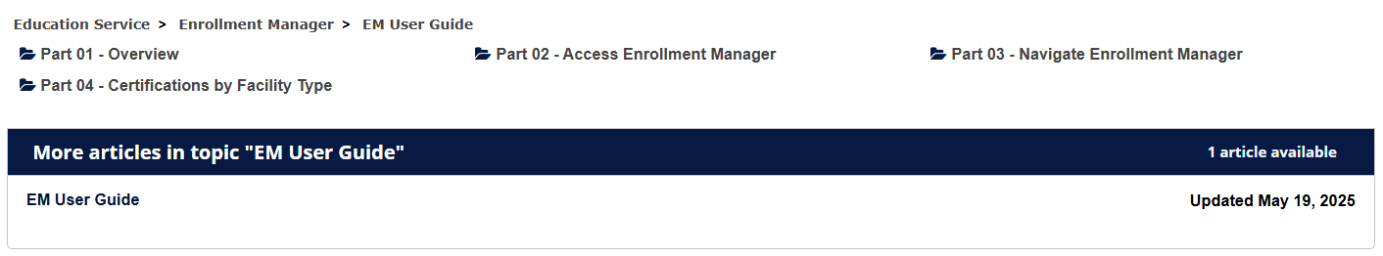
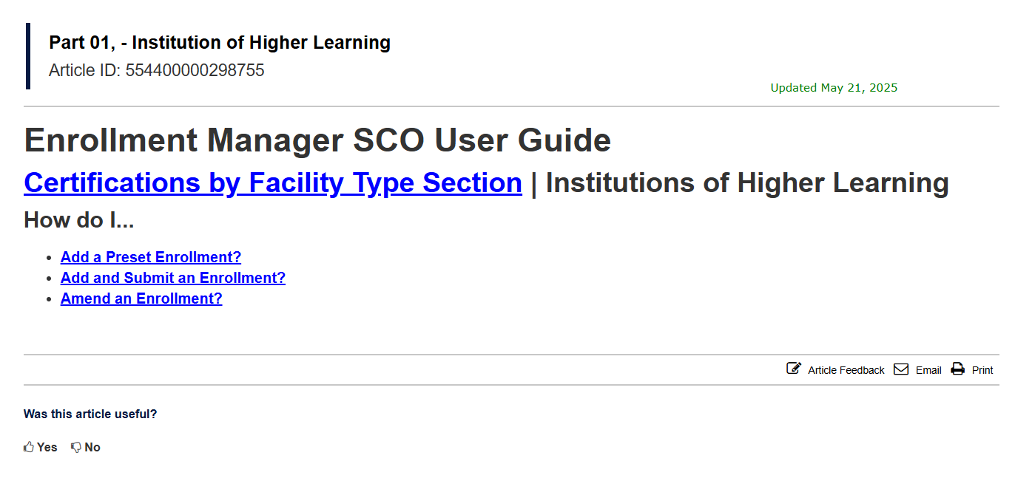
Enrollment Manager SCO User Guide – Version 4.0
The Enrollment Manager School Certifying Official User Guide was recently updated to reflect recent system changes.
What’s new with Version 4.0 of the Enrollment Manager SCO User Guide?
Release 7.1 Enrollment Manager updates
Updated Enrollment Manager log-in instructions
New screenshots to reflect current functionality
And so much more!

Slide 29
Additional Resources

Slide 30
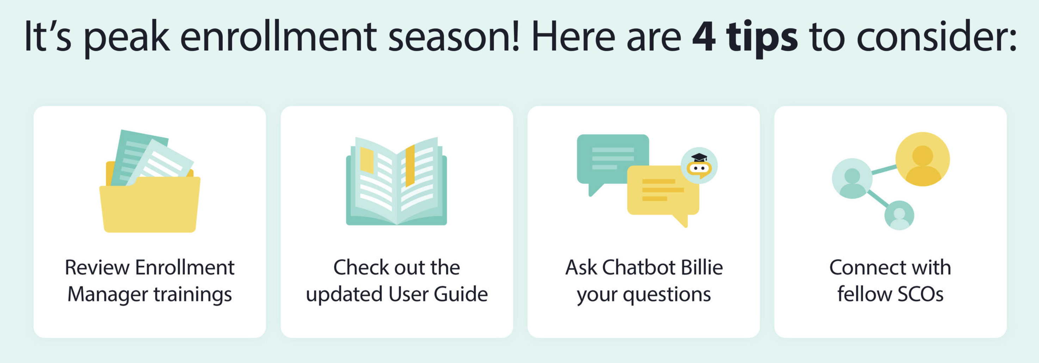


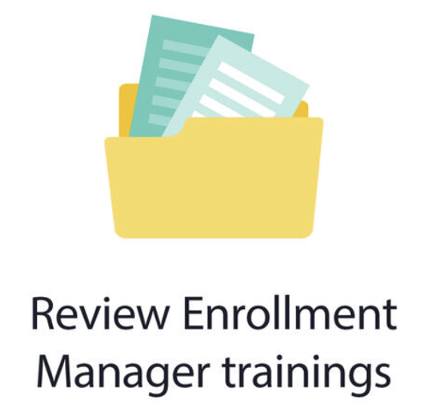




Top Four Tips
Top four tips for staying in the know
Sign up with GovDelivery
Subscribe to GovDelivery to receive direct informational messages from Education Service.
Reference
EM User Guide
Review detailed instructions on how to navigate EM and perform actions.
Tune into Office Hours
If you couldn't catch the Office Hours live, make sure to watch the recorded version on our YouTube page.
Read the SCO Newsletter
Subscribe to the bi-monthly "SCO in the Know" Newsletter for the latest updates.
30

Slide 31







Enrollment Manager Training Materials Overview
An array of EM training materials and resources are publicly available to you on VA’s Resources for Schools page.
SCO Resource Matrix
Resources for Schools page
Updated EM Training Modules
Office Hours and Webinar recordings
EM frequently asked questions
GovDelivery emails
Enrollment Manager system updates

Slide 32
Questions?
Education Call Center:
1-888-442-4551
SCO Hotline representatives available 8 a.m.-5 p.m. ET

Slide 33
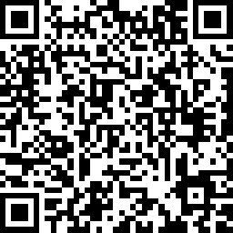
Feedback
Notes:
MA SCO QR Code

