Slide 1
Holistic Approach to Supporting Student Veterans
Tiffany Anderson
Assistant Director for UG students University of San Diego tiffanyanderson@sandiego.edu

Slide 2
Agenda
USD Thriving Student Model
USD Military and Veterans Program
Data Driven Results
MVP’s Success
Discussion: Best Practices

Slide 3

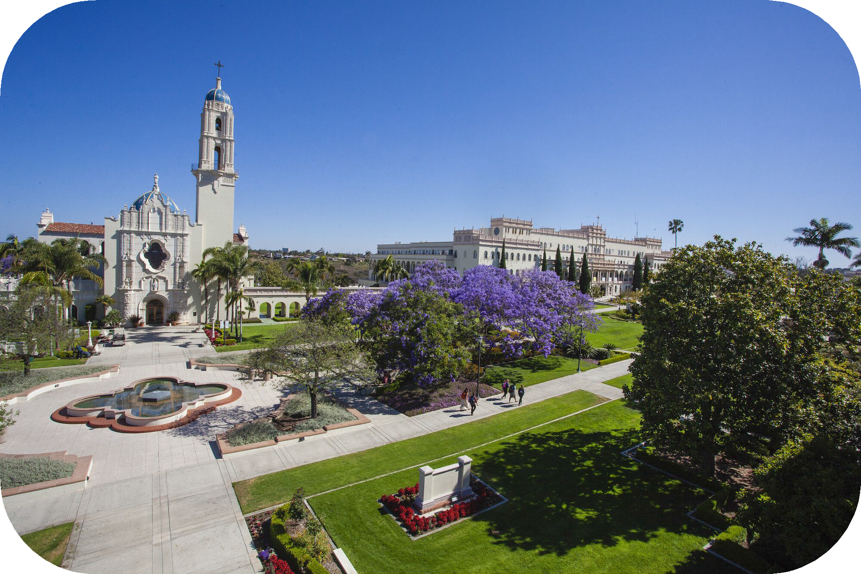
University of San Diego
Small, private, Catholic institution: Spring 2025 total enrollment - 9,545
● FY24: 886
military-connected students (700-800 GI Bill users)
FY24: 498 Chap 33 users
YR no cap

Slide 4
Thriving Student Model

Slide 5
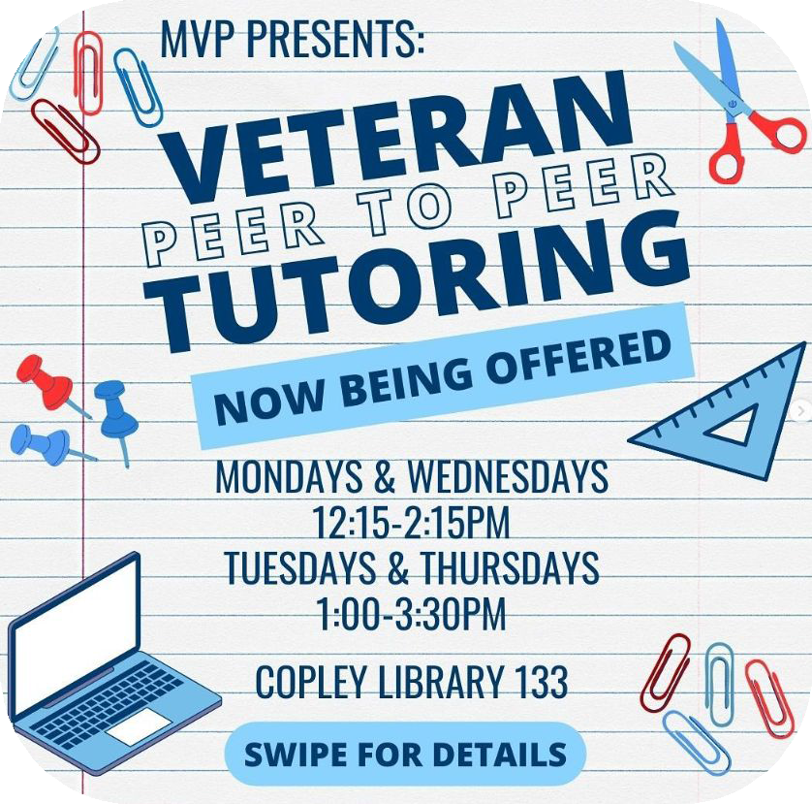
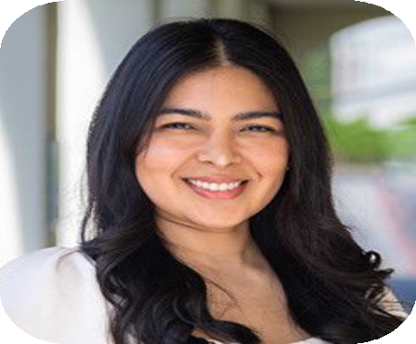
Academic Success
Academic Success Coordinator
Coordination with our Student Success department (academic success)
Mid-term deﬁcient student survey
Veteran Tutoring Network

Slide 6
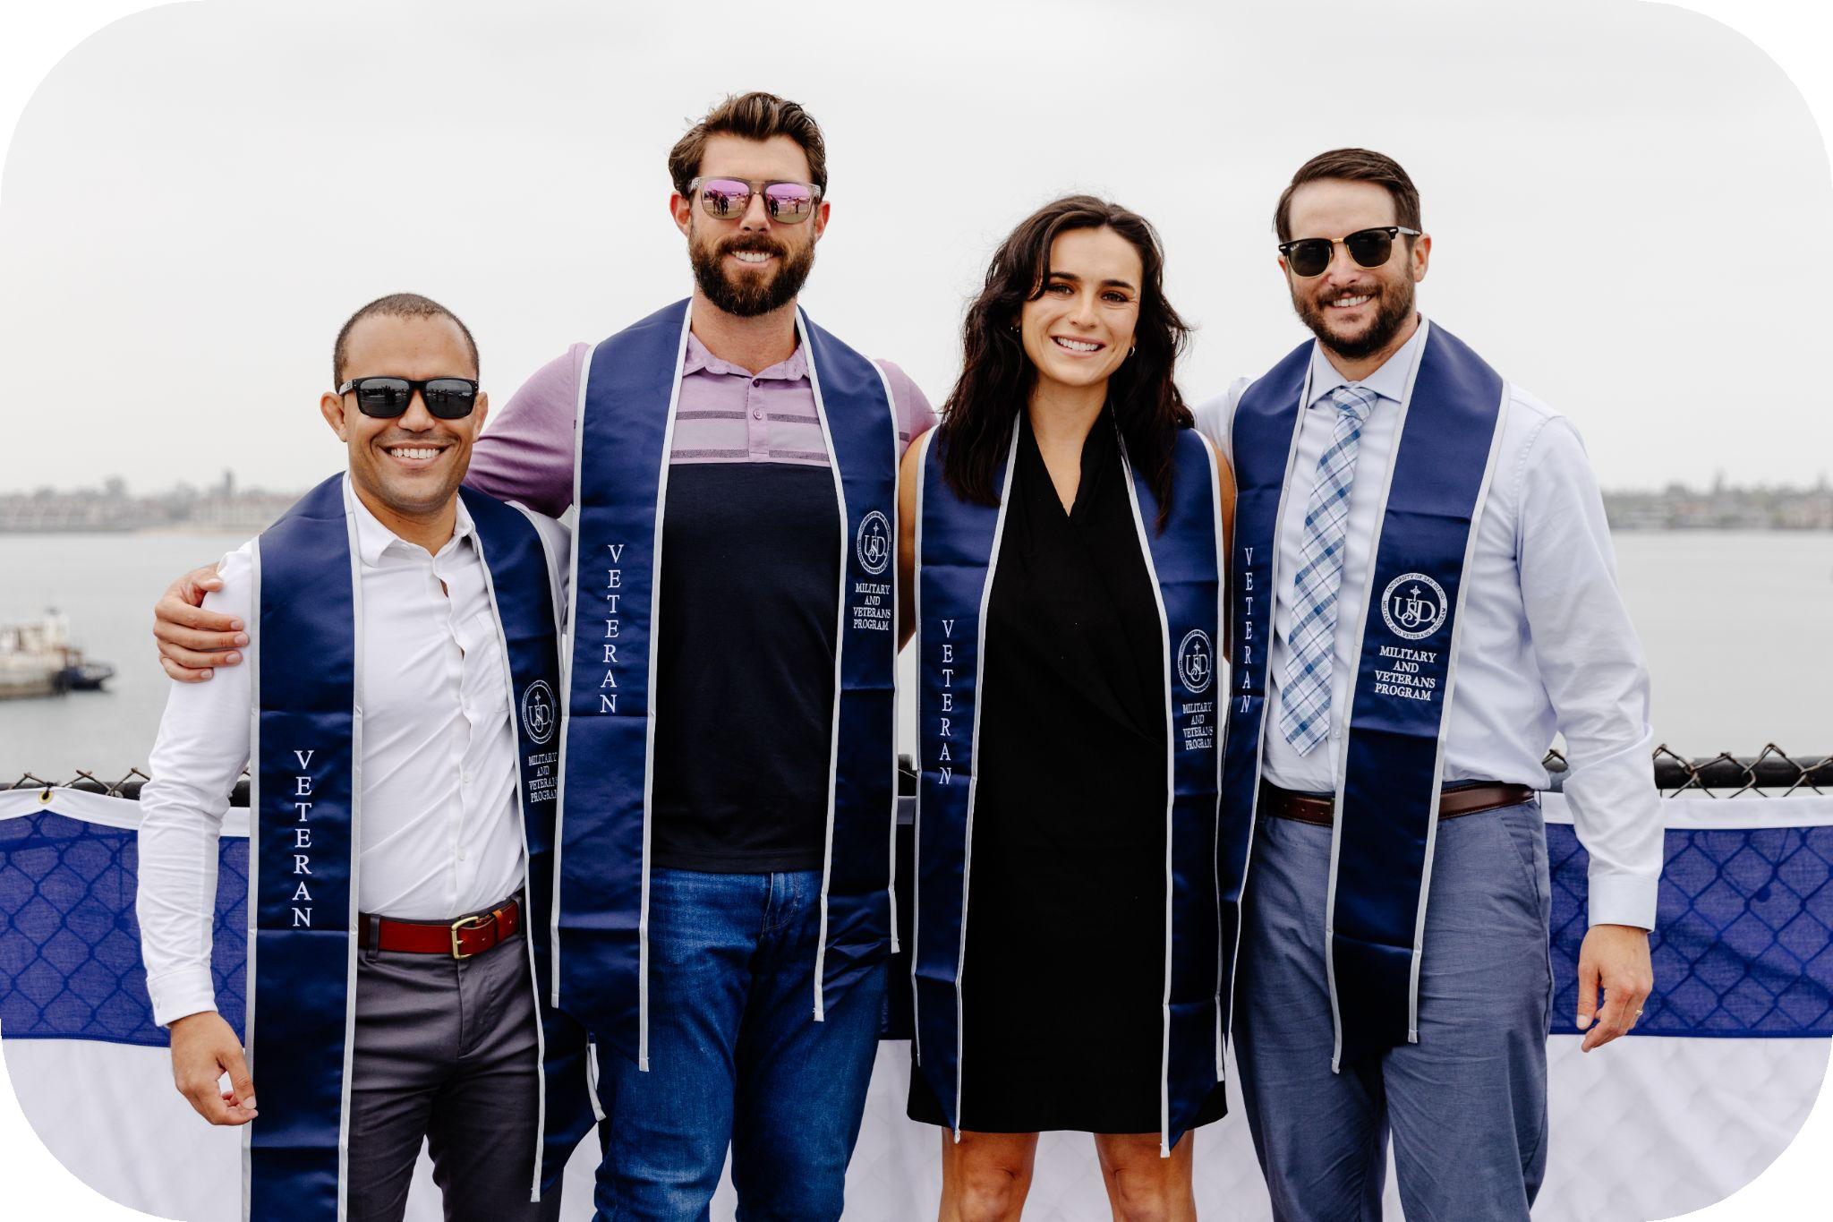
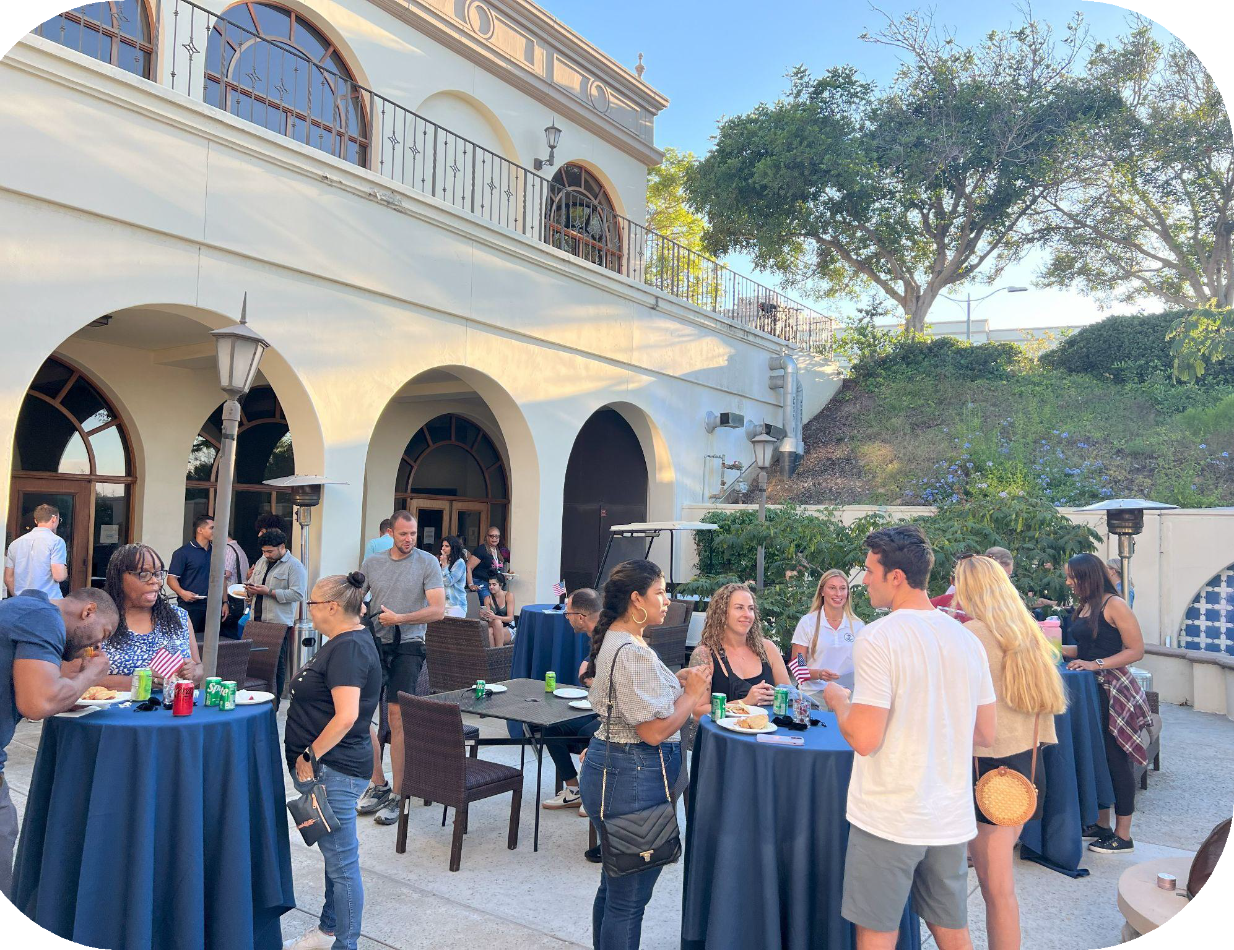
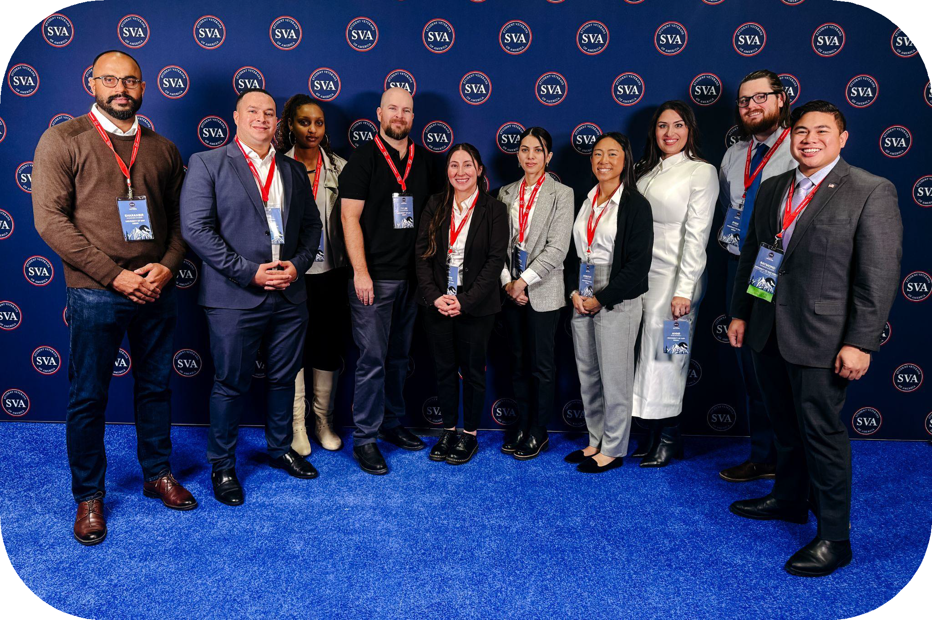
Belonging
Student Veterans Organization
Welcome Back lunch
Veterans Day week celebration

Slide 7
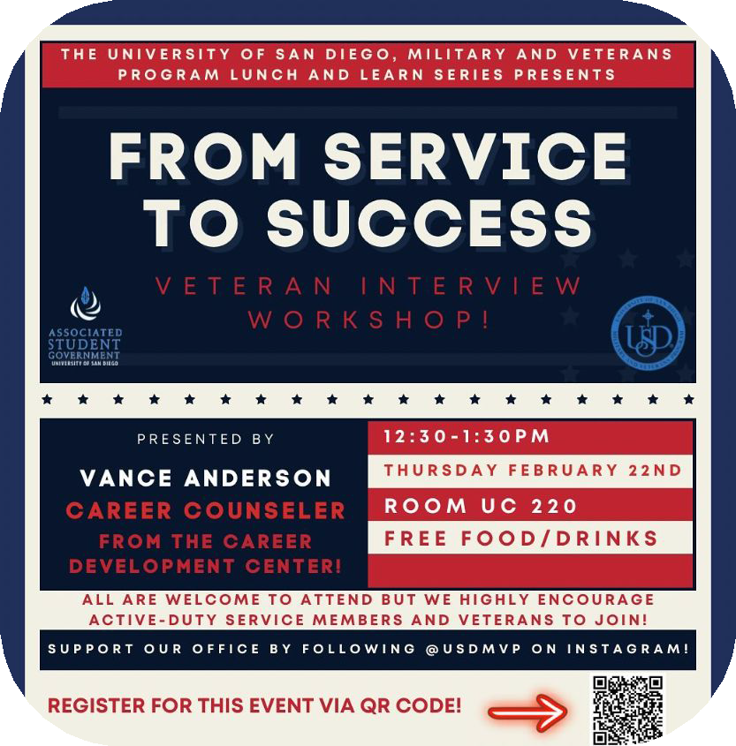
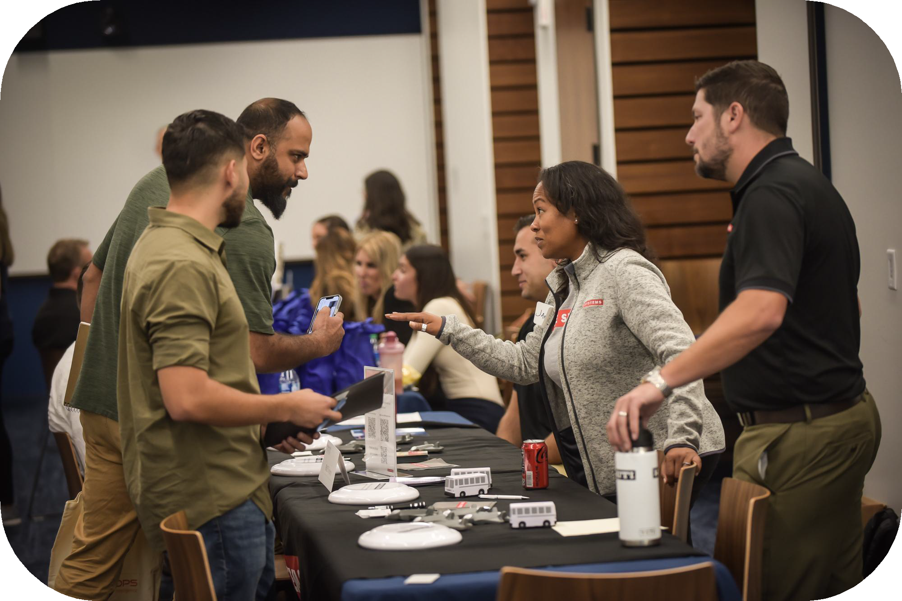
Experiential Learning
Lunch and Learns
Partnering with campus departments to host workshops

Slide 8

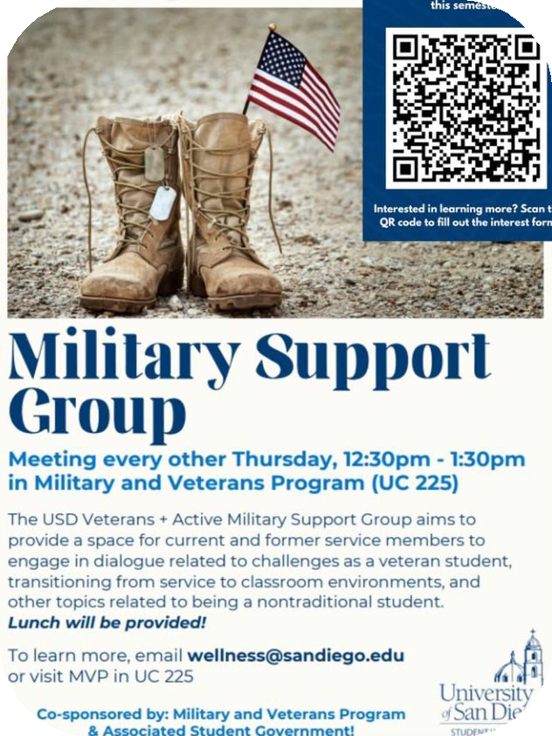
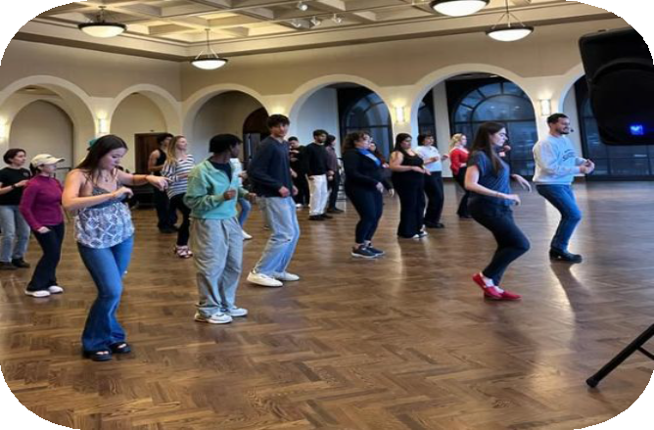
Holistic Wellness
SVO Support of athletic events
De-stress events
Veterans Wellness Meetings
●
Cohen Clinic

Slide 9
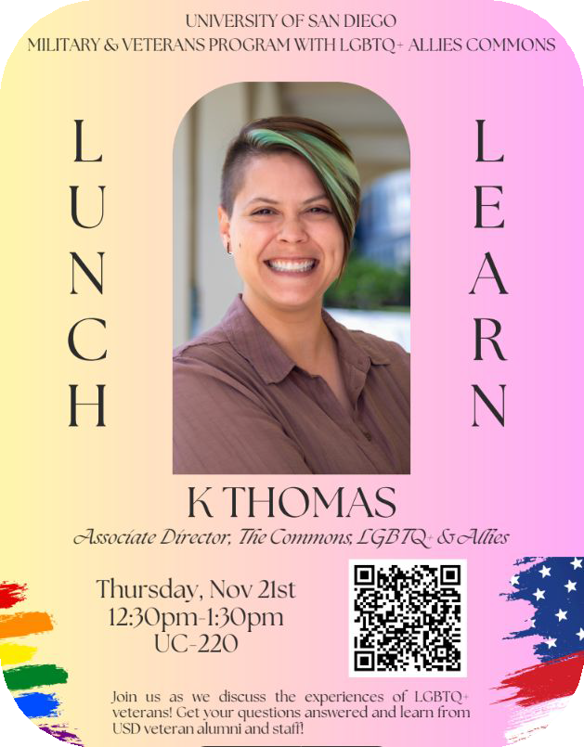
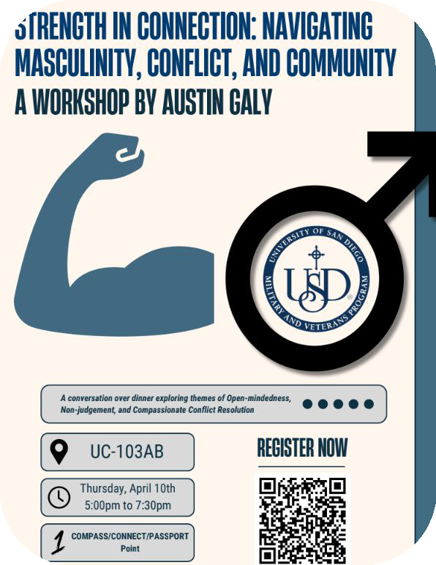

Inclusive Community
Main center for congregating, new donation will enable a renovation of new center

Slide 10
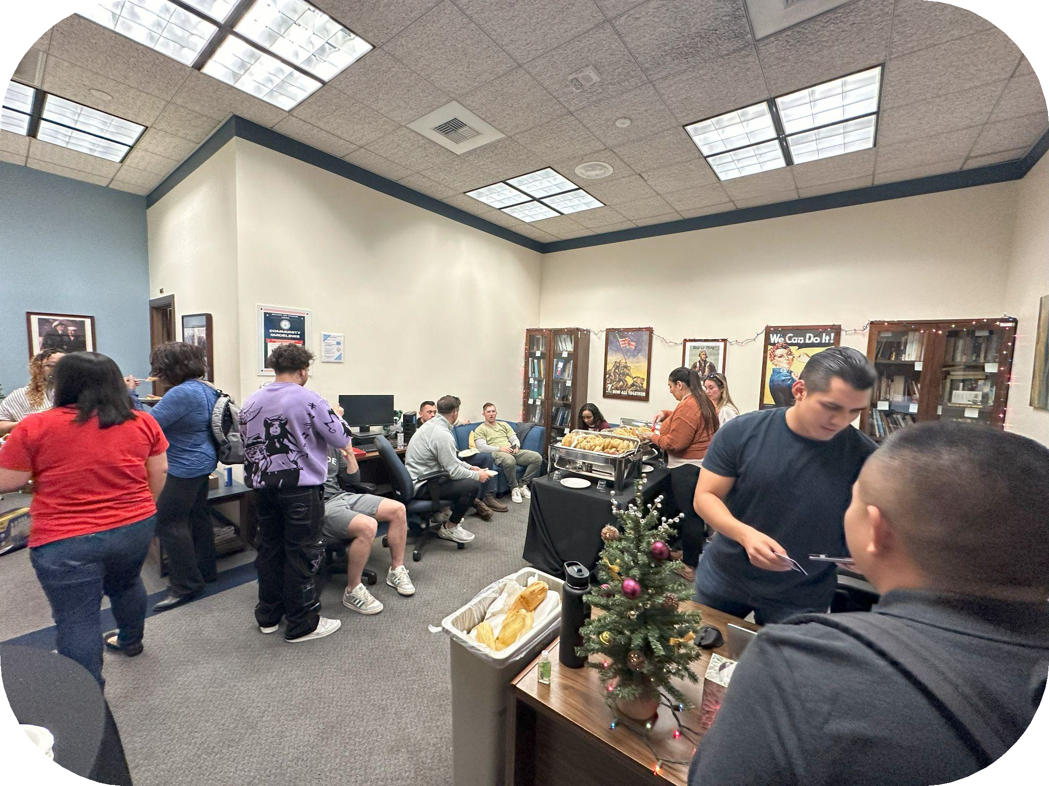
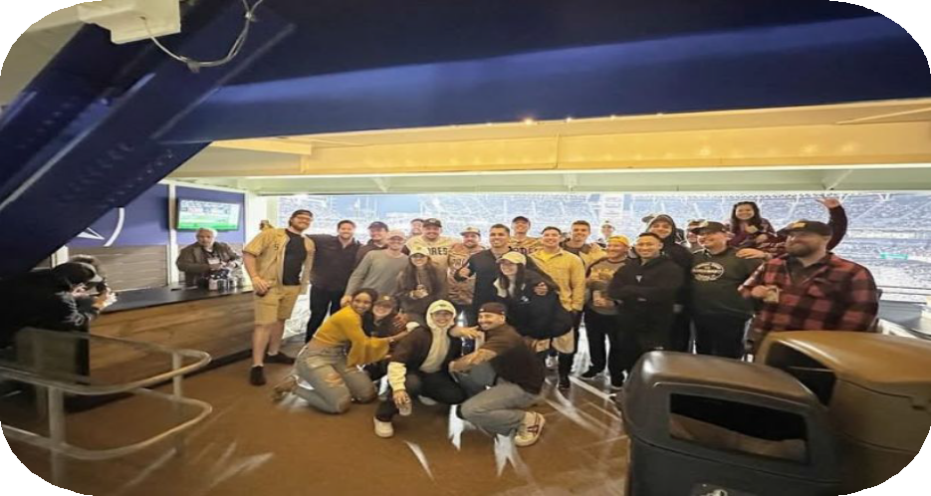
Joy
SVO partnership for Padres game
End of year Christmas

Slide 11
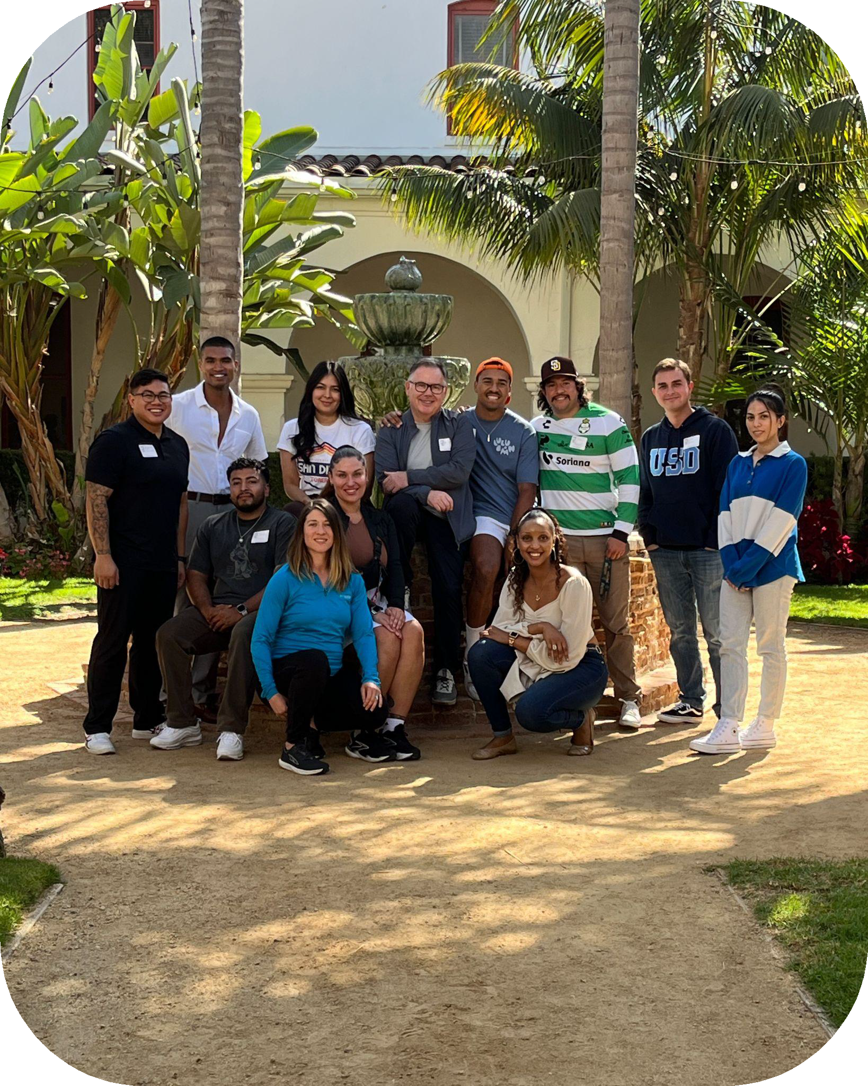
Spirituality
Partnering with Father Greg every other Tuesday
Fall student veterans retreat

Slide 12
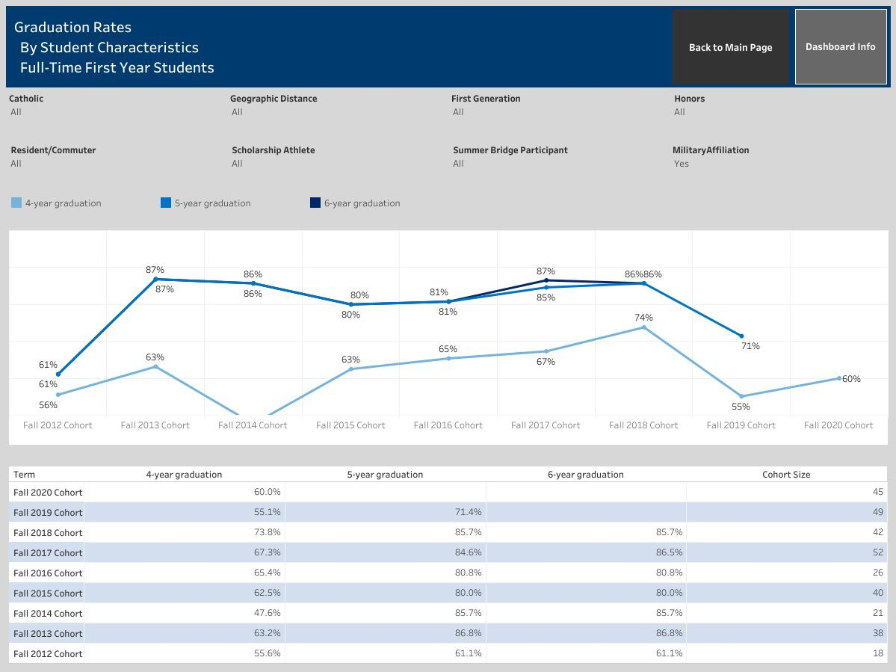
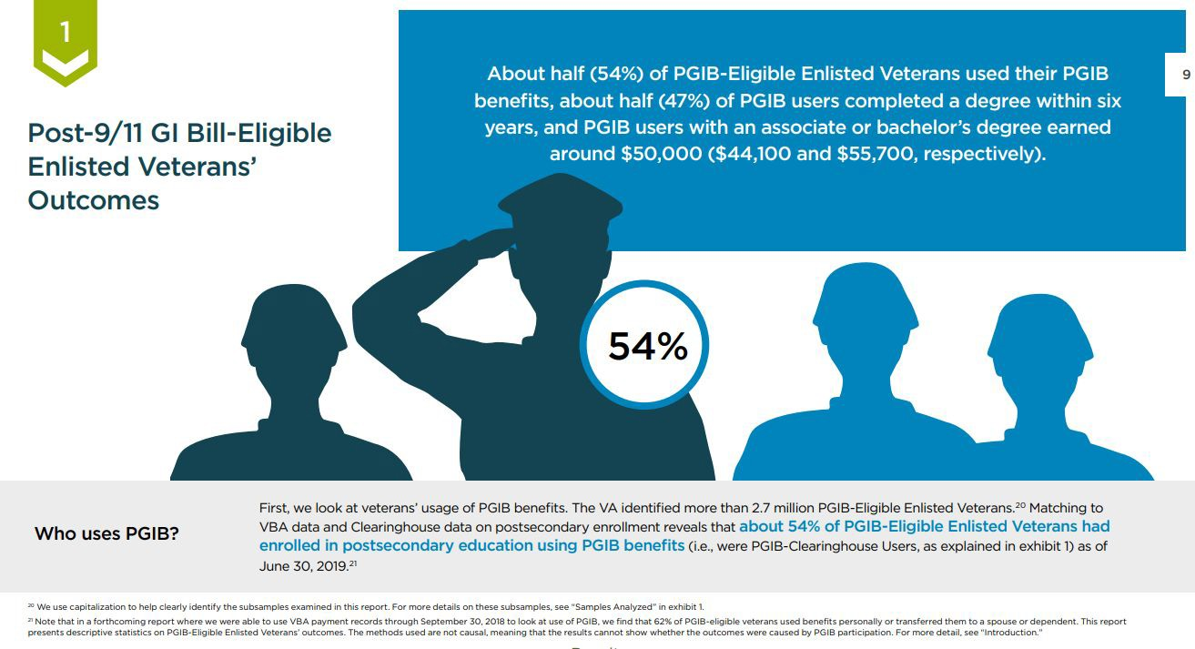
Data Driven Results

Slide 13
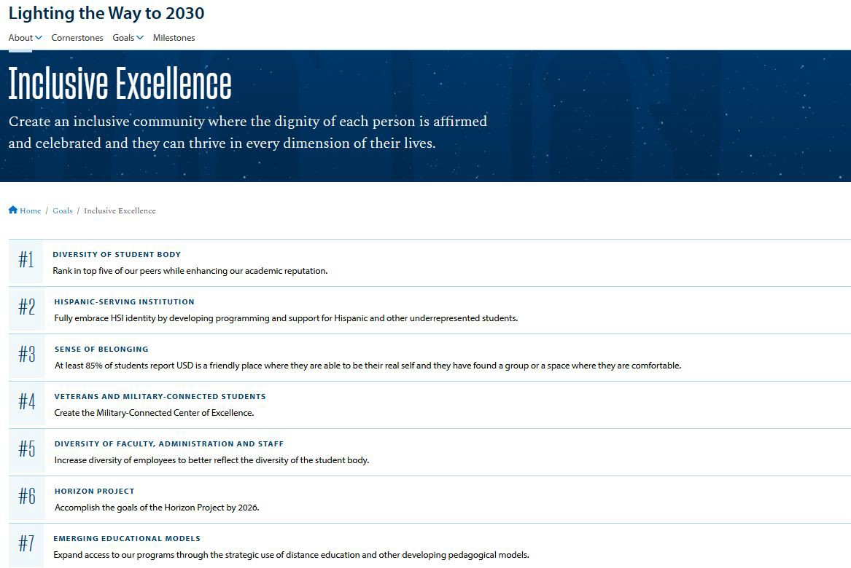
MVP’s Success
USD’s commitment to our program in the strategic plan
10 million dollar donation to go to a new space, program, and staff

Slide 14
Discussion
What systems/practices does your institution have?
Knowledge Sharing

