Slide 1
Fueling the Future of Your SVA Chapter: A Strategic Approach to Sustainable Growth
Olivia Brinsfield, MBA
Notes:
- Olivia Brinsfield, Chapter Success Coach
-My father served twenty-five years active duty in the United States Air Force and his military service shaped my entire life
- The reason I love this work at the intersection of higher education and veteran services, is because as a military brat for the first 18 years of my life, the first place that ever felt truly like home was my college campus. I seek to replicate that feeling for student veterans, family members, caregivers, and survivors across the United States through my work, and it's why I do what I do.
- My prof background is in veteran affairs on campus, and I've worked across major and small institutions to include Alabama, UTSA, and the galen college of nursing san Antonio so I have seen the spectrum and really appreciate the work you’re doing

Slide 2
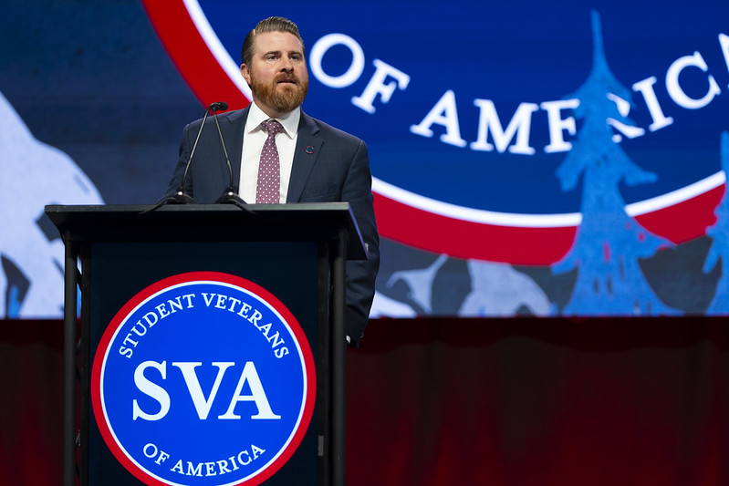
Student Veterans of America (SVA)
SVA connects a vibrant community of student veterans through nearly 1,600 on-campus chapters across all 50 states—representing over 750,000 veterans.
This powerful network provides not only a sense of belonging and peer connection but also direct access to tailored resources, one-on-one support, and leadership opportunities that help students thrive in higher education and beyond.
SVA’s national leadership spans three core pillars—government affairs, peer-reviewed research, and national programming. Through direct engagement with lawmakers, data-informed programming, and grassroots mobilization, SVA shapes the policies and practices that impact student veterans across higher education and the workforce.
Notes:
Student Veterans of America is more than just an organization—it’s a movement.
A nationwide network that spans nearly 1,600 campuses, reaching over 750,000 student veterans and military-connected students in all 50 states.
And while the scale is impressive, what makes this network powerful is the why behind it.
Every chapter is a launchpad—for community, for leadership, and for opportunity.
These aren’t just peer groups. They’re hubs for academic success, career readiness, and belonging.
Chapters are where student veterans go not just to connect—but to grow.
And behind it all is a structure built for lasting impact.
SVA’s work is guided by three pillars that support this movement at every level:
Government Affairs – where we work directly with lawmakers to protect and improve policies like the GI Bill.
Peer-Reviewed Research – to make sure our programs are informed by data and responsive to real needs.
National Programming – tailored initiatives like NatCon, Washington Week, and APEX that help veterans lead with clarity and confidence.
From the halls of Congress to the halls of your student union, SVA influences national policy and drives local change.
Whether it’s fixing credit transfer issues, expanding access to benefits, or helping students graduate with less debt—we’re building a better experience for the next generation of student veterans.
Because the goal isn’t just to help them finish school.
The goal is to help them lead.
On campus, in their communities, and throughout their careers—student veterans are the future.

Slide 3
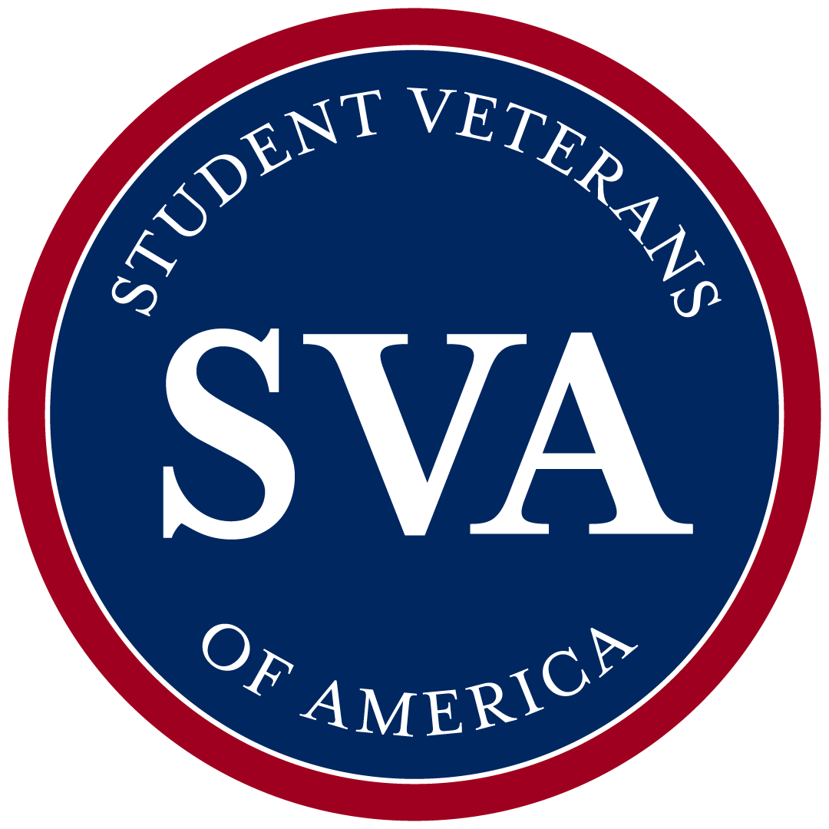



The Student Veteran of Today
Last updated February 4, 2025
More than 830,000 are receiving GI Bill benefits and almost 600,000 of them are on campuses with a SVA Chapter.
Post-Secondary Success Rates
Student veterans maintain success rates higher than the national average.
54%
72%
67%
53%
24-35 years old
Have children
Single parent
Women
Married*
39%
Veterans using Post-9/11 GI Bill to earn High-Level Degrees
43%
43%
Public or Private NFP
Enrolled full-time
First-generation
Were enlisted
Work full/part time
27%
27%
20%
Academic Performance
20%
Student veterans have higher academic performance (GPA) compared to traditional students
10%
Top 3 Fields
BUSINESS
STEM
HEALTHCARE
Notes:
When we think of a college student, we often picture an 18-year-old on their own for the first time.
But today’s student veteran looks very different.
Many are in their late 20s or early 30s. Half are parents—some are single parents. Most are married, working, and enrolled full-time.
They’re balancing school with real-life responsibilities—and they’re thriving.
Student veterans have a higher GPA and a higher success rate than their traditional peers.
They’re not just getting degrees—they’re earning them in fields like business, STEM, and healthcare, where leadership and experience matter most.
These students bring maturity, focus, and a deep sense of purpose to campus.
And when we support them by providing resources and additional support, we’re not just helping them succeed—we’re investing in the future leaders of our communities.

Slide 4
What Student Veterans Face – And What SVA Fights For
From military structure to academic freedom, student veterans navigate complex systems, unfamiliar learning environments, and a major identity shift—all while trying to access the benefits they’ve earned.
Many feel isolated from their peers, balancing family, work, and service-related challenges—while struggling to find their place on campus.
Many student veterans carry service-connected trauma, anxiety, or disabilities that aren’t always visible. These challenges can impact focus, engagement, and mental wellness—yet often go unrecognized without intentional outreach and support.
Notes:
Student veterans don’t just face one challenge—they face a series of transitions all at once.
They’re navigating GI Bill bureaucracy, trying to find their place on campus, adjusting to a completely new academic culture, and thinking about what comes next—all while juggling work, family, or service-related health issues.
But with support, those challenges become opportunities.
That’s where SVA comes in.
We help build a sense of belonging through peer connection.
We advocate for career pathways that honor their service.
We support academic planning to reduce debt and delays.
And we close the opportunity gap—so student veterans can turn their service into success.
So, how is SVA rising the occasion to meet some of these needs? What are we actually doing?

Slide 5
Spoiler Alert: It’s a Lot!
APEX
Career Center
Scholarships
National Conference
Washington Week
Regional Summits
VFW-SVA Legislative Fellowship
The Leadership Institute
Days of Service
Chapter Visits
Honor Awards
Basic Needs Survey
Veteran Opinion Survey
SVA Census Survey
National Veteran Education Success Tracker Partner
Policy Priority Portal
Chapter Success Team
Notes:
This is everything SVA offers—from national programs to research to policy and tools—but don’t worry... I’m not going to walk you through every bullet. If I did, we’d need lunch, and probably dinner, catered in.
Instead, I’ll focus on the key things that matter most for you today—and how you can plug your campus, your students, and your role into this mission

Slide 6
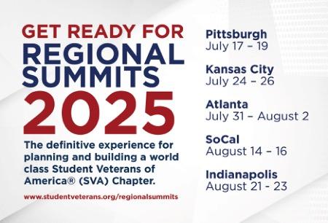
Programs & Events: Building Community and Best Practices
National Conference is the largest annual convening of student veterans and supporters in the country—NatCon brings together thousands of leaders to connect, share ideas, and shape the future of veteran support in higher education.
Regional Summits offer localized, high-impact events that deliver training, peer exchange, and resource sharing tailored to regional needs—bridging campuses, building leaders, and strengthening the student veteran network.
Notes:
So, how do we move from insight to action?
How do we take everything we know about the student veteran experience—and turn it into connection, leadership, and real progress?
We start with community.
NatCon—our National Conference—is where that transformation begins.
It’s the largest gathering of student veterans in the country. But more than that, it’s a space of energy, hope, and strategy.
Thousands of student veterans come together not just to network—but to be seen, to be inspired, and to build a future of leadership grounded in service.
I’ve seen students leave NatCon with new confidence, new mentors, and a renewed sense of purpose.
They go back to their campuses ready to lead—often with ideas they never knew existed before that moment.
But we know not everyone can travel across the country. That’s why we bring the mission closer to home.
Regional Summits are where local becomes powerful.
They’re high-impact, hands-on trainings that reflect the unique challenges of each region.
And they’re not just for the students—they’re for advisors, for administrators, for anyone who wants to create real support on campus.
These programs build more than skill.
They build belonging, confidence, and momentum.
And that momentum changes everything.”

Slide 7
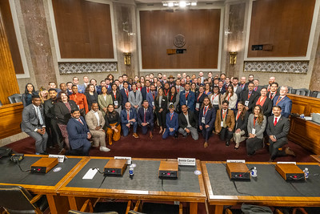
Programs & Events: Elevating Student Veteran Voices
Washington Week is a transformative experience where student veterans step into the nation’s capital, engage directly with lawmakers, and speak truth to power—advocating for policies that impact millions of military-connected students.
The VFW-SVA Legislative Fellowship is a competitive fellowship empowering student veterans to shape national policy. Fellows conduct in-depth research, craft legislative solutions, and present directly to members of Congress—amplifying lived experience into legislative action.
Notes:
We’ve talked about how student veterans build community, develop leadership, and navigate a challenging transition.
But they don’t stop there. They also step up to lead change—not just on campus, but in our country.
Washington Week is where that power becomes visible.
It’s a transformative experience—where student veterans walk into Capitol Hill and sit across from lawmakers.
And in those rooms, they don’t just share opinions. They share stories.
Stories that influence legislation, shape policy, and make higher education more accessible for everyone who comes after them.
Then there’s the VFW-SVA Legislative Fellowship—a fellowship where policy meets purpose.
These fellows aren’t just learning about change—they’re writing it.
They conduct real research, propose legislative solutions, and present directly to members of Congress.
And they do it all by drawing from their lived experience—translating challenges into action, and barriers into blueprints.
When we empower veterans to tell their story, they do more than advocate for themselves.
They advocate for an entire generation of military-connected students

Slide 8
APEX + Career Center
APEX: plan smart, go Far
Career center: Your Next move
Personalized academic and career coaching tailored to veterans, transitioning service members, and military families
Early guidance to maximize education benefits and build a strategic path – even before separation from service
Explore career pathways, translate military skills, and make informed academic decisions
800+ curated job opportunities from employers actively seeking to hire veterans
Veteran-ready, not just veteran friendly – these partners understand your value and are committed to hiring and supporting you
Quick to access, easy to use – create your profile in minutes and start exploring opportunities today
Notes:
We’ve talked about recognizing potential through scholarships, and sharpening leadership through immersive programs.
But what about the moments before a student veteran even sets foot on campus?
Or the moment when they’re getting ready to take their next step into the workforce?
That’s where SVA’s academic and career tools come in.
Our APEX platform and Career Center are designed specifically for military-connected students—by people who understand their journey.
They’re available before a student enrolls, while they’re in school, and long after they graduate.
With APEX, veterans can explore degree options, translate their military experience into civilian language, and build an academic path that aligns with their career goals—all before they ever apply to college.
And once they’re ready for that next step, SVA’s Career Center connects them to over 800+ curated job opportunities with employers who are not just veteran-friendly—they’re veteran-ready.
These employers understand their value and are committed to helping them succeed.
The best part? It’s all easy to access, intuitive to navigate, and personalized to the veteran’s unique skills and goals.
Because leadership doesn’t begin with a diploma, and it doesn’t end at graduation.
It’s a journey—and we’re here to make sure they have the tools to lead every step of the way.

Slide 9
Chapter Services: Personalized Guidance, Real Results
Dedicated Chapter Success Coaches provide 1-on-1 consultations to help chapters grow, lead, and sustain impact
On-demand support and strategic check-ins designed to meet chapters where they are
Webinars and roundtables tackle today’s most pressing challenges from leadership transitions to event planning and funding
Your feedback directly informs the tools and training we build, including our expanding resource library for chapter leaders and advisors
Notes:
So far, we’ve talked about what student veterans need—and what they can accomplish with the right support.
But none of this happens in isolation. None of this happens without you.
That’s why one of the most important things SVA offers is ongoing, personalized chapter support.
Every chapter has a dedicated Chapter Success Coach—someone who’s there for one-on-one guidance, tailored to the challenges and opportunities of that specific campus.
We show up early and often—with on-demand consultations, proactive check-ins, and strategic planning sessions that meet chapters where they are.
Our webinars and roundtables dive into real issues—from how to handle leadership transitions, to boosting event attendance, to finding sustainable funding sources.
And we don’t build tools in a vacuum. Everything we create—from our training guides to our resource library—is shaped by chapter feedback.
You tell us what you need, and we go to work making it happen.
Because when our chapters thrive, student veterans do too.
And that’s what this is all about—empowering you to support them, every step of the way

Slide 10
Starting a Chapter: From Idea to Impact
Start by identifying your motivated student veterans and communicating the why
Four simple requirements: a student leader, a chapter advisor, a constitution, and recognition from campus as a registered student organization
Set up a chapter consultation by emailing programs@studentveterans.org
Chapters are easy to start, dues-free, and fully self-directed — with missions shaped by the unique needs of their members, including veterans, caregivers, family members, survivors, and more.
Notes:
Everything we’ve walked through today—from community, to leadership, to advocacy and career support—starts with one thing: a chapter.
And starting a chapter isn’t complicated. In fact, it’s built to be accessible.
You just need four things:
A motivated student leader, a chapter advisor, a constitution, and recognition from your campus as a student organization.
But the real key is starting with why.
Why this matters. Why student veterans deserve a space of their own. Why their voices—and their futures—are worth investing in.
If you’ve got a handful of student veterans who are ready to build something bigger than themselves, we’re ready to walk with you every step of the way.
You don’t have to figure it out alone. I’m here for that.
Just reach out to me directly at olivia.brinsfield@studentveterans.org, and we’ll set up a chapter consultation to get you started

Slide 11
You Have a Chapter, Now What?!
A clearly defined mission acts as your compass – guiding your chapter’s decisions, focus, and impacts
Foster campus collaboration and lead efforts to ensure military-affiliated students are seen, heard, and supported
Chapters serve as a hub for peer support, guiding members through benefits, sharing academic resources, and connecting each other to meaningful resources
Build purpose and connection through community service, uniting veterans and allies in making a difference
Notes:
Starting a chapter is the beginning. But the real power comes in what you do next.
The first step is clarity.
A clearly defined mission becomes your chapter’s compass. It helps you stay focused, intentional, and aligned—whether you’re planning events, hosting meetings, or advocating for your members.
Then comes collaboration.
Chapters have the power to bring military-connected students into the spotlight—ensuring they’re seen, heard, and supported across campus.
That means building relationships with student affairs, financial aid, faculty, and other student orgs.
At their core, chapters are a hub for peer support.
This is where veterans help each other navigate benefits, academic resources, and life transitions. When a new student shows up unsure about where to go or how to register for classes—this is the group that says, ‘we’ve got you.’
And finally, purpose through service.
Some of the most meaningful moments come when chapters give back—through campus service projects, local partnerships, or causes that unite veterans and allies around shared values.
When you center your mission, foster connection, and serve with purpose, your chapter becomes more than a student group.
It becomes a home.”
I want to make it very clear that I’m not only available for setting up chapters – I’m also your support when a chapter exists. If you need help figuring out what’s next, call me!

Slide 12
How Chapters Grow: The Student Veteran Engagement Cycle
Awareness
• Are we visible on campus?
• Do students know what SVA is and that they’re welcome?
• Key Tools: Tabling, social media, welcome emails, classroom visits
Engagement
• Are our events relevant, consistent, and inclusive?
• Do members feel seen and supported?
• Key Tools: Meet-ups, resource-sharing, academic support, mentoring
Leadership
• Are we building a pipeline of future leaders?
• Do we delegate and develop others, or do the same few do everything?
• Key Tools: Officer training, mentorship, succession planning
Growth isn’t just about numbers—it’s about impact, belonging, and continuity.

Slide 13
Five Simple Ways to Grow Your Chapter this Fall
Host a Visibility Event in the First 6 Weeks
– Coffee social, welcome BBQ, resource table in student union
Create a Military-Affiliated Interest Form
– Capture students who want to connect but aren’t ready to commit
Partner with One Campus Office Per Month
– Career Center, DEI Office, Counseling, Registrar, or Athletics
Share 1 Member Story Per Month on Social Media
– Let people see who’s in your chapter and why it matters
Invite Members into Micro-Leadership Roles
– Event chair, social media lead, resource coordinator = buy-in
.

Slide 14
Your Chapter, Your Legacy
SVA chapters thrive when student veterans lead with
purpose, build with intention, and create space for others to belong

Slide 15
Continue the conversation by reaching out to me at olivia.brinsfield@studentveterans.org

Slide 16
SVA – Legislative Landscape
Tammy Barlet, Vice President of Government Affairs

Slide 17
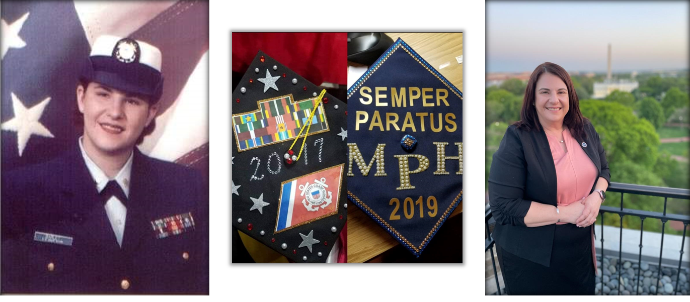
My story
2003
2025
Notes:
Good morning, everyone here in the room and watching virtually.
My name is Tammy Barlet and I’m Vice President of Government Affairs for Student Veterans of America.
Some of you may be wondering why I chose pictures of myself for the first slide. I wanted to illustrate that no matter how long ago we served, the dream of obtaining a degree is achievable, and it can lead a veteran like myself to a position where we can give back and make a positive impact.
AND this would not have been possible for the SCOs at Lehigh Community College, Reading Community College, Temple University and George Washington University.

Slide 18
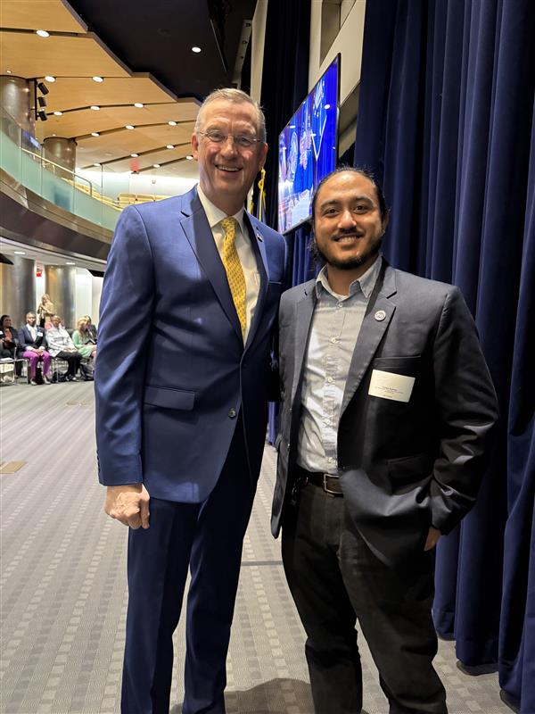
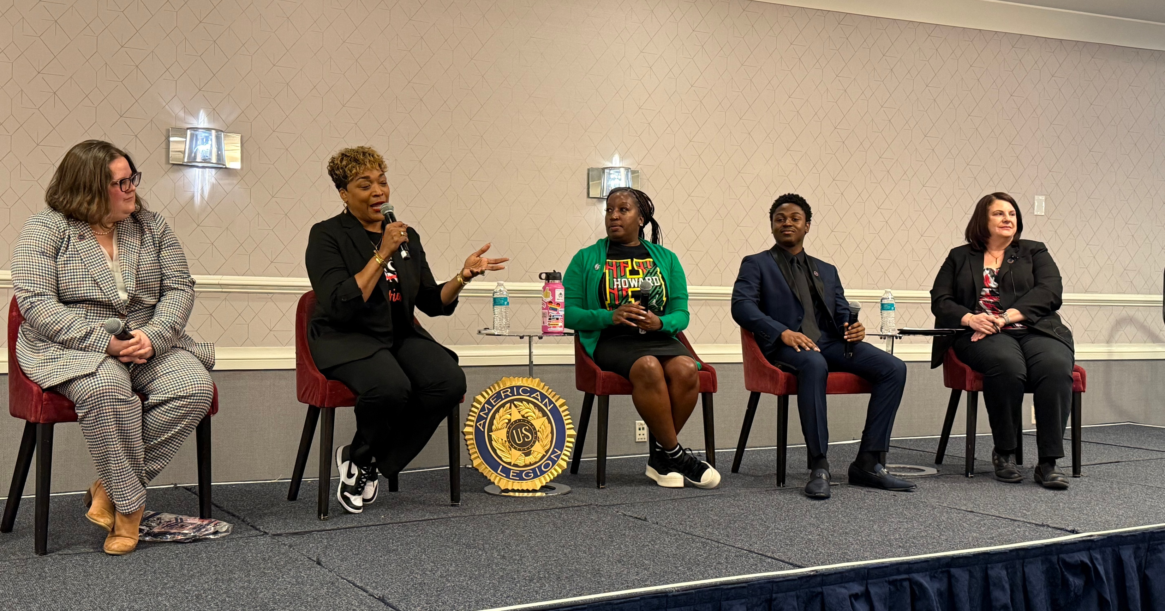
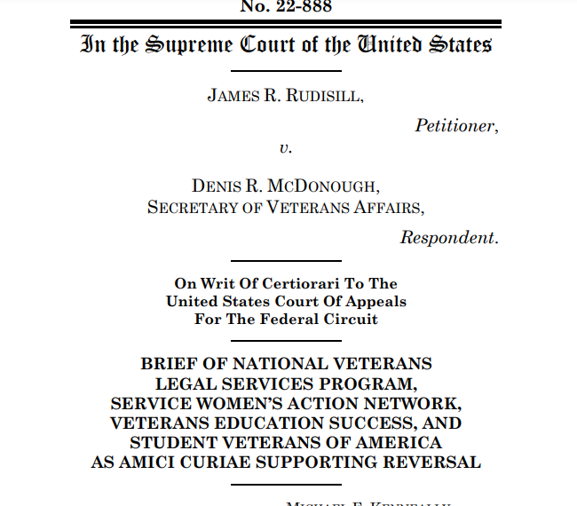
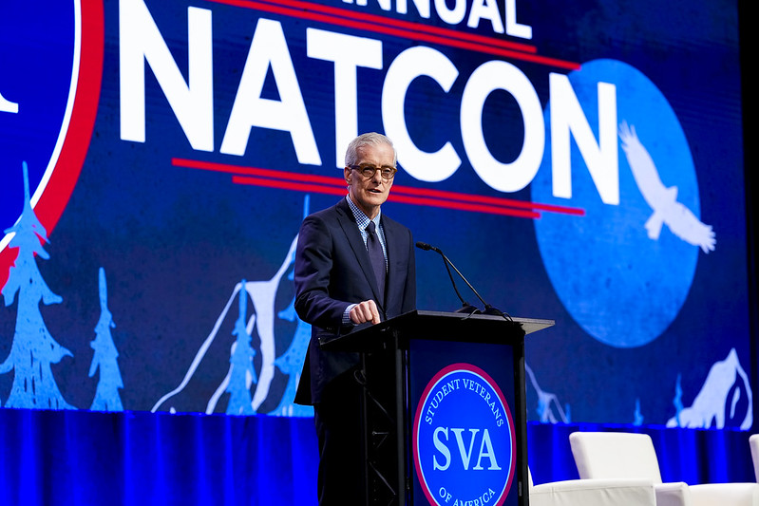
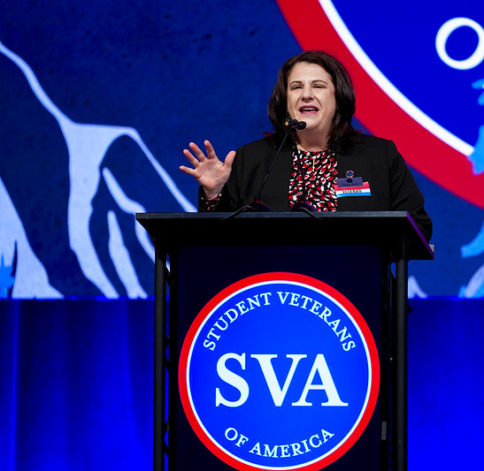
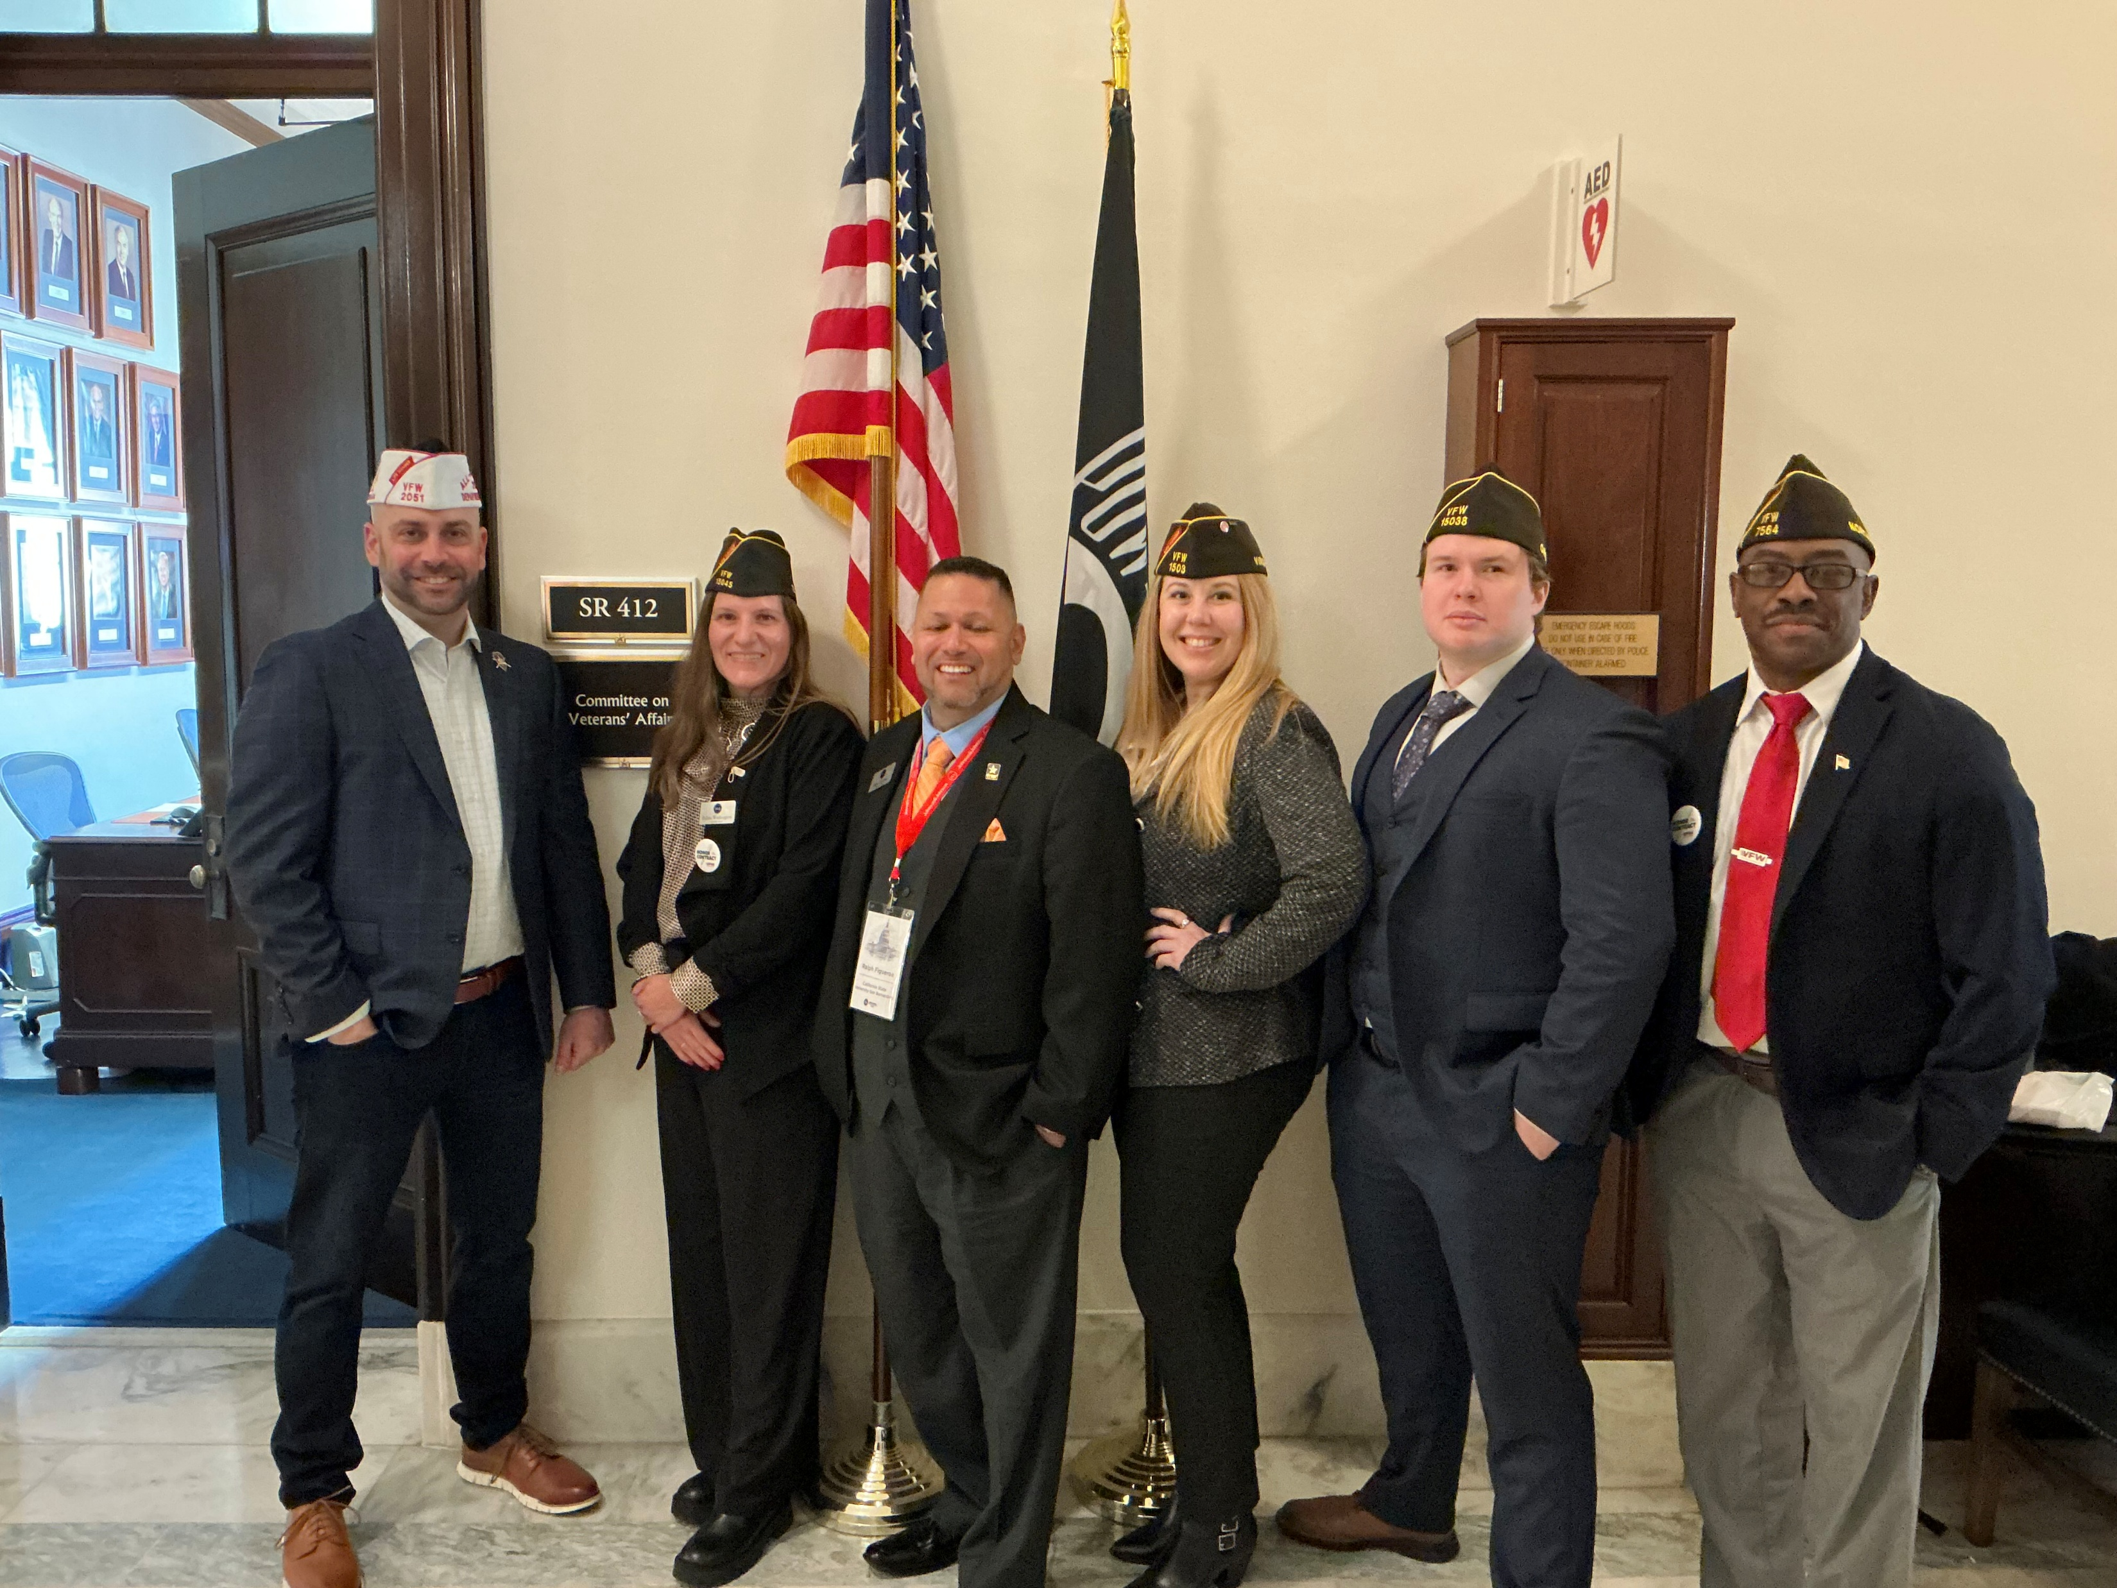
SVA Government Affairs
Executive Branch
Legislative Branch
Judicial Branch
VSOs/MSOs
Coalitions/Partnership
VFW-SVA Fellowship
Research- surveys/reports
Programs/Outreach
Notes:
Executive Branch
White House--Quarterly VSO/MSO meeting with the Special Assistant to the President/Domestic Policy Council
VA- VBA to VEO and all that in-between– SVA sits on the Veterans' Advisory Committee on Education
Dept of Ed.
DOD- Army and Air Force, although SVA is connected with all branches of the uniform services.
Legislative Branch
SVAC/HVAC (Senate and House Veteran Affairs Committee)
SASC/HASC (Senate and House Armed services Committee) NDAA—
Ed&Workforce
HELP (Health Education Labor and Pension)
Judicial Branch
Supreme Court (Rudisill v. McDonough)
VSOs/MSOs
Conventions VFW, Legion, DAV
NatCon (who attends NatCon- AVECO had a table last year)
Coalitions/Partnership
CEF (Committee on Education Funding), PSLF, White Oak, and many more
Today Student Coalition (TSC)
FAVES, WAVES, and AVECO
VFW-SVA Fellowship
Not just a Number Act
National Guard and Reserve GI Bill Parity
Application open in end of July
Research- surveys/reports (Data supports legislation)
Annual Census
Basic Needs Survey
VA VITAL white paper (by a raise of hands, how many people know about the VA Vital program, how many know how many VA Vital sites are in Florida? 0
Programs/Outreach
GA request – WH, Congress, and HVAC keeping bipartisanship

Slide 19

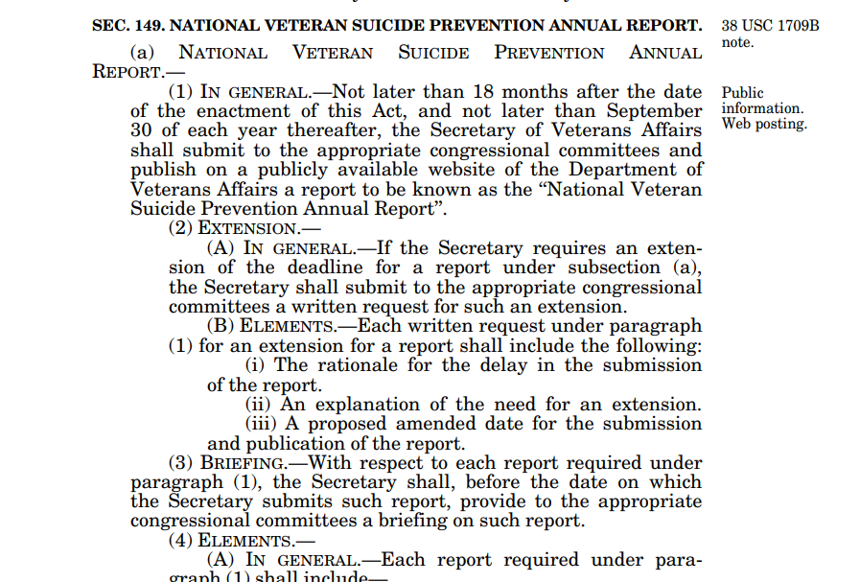
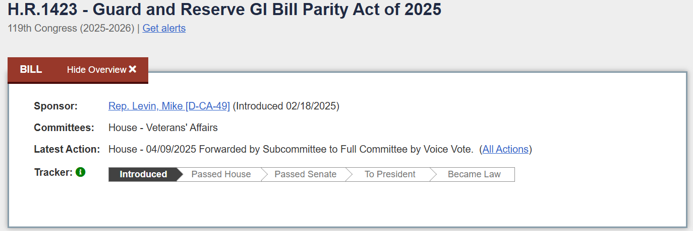
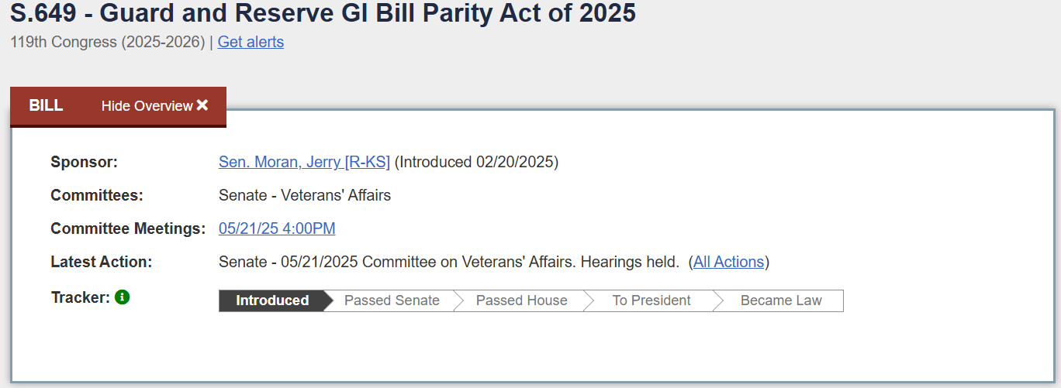
VFW-SVA Fellowship
PASSED

Slide 20
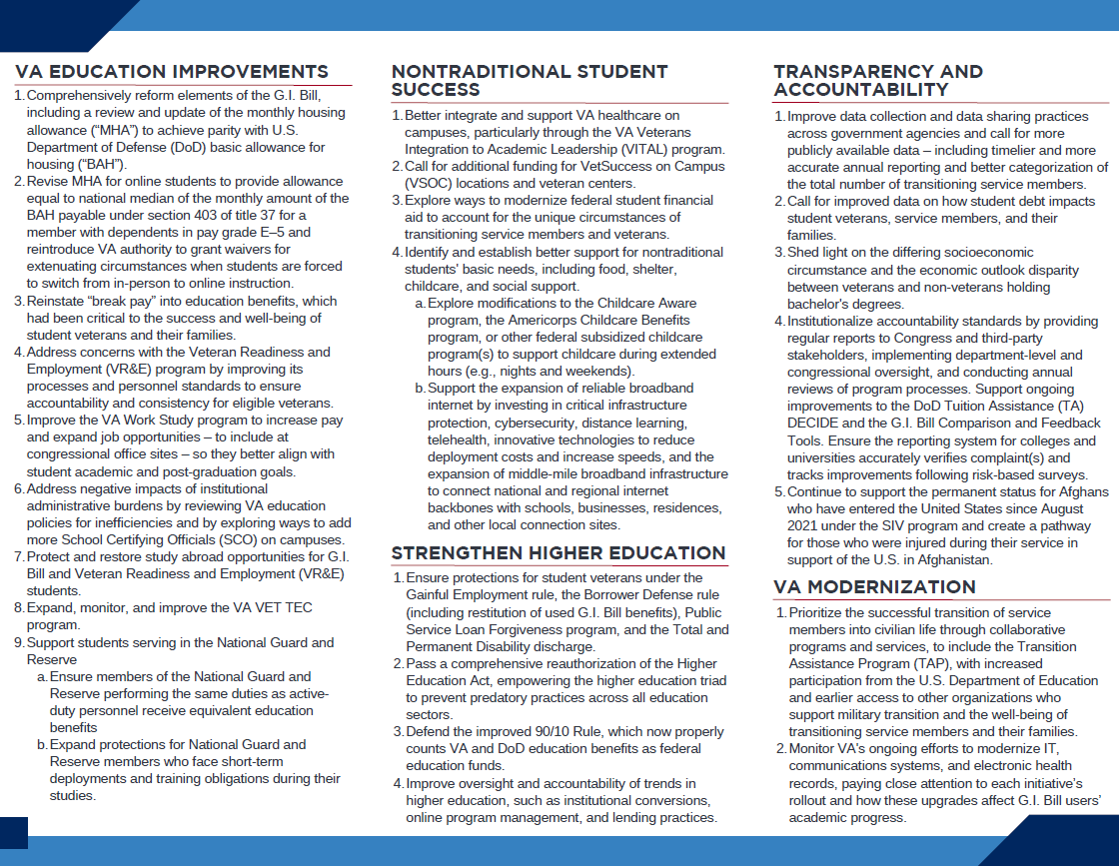
2025 SVA Policy Priorities
Conceived through conversation
  NatCon
    Policy Think Tank
  Washington Week (next slide)
  Regional Summits
  Leadership Institute
  Opportunities throughout the year
SVA 2025 Policy Priorities
H.R. 3753 – Online MHA Parity
H.R. 1965 – Book Stipend Increase
H.R. 1391 – GI Bill Restoration
VA Work Study
Notes:
Conceived through conversation with student veterans, military –connected students, their families, caregivers, survivors, advisories, and SCOs
NatCon
Policy Think Tank
Advisory Track – GA did a breakout session with our Research to illustrate what we did. NAVPAA and AVECO panel led by Tammy to share on their orgs.
Washington Week
Regional Summits (Vanessa Ryan – VP of Chapter and Community Engagement) will discuss more in her 3:30PM Presentation Titled “Creating a Successful SVA Chapter in Bird/Indian Key)
Leadership Institute
Opportunities throughout the year… like FAVES/WAVES/AVECO
VA Modernization
Increase VA Work Study Pay and expand job opportunities (include Takano bill)
VR&E
Improve TAP and VA VET TEC
GI Bill Improvements
Update MHA
Ensure members of National Guard and Reserve receive same benefits as those on active duty
Post-Traditional Student Success
Better support for VA VITAL
Additional funding for VSOC
Transparency and Accountability
Improve data collection and sharing across gov’t agencies
Shed light on the differing socioeconomic circumstance and the economic outlook disparity between veterans and non-veterans holding bachelor's degrees, which encompasses multiple dimensions.
Strengthening Higher Education
Improve oversight and accountability of trends in higher education, such as institutional conversions, online program management, and lending practices.
Protect and monitor the Public Service Loan Forgiveness program.

Slide 21
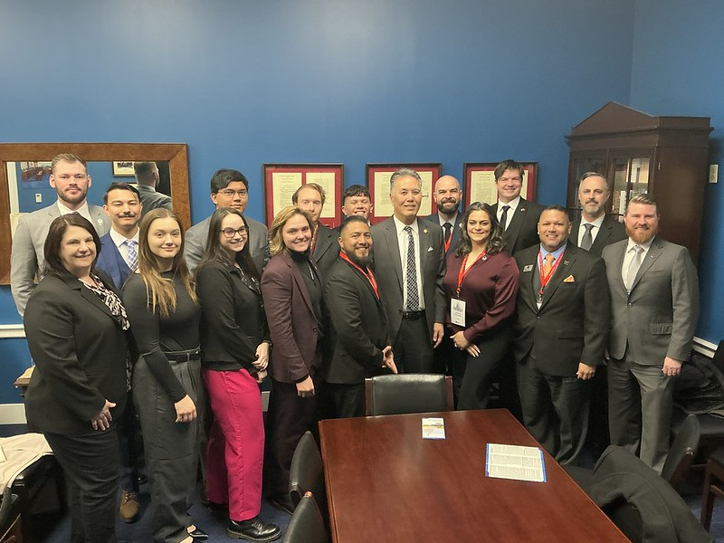
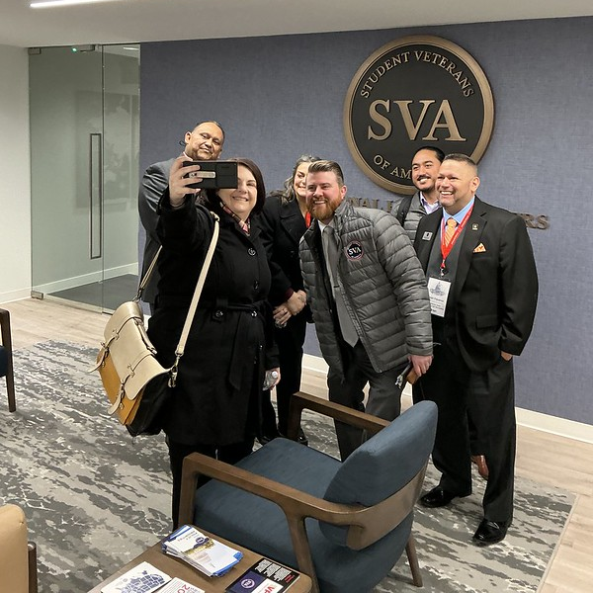
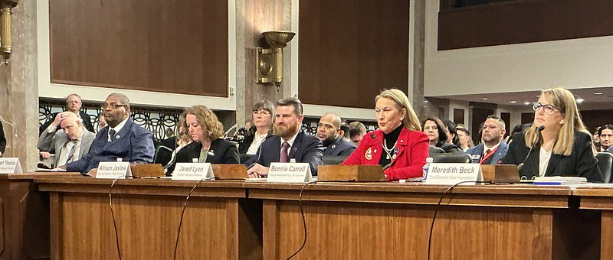
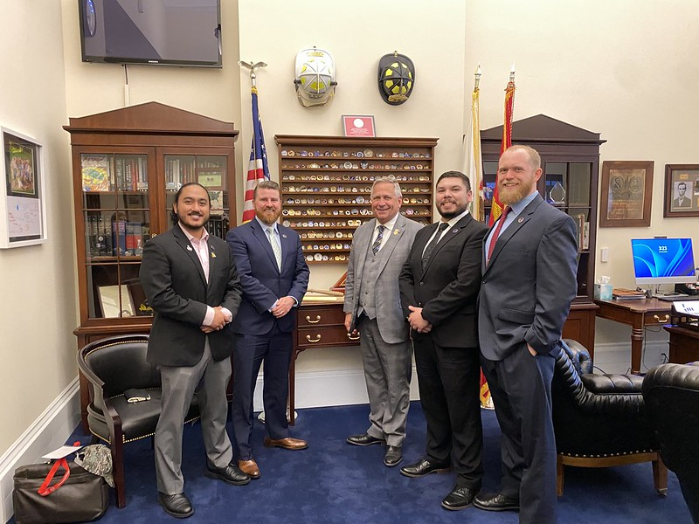
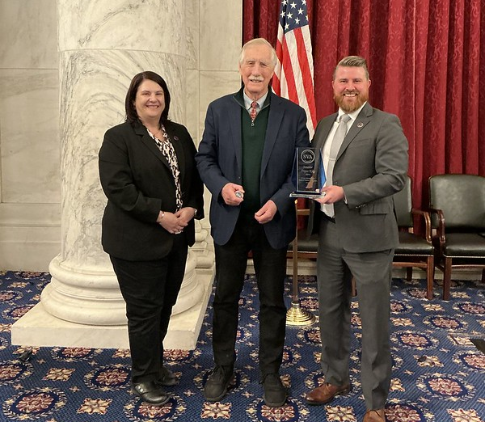
Washington Week
Amplifying SVA’s Voice at GWU Student Center
  Researching Your Member of Congress
  SVA WW25 Talking Points
  Effective Communication on the Hill
  Communications and Marketing Strategy
SVAC/HVAC hearing – 2025 Policy Priorities
SVA member congressional office visits
Chapter Networking on the Hill/HQ Open House
SVA WW Reception/Awards in the Kennedy Caucus Room
  Sonny Montgomery Student Veteran Champion
    Senator Angus King (I-ME)
    Senator Mike Rounds (R-SD)
    Senator Brian Schatz (D-HI)
  Dwight D. Eisenhower Distinguished Public Service Awards
    Former VA Executive Director of Education Service – Joseph Garcia
Notes:
Over 250+ attendees this year, and continues to go
Amplifying SVA’s Voice at GWU Student Center
Researching Your Member of Congress (talk about the Webinar series)
SVA WW25 Talking Points
Effective Communication on the Hill
SVAC/HVAC hearing – 2025 Policy Priorities
SVA member congressional office visits
To discuss SVA Talking Points (GI Bill Restoration, Book Stipend, Online MHA, VA Work Study)
Met with some Members – Rep. Takano, Rep. Bost, Senator Moran
Tentative date for Washington Week 2026 will be the last week of February/first week of March.
The Sonny Montgomery Student Veteran Champion Award—honoring leaders who dedicate time and resources to improving student veterans’ lives—was presented to Senators Mike Rounds (R-SD), Brian Schatz (D-HI), and Angus King (I-ME).
MR and BS - Sponsored and co-sponsored S. 1309, Student Veterans Transparency and Protection Act of 2023, which was adopted as Sec. 215. Improving Transparency and Accountability of Educational Institutions
This section would modernize the GI Bill Comparison Tool by updating information and statistics, such as graduation rates and average salary after graduation, available to beneficiaries of VA education benefits. This section would also create due process for complaints in the GI Bill Comparison Tool.
AK - Sponsored of S. 1678 VET–TEC Authorization Act of 2023, which was adopted as Sec. 212. Department of Veterans Affairs High Technology Program
Extend the VET-TEC pilot program to September 30, 2027, and make needed improvements to how the program runs. It would allow 4,000 veterans to enroll in the program yearly.
It would also allow institutions of higher education to participate in the program under the same guidelines as current VET-TEC providers. Veterans using the program would also still receive many of the benefits student veterans have under the Post-9/11 GI Bill, such as monthly housing allowances, and tuition assistance to ensure that they have the resources they need to successfully complete.
The Dwight D. Eisenhower Distinguished Public Service Award—recognizing continued public service beyond the military—was awarded to Joseph Garcia, former VA Executive Director of Education Service.
VA’s strongest supporters of legislation to increase the Post-9/11 GI Bill book stipend
Continued forward movement of rollout of the Digital GI Bill has modernized the VA’s education benefits system. Enrollment Manager and consolidation of direct deposit accounts, which he included SVA in early communications

Slide 22
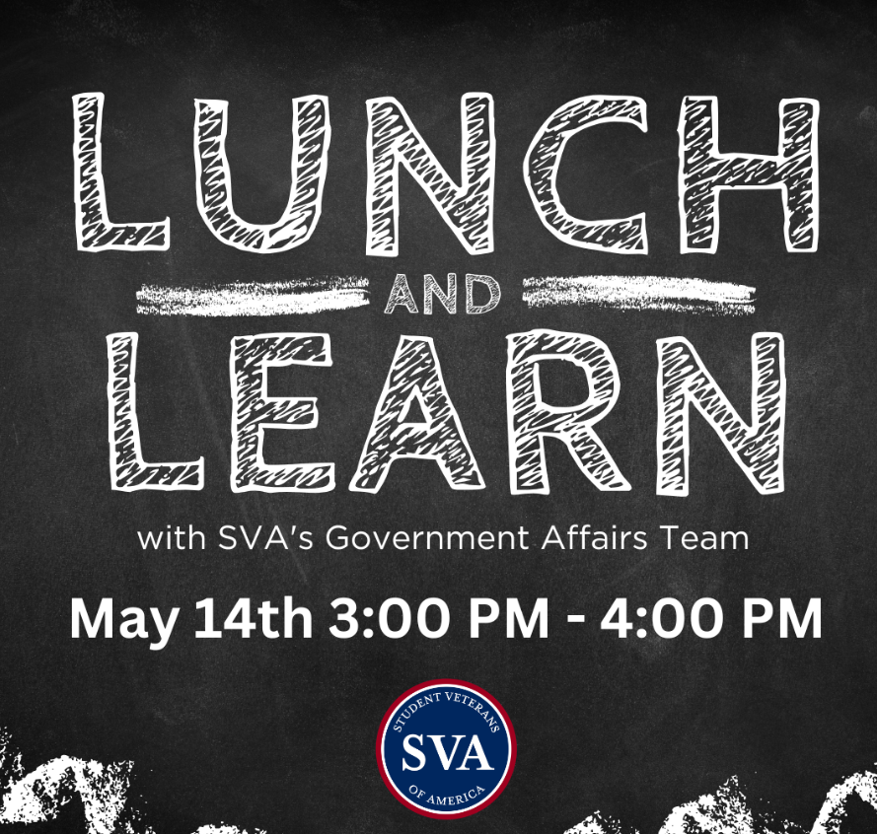
Washington Week
Amplifying SVA’s Voice at GWU Student Center
  Researching Your Member of Congress
  SVA WW25 Talking Points
  Effective Communication on the Hill
  Communications and Marketing Strategy
SVAC/HVAC hearing – 2025 Policy Priorities
SVA member congressional office visits
Chapter Networking on the Hill/HQ Open House
SVA WW Reception/Awards in the Kennedy Caucus Room
  Sonny Montgomery Student Veteran Champion
    Senator Angus King (I-ME)
    Senator Mike Rounds (R-SD)
    Senator Brian Schatz (D-HI)
  Dwight D. Eisenhower Distinguished Public Service Awards
    Former VA Executive Director of Education Service – Joseph Garcia
2nd Wednesday of EVERY Month!
Notes:
Over 250+ attendees this year, and continues to go
Amplifying SVA’s Voice at GWU Student Center
Researching Your Member of Congress (talk about the Webinar series)
SVA WW25 Talking Points
Effective Communication on the Hill
SVAC/HVAC hearing – 2025 Policy Priorities
SVA member congressional office visits
To discuss SVA Talking Points (GI Bill Restoration, Book Stipend, Online MHA, VA Work Study)
Met with some Members – Rep. Takano, Rep. Bost, Senator Moran
Tentative date for Washington Week 2026 will be the last week of February/first week of March.

Slide 23
118th Congress 2nd Session
S. 141, Sen. Elizabeth Dole 21st Century Veterans Healthcare & Benefits Improvement Act (Signed into Law on January 2, 2025)
  Omnibus EO Sections
    Sec. 149 National Veteran Suicide Prevention Annual Report (based on S. 928 and H.R. 4157, Not Just a Number Act).
    Sec. 203 Sole Liability Transferred Educational Assistance by an Individual who Fails to Complete a Service Agreement (based on H.R. 1798, Protect Military Dependents Act).
    Sec. 206 Expansion of Department of Veterans Affairs Oversight of Certain Educational Institutions (based on H.R. 3981, Isakson Roe Education Oversight Expansion Act).
    Sec. 207 Requirement that Educational Institutions Approved for Purposes of Department of Veterans Affairs Educational Assistance Programs Provide Digital Official Transcripts (based on H.R. 3898, Transcript Assurance for Heroes Act).
    Sec. 208 Payment of Full Monthly Housing Stipend for Veterans Enrolled in Final Semester using Educational Assistant under Post 9/11 Educational Assistance Program (based on H.R. 3874, Veterans Education Assistance Improvement Act).
Notes:
H.R. 8371, Sen. Elizabeth Dole 21st Century Veterans Healthcare & Benefits Improvement Act (Introduce in the House on May 14th)
Omnibus EO Sections:
Section 149 - National Veteran Suicide Prevention Annual Report. Based on H.R. 4157 and S. 928, Not Just a Number Act.
Section 201 - Temporary Expansion of Eligibility for Marine Gunnery Sergeant John David Frye Scholarship. Based on H.R. 3651 and S. 1266, Love Lives On Act.
Section 202 - Removal of Expiration on Entitlement to Marine Gunnery Sergeant John David Fry Scholarship for Surviving Spouses. Based on H.R. 3651 and S. 1266, Love Lives On Act.
Section 203 - Sole Liability Transferred Educational Assistance by an Individual who Fails to Complete a Service Agreement. Based on H.R. 1798, Protect Military Dependents.
Section 209 - Modification of Rules for Approval of Commercial Driver Education Programs for Purposes of Educational Assistance Programs of the Department of Veteran Affairs. Based on H.R. 2830 and S.656, Veteran Improvement Commercial Driver License Act.
Section 210 - Provision of Certificates of Eligibility and Award Letters Using Electronic Means. Based on H.R. 1169, VA-E Notification Enhancement Act.
Section 214 - Payment of VA Educational Assistant Via Electronic Fund Transfer to a Foreign Institution of Higher Education. Based on S. 1090, Directs the VA to update the payment system to allow for electronic fund transfer of educational assistance to a foreign institution of higher education.
Section 215 - Improving Transparency and Accountability of Educational Institutions for Purposes of Veterans Educational Assistance. Based on H.R. 5956, Transparency for Student Veterans Act, and S. 1309, Student Veterans Transparency and Protection Act of 2023.

Slide 24
118th Congress 2nd Session (cont.)
S. 141, Sen. Elizabeth Dole 21st Century Veterans Healthcare & Benefits Improvement Act (Signed into Law on January 2, 2025)
  Omnibus EO Sections
    Sec. 209 Modification of Rules for Approval of Commercial Driver Education Programs for Purposes of Educational Assistance Programs of the Department of Veteran Affairs (based on H.R. 2830 and S. 656, Veteran Improvement Commercial Driver License Act).
    Sec. 210 Provision of Certificates of Eligibility and Award Letters Using Electronic Means (based on H.R. 1169, VA-E Notification Enhancement Act).
    Sec. 212 Department of Veterans Affairs High Technology Program (based on H.R. 1669, VET TEC Authorization Act; and S. 1678, VET TEC).
    Sec. 214. Payment of VA Educational Assistant Via Electronic Fund Transfer to a Foreign Institution of Higher Education (based on S. 1090, To direct the Secretary of Veterans Affairs to update the payment system of the Department of Veterans Affairs to allow for electronic fund transfer of educational assistance, administered by the Secretary, to a foreign institution of higher education, and for other purposes).
Notes:
H.R. 8371, Sen. Elizabeth Dole 21st Century Veterans Healthcare & Benefits Improvement Act (Introduce in the House on May 14th)
Omnibus EO Sections:
Section 149 - National Veteran Suicide Prevention Annual Report. Based on H.R. 4157 and S. 928, Not Just a Number Act.
Section 201 - Temporary Expansion of Eligibility for Marine Gunnery Sergeant John David Frye Scholarship. Based on H.R. 3651 and S. 1266, Love Lives On Act.
Section 202 - Removal of Expiration on Entitlement to Marine Gunnery Sergeant John David Fry Scholarship for Surviving Spouses. Based on H.R. 3651 and S. 1266, Love Lives On Act.
Section 203 - Sole Liability Transferred Educational Assistance by an Individual who Fails to Complete a Service Agreement. Based on H.R. 1798, Protect Military Dependents.
Section 209 - Modification of Rules for Approval of Commercial Driver Education Programs for Purposes of Educational Assistance Programs of the Department of Veteran Affairs. Based on H.R. 2830 and S.656, Veteran Improvement Commercial Driver License Act.
Section 210 - Provision of Certificates of Eligibility and Award Letters Using Electronic Means. Based on H.R. 1169, VA-E Notification Enhancement Act.
Section 214 - Payment of VA Educational Assistant Via Electronic Fund Transfer to a Foreign Institution of Higher Education. Based on S. 1090, Directs the VA to update the payment system to allow for electronic fund transfer of educational assistance to a foreign institution of higher education.
Section 215 - Improving Transparency and Accountability of Educational Institutions for Purposes of Veterans Educational Assistance. Based on H.R. 5956, Transparency for Student Veterans Act, and S. 1309, Student Veterans Transparency and Protection Act of 2023.

Slide 25
119th Congress 1st Session
  Legislation Tracking
    H.R. 913 – Streamlining Aviation for Eligible Veterans Act
    H.R. 980 – Modernizing the Veterans On-Campus Experience Act
    S. 610 – Ensuring VetSuccess On-Campus Act
    H.R. 1391 – Student Veterans Benefits Restoration Act
    H.R. 1423 / S. 649– National Guard and Reserve GI Bill Parity Act
    H.R. 1458 – Veterans Education and Technical Skills Opportunity Act
    S. 1543 – Veterans’ Opportunity Act
    H.R. 1965 – Veteran Education Assistance Adjustment Act
    H.R. 1957 – End Veteran Homelessness Act
    H.R. 2034 – Edith Nourse Rogers STEM Scholarship Opportunity Act
  Statements for the Record
    March 4 – Joint Senate-House Veterans Affairs Committee
    March 11 – HVAC Pending Legislation Hearing
    May 21 – SVAC Pending Legislation Hearing
    June 11 – HVAC EO Pending Legislation Hearing
    June 12 – HVAC Health Pending Legislation Hearing
Notes:
H.R. 1458 – VETS Opportunity Act - (certain ind. study qualifies for educational benefits)
S. 1543 – Veteran Opportunity Act (4th Admin within the VA to focus issues related to Veterans Economic Opportunity and Transition).

Slide 26
119th Congress 1st Session
House Education and Workforce Committee​
  Full Committee Markup – April 29​
    Section by Section​
      Sec. 30002 – Amount of Need; Cost of Attendance; Median Cost of College​
      Sec. 30031 – Pell Grant Changes to “Full Time”; Less than Half Time Eligibility​
      Sec. 30051 – Repeal of the 90/10 Rule; Gainful Employment; Borrower’s Defense, and Closed School Discharge
Senate Health, Education, Labor and Pension Committee
  Released Bill Text – June 11
    Sec. 81001 – Loan Limits for Graduate, Professional, and Parent Borrowers
    Sec. 85001 – Repeal of Borrower’s Defense
    Sec. 85002 – Closed School Discharge
Other Legislation
  H.R. 1 – One Big Beautiful Bill
Notes:
BD – repeals the Biden-Harris administration’s regulations pertaining to borrower defense to repayment and closed school discharges
CSD - If your school closes while you're enrolled or soon after you withdraw, you may be eligible for discharge of your federal student loan.

Slide 27
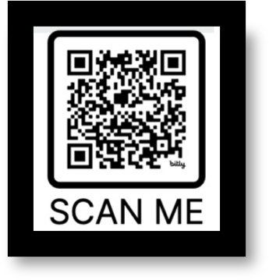
SVA Basic Needs Survey
In-depth and innovative research project designed to identify gaps and improve supports in the veteran community following transition and to promote wellness for all veterans.

Slide 28
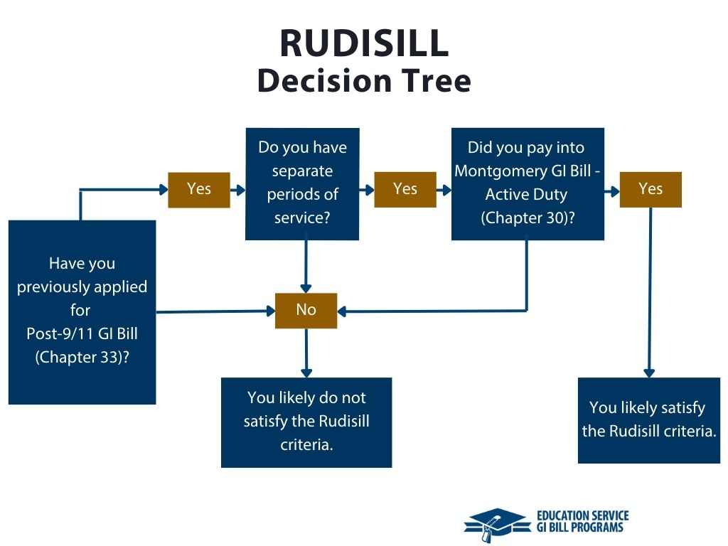
SCOTUS Developments
Rudisill v. McDonough, 601 U.S. __ (2024)
  Held: Servicemembers who accrue educational benefits under both the Montgomery and Post-9/11 GI Bills may use either one and may use them in any order.
  Guidance from VA

Slide 29
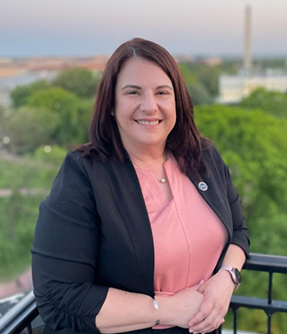
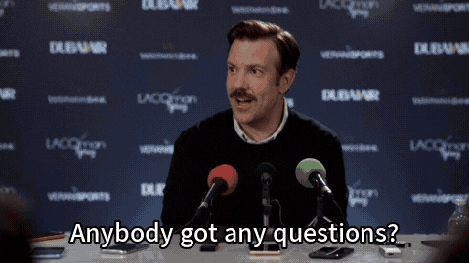
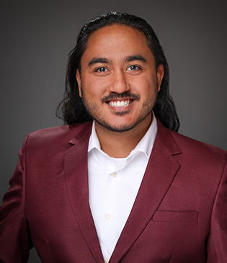
Tammy Barlet, MPH (she, her, hers)
Vice President of Government Affairs
Student Veterans of America
202-573-7770 | tammy.barlet@studentveterans.org
Faisal Sulman, JD, MBA (he, him)
Legal Fellow
Student Veterans of America
202-350-2063 | faisal.sulman@studentveterans.org

