Slide 1

U.S. Department of Veterans Affairs
Work Study Allowance Program
Briefed by: Kevin White
Date: July 2025
Pre-Decisional
Notes:
U.S. Department of Veterans Affairs Work Study Allowance Program

Slide 2

Overview
Work Study is a Veterans Administration (VA) tax exempt education benefit paid to students for performing VA-related activities at an approved Work Study site.
Notes:
Work Study is a Veterans Administration (VA) tax exempt education benefit paid by VA to students for performing VA-related activities at an approved Work Study work site. The money a student receives for this benefit is not considered income and there is no cost to the approved Work Study site.
This course is designed for new School Certifying Officials interested in learning what the VA Work Study program has to offer. This session will cover the basics of Work Study including what qualifies a student and work site for Work Study, how Work Study contracts are written, and the payment procedures.

Slide 3
Learning Objectives
Know work site and site supervisor responsibilities
Understand Work Study contracts
Identify the requirements for payments
Know how to contact Work Study
Identify the criteria used to select students
Supervising students
Notes:
Upon completion of this training, you should be able to:
Know work site and site supervisor responsibilities
Identify the criteria used to select students
Understand Work Study contracts
Identify the requirements for payments
Understand how to supervise students
Know how to contact Work Study

Slide 4

Work Site Qualifications
Approved Work Sites
Work Assignments/Duties
Site Supervisors
Notes:
The next series of slides will help you understand which facilities are considered approved work sites, the different types of work assignments or job duties students can perform at various facilities and the responsibilities of the Work Study site supervisors.

Slide 5
Approved Work Sites
VA Facilities
DOD Facilities
Educational Institutions
Veteran Cemeteries
SAA’s
Congressional Offices
Vet Success Centers
Notes:
There are many different types of places that can be approved to be a Work Study work site. Allowable Work Study duties are different for each work site type.
For example:
VA Facilities: There’s no limitation as to the VA-related duties for Work Study students at any VA facility. Only VA facilities are approved to allow “driving” as an approved duty for Work Study students.
Department of Defense (DOD), Coast Guard or National Guard Facilities: disseminating information (outreach) on VA benefits and services and helping individuals in obtaining these benefits. Work Study students may assist with general office duties that directly relate to or impact Veteran students. Such duties should be necessary to ensure the success of Veterans achieving educational and career goals.
In the case of an individual who is receiving educational assistance under chapter 1606, Work Study students may assist with an activity relating to the administration of this chapter (for which he or she is receiving benefits) at DoD, Department of Homeland Security (DHS), or National Guard facilities. Appropriate tasks include completing Notice of Basic Eligibility (NOBE), also known as DD Form 2384-1, or reporting information through channels when individuals make a six-year commitment or in the event someone fails to carry out his or her commitment. A DoD, DHS, or National Guard official must supervise these students.
Other Non-VA facilities: Other non-VA facilities can use Work Study students for disseminating information on VA benefits and services and providing assistance to individuals in obtaining these benefits. Duties may also include, to the extent feasible, providing information on other governmental programs such as other federal, state, or local programs determined to be beneficial to Veterans and eligible dependents. Work Study students should not be performing the services associated with any non-VA program and should not be performing administrative duties or processing paperwork for the non-VA facility. For example, an allowable duty would be to distribute information about job programs, whereas assisting a Veteran with locating a job would not be an allowable duty.
National Cemetery or State Veteran’s Cemetery: Work Study students may assist with the administration of national cemeteries or state Veteran’s cemeteries.
Outreach Services Assisting SAA employees: Work Study students may assist State Approving Agency employees in performing outreach activities which includes disseminating information on VA benefits and services and providing assistance to individuals in obtaining these benefits. Duties may also include, to the extent feasible, providing information on other governmental programs such as other federal, state, or local programs determined to be beneficial to Veterans and eligible dependents . If the SAA is under the state’s Veterans Affairs Office, then there’s no limitation to those duties as they should all be Veteran-related.
Hospital and Domiciliary Care at State Home: Work Study students may assist with the delivery of hospital and domiciliary care and medical treatment to Veterans in a state facility when VA pays an allowance to the state for the Veteran’s care.
Congressional Offices:
• The distribution of information to members of the Armed Forces, Veterans, and their dependents about the benefits and services administered by the Department of Veterans Affairs; and other appropriate governmental and nongovernmental Veterans programs.
• The preparation and processing of papers and other documents, including documents to assist in the preparation and presentation of claims for benefits administered by the Department of Veterans Affairs.

Slide 6
Work Assignments for Educational Institutions
• Preparation and processing of necessary Veteran related papers and other documents at educational institutions, and the gathering of information to fulfill reporting requirements.
• Assisting with dissemination of general information regarding Veteran benefits and/or services and providing assistance to individuals in obtaining these benefits.
• Aiding Veteran students with general inquiries about Veteran benefits via phone, email, or in person.
• Maintaining and organizing Veteran related files.
• Outreach activities which involve the distribution of information about VA benefits to VA beneficiaries or potential beneficiaries and providing assistance to them in obtaining these benefits; distributing information about other governmental programs beneficial to VA beneficiaries or potential VA beneficiaries.
Notes:
Work Assignments for Educational Institutions are as follows:
• Preparation and processing of necessary Veteran related papers and other documents at educational institutions, and the gathering of information to fulfill reporting requirements.
• Assisting with dissemination of general information regarding Veteran benefits and/or services and providing assistance to individuals in obtaining these benefits.
• Aiding Veteran students with general inquiries about Veteran benefits via phone, email, or in person.
• Maintaining and organizing Veteran related files.
• Outreach activities which involve the distribution of information about VA benefits to VA beneficiaries or potential beneficiaries and providing assistance to them in obtaining these benefits; distributing information about other governmental programs beneficial to VA beneficiaries or potential VA beneficiaries.

Slide 7
Site Supervisors
Responsibilities
Submit a Work Site Application and position description to Work Study every year
Provide direct supervision and training
Ensure only approved tasks are performed
Ensure the student works only at the approved work site
Review and maintain all correspondence from VA Work Study
Ensure approved hours are worked
Submit a Site Supervisor Update Form when needed
Maintain records
Read the Site Supervisor Handbook
Notes:
Site Supervisor responsibilities include but are not limited to:
• Your site must submit a Work Site Application (VA Form 22-10219) and attach a Position Description to VA Work Study for initial approval and every year thereafter to continue your WS program. The 22-10219 will be dis/approved after review by Work Study. The site must immediately send an updated 22-10219 and a position description if the duties have changed or they need a 10%+ increase in approved hours. There must be a justification for this increase in hours. This form will be submitted to Work Study via AskVA. We’ll cover AskVA later on in this presentation.
• Providing direct supervision and training
• Ensuring only approved tasks are performed. Under no circumstances should students do homework or study during their assigned Work Study time.
• Ensuring only approved hours are worked
• Ensure the student works only at the approved work site listed on the time record. Work Study students are assigned to a specific work site and cannot perform work at any other location.
• Review and maintain all correspondence from VA Work Study
• Maintaining records for a minimum of 3 years
• Read the Work Study Site Supervisor Handbook
• Your site must submit a Site Supervisor Update Form anytime they add or remove a site supervisor.
There is a link to the Site Supervisor Update Form on this PowerPoint slide that you can use (see Word Document link on this page for a copy of the SS Update Form)

Slide 8

Student Qualifications
Approved Education Benefit Programs
Enrollment Requirements
Selection Criterion
Notes:
Now that we know work site qualifications and responsibilities, let’s dive into student qualifications. For a student to be eligible for the VA Work Study Allowance Program, they must first meet a list of qualifications. The qualifications reviewed in the next few slides contain information on the VA education benefit programs approved for participation in the Work Study program, the student enrollment requirements, and the components evaluated in the student selection process.

Slide 9

Enrollment Requirements
Be receiving an approved VA Education benefit
Enrolled in an approved degree, vocational or professional program
Attending at a rate of ¾ time or higher or 75% ROP for Ch33 participants
Work at an approved work site
Notes:
A student must be using an approved VA education benefits program to pay for their education or training to be considered for participation in the Work Study Allowance program.
Approved VA education benefits programs include:
• Chapter 33: Post-9/11 GI Bill for Veterans, including Post-9/11 GI Bill for family members using transferred benefits (TOE) and Fry Scholarship recipients
• Chapter 30: Montgomery GI Bill Active Duty (MGIB-AD)
• Chapter 1606: Montgomery GI Bill Selected Reserve (MGIB-SR)
• Chapter 32: Veterans’ Educational Assistance Program (VEAP)
• Chapter 35: Survivors’ and Dependents’ Educational Assistance (DEA)
(Note: Dependents who qualify under 38 U.S.C. Chapter 35 may use work study only while enrolled at a school in one of the 50 states.)
• Chapter 31: Veteran Readiness and Employment (VR&E)
• The Edith Nourse Rogers Science Technology Engineering Math (STEM) Scholarship
A student must be enrolled in an approved degree, vocational or professional program at a rate of ¾ time or higher; or, 75% ROP for Ch33 participants and work at a VA approved work site.
Neither federal employees nor students receiving VA education benefits, while participating in an internship program at a VA Facility, are eligible to participate in the Work-Study Allowance Program simultaneously at a VA facility.

Slide 10
Selection Criterion
Service-connected disability
Financial need
Availability of transportation
No conflict with disability
Motivation
Notes:
When it comes to student selection, the following factors need to be carefully evaluated:
• Students with service-connected disabilities have priority (30% or more)
• Financial need
• Availability of transportation
• Motivation
• Work assignments don’t conflict with disability or are accommodated. Each facility must ensure that the work assignment is compatible with the student’s service connected disability. If the disability is discovered after placing the student, try to accommodate the individual as you would a regular employee. You may consult your local HR or contact VA Work Study Department if you have questions.
*Work Study students cannot receive or accept compensation from any other source for the same hours of work performed under a Work Study contract.

Slide 11
Knowledge Check #1
Work Study students will receive a W-2 every year for time worked as a VA Work Study.
True
False
Notes:
Knowledge Check #1 Question

Slide 12
Knowledge Check #1
Work Study students will receive a W-2 every year for time worked as a VA Work Study.
True
False
Notes:
Knowledge Check #1 Answer

Slide 13
Knowledge Check #2
Which statements are the most accurate about student selection? (Select all that apply)
    A. Service-connected disabilities have priority
    B. They do not need to exhibit financial need
    C. Must have availability to transportation
    D. Work assignments don’t conflict with disability
Notes:
Knowledge Check #2 Question

Slide 14
Knowledge Check #2
Which statements are the most accurate about student selection? (Select all that apply)
    A. Service-connected disabilities have priority
    B. They do not need to exhibit financial need
    C. Must have availability to transportation
    D. Work assignments don’t conflict with disability
Notes:
Knowledge Check #2 Answer

Slide 15

Work Study Contracts
Agreement Process
Approval Process
Hours of Service
Contract Extensions
Zero Hour Extension
Notes:
Next, we’ll discuss how Work Study contracts are determined and written.

Slide 16
Agreement Process
The approved work site finds a student; or a student finds a work site willing to bring them on.
The student completes the Application for Work Study Allowance
(VA Form 22-8691).
The work site will send the completed student application to Work Study (WS).
Work Study will review the application and if approved, send the Time Record (VA Form 22-8690), and Student WS Agreement
(VA Form 22-8692).
The site supervisor will obtain the student’s signature on the Student WS Agreement and return it to Work Study.
The site supervisor will send completed Time Records and future contract requests to Work Study.
Notes:
Here’s a general overview of the Work Study contract request process.
The student’s 22-8691 is good for 1 year from the original start date, unless they’re switching benefits or work sites.

Slide 17
Approval Process
If Approved:
Contract and time record sent to site supervisor
Students may not begin working prior to VA approving the contract
If Denied:
Denial letter sent to student
Courtesy email sent to site supervisor
Time frame and number of approved hours
Notes:
• Once a contract request is approved by Work Study, the Student WS Agreement (22-8692) and Time Record (22-8690) are sent to site supervisor via email.
• Applications may be submitted to Work Study up to 45 days before a term begins.
• Contracts may start up to 30 days before the term begins as long as Work Study has approved the contract. This allows the student a larger timeframe to work allotted hours.
• This additional time, up to 30 days, will automatically be given if the contract is processed before the term begins and it doesn’t overlap with a previous contract. The student will not receive additional approved hours for this extra time.
• A Work Study contract is written based on eligible enrollment that has been processed.
• The 22-8690 and 22-8692 list the time frame for working and the number of approved hours.
• Students may not begin working prior to VA approving the contract.
• Any hours worked prior to approval, after a contract ends, or are in excess of the approved hours CANNOT be paid.
If a WS contract is denied then a denial letter will be sent to the student and an email is sent to site supervisor. These documents list the reason for the denial.

Slide 18

Hours of Service
25 hours per week, prorated for partial weeks
Can be up to one (1) year or 1300 hours
Not limited to number of hours in a day or week
Not eligible for overtime pay
Covered under Worker’s Compensation laws
Notes:
• The number of approved hours for a contract are figured by calculating 25 hours per week of eligible enrollment; these hours are prorated for partial weeks
• Contracts can be written for up to one (1) year in length, based on eligible enrollment that has been processed, for a maximum of 1,300 hours
• Students are not limited to the amount of hours they work in a day or week. This is up to site based upon the site’s workload, the student’s availability, the site’s working hours, etc.
• The student is not eligible for overtime pay.
• Covered under Worker’s Compensation laws while performing work under a Work Study contract – contact Work Study if you have a student injured while on the job for guidance on what paperwork to fill out.
Example of a contract-
A contract has been approved for the term 1/15/25 through 5/15/2025 and has allotted the student 400 hours to work by 5/15/2025. The student has worked all 400 hours by 4/30/2025. There will not be any new hours allotted until after the contact ends on 5/15/2025.

Slide 19

Contract Extensions
A continuation of the original agreement
A contract extension can begin up to 30 days before the next term begins
All hours from previous contract not worked by the END DATE are forfeited
Contract extensions requests can be submitted through the GI Bill ® Ask VA site
Must be approved by VA
Notes:
• The Work Study Application, 22-8691, is good for 1 year from the original contract start date. The original contract is written based on enrollment that has been processed. Therefore, contract extensions can be requested by the site for future terms within that 1 year. Extensions are a continuation of the original contract agreement and are based on eligible enrollment that has been processed.
• A contract extension can begin up to 30 days before the next term begins and cannot overlap with another Work Study contract. Contract extension requests can be submitted to Work Study up to 45 days before a term begins.
• All hours from a previous contract not worked by that contract’s end date are forfeited.
• Contract extension requests must be submitted to Work Study and include the contract dates the site is requesting.
• The contract extension must be processed and approved by VA Work Study before the student can begin working.
• The contract extension time record and signed agreement will reflect the correct start date and approved hours.
For Example: An original contract has been approved for the term 1/15/25 through 5/15/2025 and has allotted the student 400 hours to work by 5/15/2025. The student has a qualifying term on file beginning 6/15/25 to 7/15/25. The site can request an extension for this summer term up to 45 days before that term begins. The extension contract can begin up to 30 days before the summer term begins as long as the request is submitted and approved by VA Work Study in time, and the contract does not overlap with another Work Study contract.

Slide 20
Zero Hour Extension
Not to be used when out of hours on previous contract
Used at the end of a contract
Additional timeframe to work hours from previous contract
Zero hour extension requests can be submitted through the GI Bill ® Ask VA site
Does not exceed 30 days from END DATE of previous contract
Must be approved by VA
Notes:
• A zero hour extension can be requested and used at the end of a contract.
• It allows additional time for the student to work hours from the previous contract.
• Does not exceed 30 days from the end date of the previous contract
• Not to be used when the student is out of hours on the previous contract
• It does not grant additional work hours.
• Zero hour extension requests must be submitted to Work Study, with the submitter specifically stating “zero hour extension request” and giving the dates the site is requesting.
• The zero hour extension request can be submitted up to 45 days before the end date of the current contract.
• The zero hour extension must be processed and approved by VA Work Study before the student can begin working.
• Work Study will automatically grant up to 30 days after the contract ends unless the site specifically requests otherwise, or there’s a future term in the student’s education file.
• The student and site supervisor will be required to continue keeping cumulative hours from the previous time record as they fill out the Zero Hour extension time record.
For Example:
An original contract has been approved for the term 1/15/25 through 5/15/25 and has allotted the student 400 hours to work by 5/15/25. On 5/1/25 the site supervisor determines the student will have approximately 50 hours remaining on this contract on 5/15/25. Therefore, the site supervisor submits a request to Work Study on 5/1/25 specifically requesting a zero hour extension to begin 5/16/25 through 5/30/25. The site supervisor is aware that the student will work all 50 of those hours within that 2-week zero hour extension contract. Furthermore, the site supervisor knows the student will have a summer term that they will request an extension for; therefore, the site supervisor requests the zero hour only be for two weeks. If the site supervisor was not specific with the dates in this request and there’s no subsequent enrollment on file, then Work Study would write the zero hour for the full 30 days (5/16/25 to 6/15/25) which could affect a future extension request since contract dates cannot overlap.

Slide 21

Work Study Payments
Time Records
Payment Parameters
Advanced Payment
Change in Enrollment Status
Notes:
Next, we’ll cover Work Study payments.

Slide 22
Time Records
Site Supervisor submits student Time Records on VA Form 22-8690
Time records are processed in order of receipt
Hours should be kept cumulative, initialed, signed, and filled out before starting a new Time Record
Zero-hour time records must continue with cumulative hours from previous time records
Notes:
• Site Supervisor submits student Time Records on VA Form 22-8690
• Time Records are processed in order of receipt
• Time record hours should be kept cumulative, initialed, signed, and filled out before starting a new Time Record
• Zero-hour time records must continue with cumulative hours from previous time records

Slide 23
Payment Parameters
Paid in 50-hour increments or two weeks
VA will not process and pay out “Future Dates”
01
04
Paid the higher of either the state or federal minimum wage
Email notification sent to the site supervisor once payment is processed
02
05
Hours worked on or after effective date of Department of Labor new rates will be paid at the higher rate
The student can expect payment 3-5 business days after time record processed
03
06
Notes:
• Paid in 50-hour increments or two weeks, whichever comes first.
• Paid the higher of either the state or federal minimum wage.
• Once a new rate has taken effect by the Department of Labor, any hours worked on or after the effective date will be paid at the higher rate. The Department of Labor website will have the rates.
• VA will not process and pay out “Future Dates” meaning if the time record was submitted to Work Study on 12/1/25 it must not list work dates after this submission date since that would be in the future and the student has not yet worked.
• An email notification is sent to the site supervisor when the payment has been processed. The email will include the dates of work and amount paid.
• The student can expect payment 3-5 business days after the time record has been processed.

Slide 24

Advanced Payment
Students may elect to be paid in advance for 50 hours in their Work Study agreement
Advanced payment is recouped from the first regular payment
Students must fulfill their requirement within 60 days of starting their contract
Advance payment and time records cannot be processed until the signed contract is received
Notes:
• Students may elect to be paid in advance for 50 hours in their Work Study agreement (field 9 on the Work Study Application, VA Form 22-8691)
• The advance payment is recouped from the first regular payment
• Students must fulfill their requirement within 60 days of starting their contract
• Advance payment and time records cannot be processed until the signed contract is received (VA Form 22-8692). It’s important to know that if your student requested Advanced Payment the student must sign the contract as soon as possible so that the advancement can be released. The site supervisor is responsible for returning a copy of the signed contract to VA. This advance payment will not be processed until the VA Work Study Department has received the signed contract.
• A debt will be established for the student if they don’t work to pay off the advance payment sent to them.

Slide 25


Change in Enrollment Status
Reduction
Termination
In most instances, VA allows the student to continue/finish
Contract stopped at the end of the month of withdrawal
If advancement received, the student is allowed to work until it’s paid
If the pattern continues, VA will notify site and student
Notes:
If enrollment status changes, report it to Work Study Department immediately.
Reduction
In most instances, VA allows the student to continue/finish
If the pattern continues, VA will notify site and student
Termination
Contract stopped at the end of the month of the withdrawal
If advancement received, the student is allowed to work until it’s paid

Slide 26
Knowledge Check #1
Which statements are the most accurate about hours of service? (Select all that apply)
    25 hours per week, prorated for partial weeks
    Can be up to one (1) year or a maximum of 1300 hours
    Limited to a number of hours in a day or week
    Can only work number of hours approved on contract
    Is eligible for overtime pay
Notes:
Knowledge Check #1 Question

Slide 27
Knowledge Check #1
Which statements are the most accurate about hours of service? (Select all that apply)
    25 hours per week, prorated for partial weeks
    Can be up to one (1) year or a maximum of 1300 hours
    Limited to a number of hours in a day or week
    Can only work number of hours approved on contract
    Is eligible for overtime pay
Notes:
Knowledge Check #1 Answer

Slide 28
Knowledge Check #2
A student is enrolled in a term beginning 8/15 to 12/15 and has a Work Study contract for this time period. The student withdraws from the term effective 10/15. The student can work and be paid as a WS student until 12/15.
True
False
Notes:
Knowledge Check #2 Question

Slide 29
Knowledge Check #2
A student is enrolled in a term beginning 8/15 to 12/15 and has a Work Study contract for this time period. The student withdraws from the term effective 10/15. The student can work and be paid as a WS student until 12/15.
True
False
Notes:
Knowledge Check #2 Answer

Slide 30

Supervising Students
Tracking
Performance/Conduct
Notes:
Let’s go over an example of what a site can use to track all aspects of its Work Study program.

Slide 31
Tracking
QUESTION:
How should a work site track its Work Study students.
ANSWER:
There’s no one answer for this. It depends on the work site.
Notes:
Let’s go over an example of what a site can use to track all aspects of its Work Study program.

Slide 32
Example 1: Tracking Template
Notes:
Let’s go over an example of what a site can use to track all aspects of its Work Study program.
There is a link to the sample document on this PowerPoint slide that you can use as a template.

Slide 33
Example 2: Tracking Template
Notes:
Let’s go over an example of what a site can use to track all aspects of its Work Study program.

Slide 34
Performance/Conduct
QUESTION:
What if a student is having performance or conduct issues?
ANSWER:
A work site needs to have parameters in place to properly address conduct or performance issues. The frequency and severity of the issue should be taken into account when addressing such issues.
Notes:
Let’s cover some examples of what your site can implement to address performance and conduct issues.

Slide 35
Notes:
The student and work site agreement covers the basics of student’s responsibilities and the Work Study program. Let’s go over this document in detail.
There is a link to the sample document on this PowerPoint slide that you can use as a template.

Slide 36
Notes:
The Student Statement of Understanding helps to cover conduct issues. Let’s go over this document in detail.
Note- Hours of duty and being flexible with the students, and communicating with this with them.
There is a link to the sample document on this PowerPoint slide that you can use as a template.

Slide 37
Notes:
Continued… The Student Statement of Understanding helps to cover conduct issues. Let’s go over this document in detail.

Slide 38
Notes:
Performance measurement covers expectations and metrics used to evaluate the student’s performance.
There is a link to the sample document on this PowerPoint slide that you can use as a template.

Slide 39

REMINDER….
Document Document Document
Notes:
It’s important to keep good records. Also, any meeting you have with a student concerning conduct or performance should have the meeting notes shared with the student. You may have to bring in a 3rd party for meetings to help document the meeting notes.

Slide 40

Common Questions
Notes:
Next, we’ll cover questions Work Study has received in the past concerning non-routine issues you may experience.

Slide 41
Common Questions
QUESTIONS:
Can a Work Study student do homework or study while working?
Can a Work Study student be paid to travel to and from the work site, from one location to another on campus, or to an outreach event?
ANSWER:
No, Work Study students working at an educational facility can perform the following tasks-
Preparation and processing of necessary Veteran related papers and other documents at educational institutions, and the gathering of information to fulfill reporting requirements.
Assisting with dissemination of general information regarding Veteran benefits and/or services and providing assistance to individuals in obtaining these benefits.
Aiding Veteran students with general inquiries about Veteran benefits via phone, email, or in person.
Maintaining and organizing Veteran related files.
Outreach activities which involve the distribution of information about VA benefits to VA beneficiaries or potential beneficiaries and providing assistance to them in obtaining these benefits; distributing information about other governmental programs beneficial to VA beneficiaries or potential VA beneficiaries.
Notes:
Please remember that a Work Site Application, VA Form 22-10219, must be submitted yearly, or earlier if one of the following exists:
• the duties change
• the work site location changes
• your site needs more than a 10% increase in its approved hours. If your site needs a 10%+ increase in your approved hours, then you must state why you need this increase.

Slide 42
Common Questions
QUESTION:
Are Work Study students able to work remotely?
ANSWER:
Yes, if the work site allows it. However, the work site still needs to adhere to the student selection criteria, provide direct supervision, and the student must still work only on approved tasks listed on the 22-10219/position description.
Notes:
When it comes to student selection, the following factors need to be carefully evaluated:
• Students with service-connected disabilities have priority (30% or more)
• Financial need
• Availability of transportation
• Motivation
• Work assignments don’t conflict with disability or are accommodated. Each facility must ensure that the work assignment is compatible with the student’s service connected disability. If the disability is discovered after placing the student, try to accommodate the individual as you would a regular employee. You may consult your local HR or contact VA Work Study Department if you have questions.

Slide 43
Common Questions
QUESTION:
Can the student be paid for the training they need to perform their job?
ANSWER:
Yes, Site supervisors are responsible for ensuring their students are trained to perform the tasks listed in their approved position description. Training for Work Study assignments should not exceed more than 20% of the authorized Work Study hours for the specified contract period. Training must be 100% related to their position as a Work Study student.
Notes:
Can the student be paid for the training he or she needs to perform the job?

Slide 44
Common Questions
QUESTION:
Can a work site subsidize a student’s wage?
ANSWER:
Yes, a student who receives Work Study allowance and is assigned by VA to perform Work Study services at a school, may be paid separately by the school at a rate reflecting the difference between the amount payable by VA and the amount which the school otherwise pays to non-VA Work Study students performing similar services.
Notes:
• Please check with your site’s Human Resources and/or management for guidance/concerns/issues if you decide to subsidize Work Study student wages.
• Work Study students can’t receive compensation from multiple sources for the same Work Study hours worked. In other words, work sites shouldn’t be double paying the students.
• The work site should keep records indicating why and how they’re subsidizing the wage.
• Any amount the student receives for subsidizing the wages may be considered taxable income. The work site will need to provide proper tax documents to the students and ensure they’re following all laws/policies/rules associated with this.

Slide 45
Common Questions
QUESTION:
A Work Study student is applying for a loan and needs verification of employment. Can Work Study provide this?
ANSWER:
Work Study can provide a history of the payments the student has received. Furthermore, it’s suggested the student also submit a copy of his or her current contract.
Notes:
Work Study can provide a history of Work Study payments the student received.

Slide 46
Common Questions
QUESTION:
My Work Study was injured on the job. What should I do?
ANSWER:
Document what took place. Workers’ compensation claims need to be filed on a CA-1 via ECOMP on the DOL-OWCP website. Attach a copy of the most recent/current Work Study contract, any medical documents on behalf of the student, and the student’s position description.
Site Supervisors may use the following email address when filling out the information on ECOMP: WORKERSCOMP.VBAVACO@va.gov
Notes:
Work Study students performing duties at their assigned work site will be considered a VA employee for the purpose of receiving benefits under the provisions of (Compensation for Work Injuries) Chapter 81 of title 5, U.S.C. As such, they are entitled to compensation benefits due to personal injury sustained while in the performance of duty or compensation for employment-related disease.
The Office of Workers' Compensation Programs (OWCP) of the U.S. Department of Labor (DOL), administers, interprets, and ensures compliance with the Federal Employees’ Compensation Act (FECA) and is the sole adjudicator of all workers’ compensation claims for Veterans’ Benefits Administration (VBA) employees.

Slide 47
Common Questions
QUESTION:
Can Work Study hours be paid for those students affected by an emergency situation?
ANSWER:
Work Study payments may be made under Public Law 117-333. In the case of someone who’s in receipt of Work Study allowance as of the date on which an emergency situation occurs and who is unable to continue to perform the qualifying Work Study activities, Work Study may be paid during the period of such emergency situation. Work Study may be paid up to 4 consecutive weeks from the school close date due to the Emergency Situation; or, the end of the Work Study contract, whichever is earlier. In situations where the student has requested advanced payment, Work Study may also award those where applicable. The student may not be paid more than 25 hours per week during the period of an emergency situation. An emergency situation means a situation that the President declares is an emergency and the Secretary determines is an emergency for purposes of the laws administered by the Secretary.
If your student has met this criteria, then you may submit the student’s Work Study approved Time Record, VAF 22-8692, with the following: the name of the declared emergency situation in field 8 “REMARKS”; the begin and end (if known) dates the student was affected in field 8 “REMARKS”, and, field 7 “DATE”; and, enter the number of hours the student would have worked in field 7 “NO. OF HOURS”. All other fields on the VAF 22-8690 must be filled in like normal (e.g. CUMULATIVE TO DATE, INITIALS, SUPERVISOR SIGNATURE).
Notes:
Public Law 117-333.

Slide 48
Common Questions
QUESTION:
Can my work site manage the payment of all time records for it’s students?
ANSWER:
There’s a voluntary program that allows an educational facility to do this…
Notes:
Let’s cover the basics of Public Law 116-154, Improvement to Work Study Act.

Slide 49
Public Law 116-154
Improvement to Work Study Act
Allows a 154 Administering Facility (154AF) to pay Time Records to GI Bill students at their facility
A 154AF can be an approved education facility with a Facility Code assigned to it and students receiving GI Bill benefits at that institution
A Non-154 Administering Facility (non-154AF) is an approved VA Work Study work site that is not approved to administer the payment of Work Study benefits
Students enrolled at 154AF educational institution and is a Work Study at a non-154AF work site; the non-154AF cannot opt-out of 154AF certification and payment system
Approved 154AF will receive a lump sum amount which must be used to pay VA Work Study students only
An educational institution wanting to be 154AF must complete and submit PL 116-154 Participation Form, 22-10270, within the open enrollment period and submit a Position Description with a 22-10219
Academic year and funding: August 1st to July 31st
See the link on the Resources page of this presentation for more in-depth training on PL-116-154
Public Law 116-154 Improvement to Work Study Act Training Video
Notes:
Public Law 116-154

Slide 50

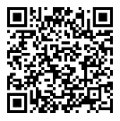
Resources
AskVA
Work Study Site Supervisor phone number: 1-855-225-1159, option 2
Work Study students may call:
1-888-442-4551
Work Study Site Supervisor Guidance Website
Notes:
Work Study Resources.

Slide 51
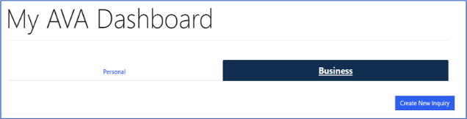
Submitting VA Work Study Documents
Ask VA (AVA)
https://ask.va.gov
Choose a Secure VA Partner
Notes:
All Work Study documents should be submitted through the GI Bill “Ask VA” (AVA) website.
You may go to the https://ask.va.gov website to set up an account and submit Work Study documents and questions.
Choose a secure VA partner to verify your identity and sign into your AskVA (AVA) account. Your options include DS Logon, ID.me, and Login.gov.

Slide 52
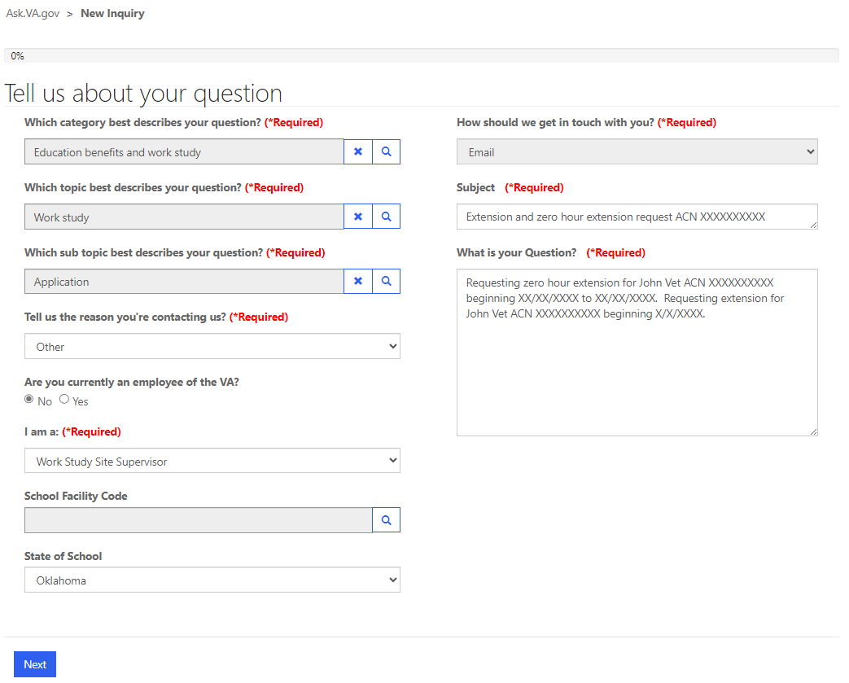

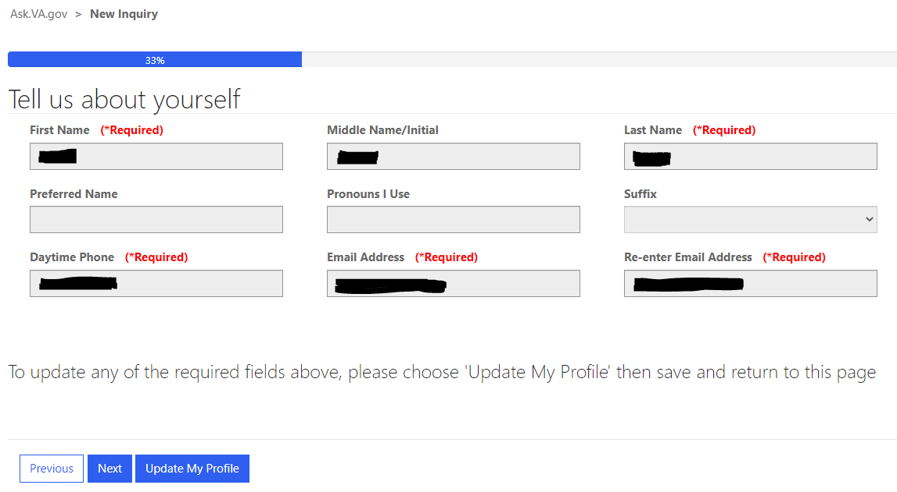

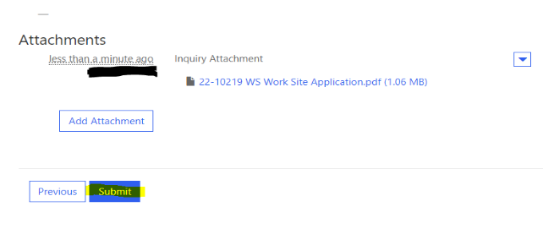

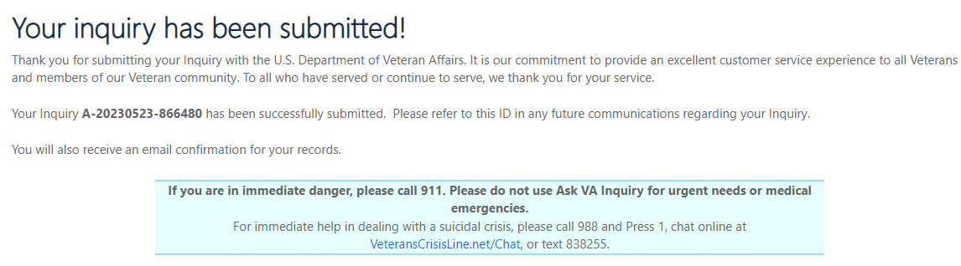

Ask VA (AVA) Submission
Notes:
Once you have a secure sign in account, you may log into your AVA account. Once in your account, select “Create New Inquiry”.
Fill out the information and click “Next”. Please note: You can choose “Work Study” as a topic after choosing “Education benefits and work study)” as the category. From there, you have a variety of Work Study related sub-topics to choose from.
Note:
• The “How should we get in touch with you?” field is automatically selected as “Email” and cannot be changed.
• If “GI Bill Beneficiary” or “Other” is chosen in the “I am a:” field, then the inquiry will be shown under the submitter’s “Personal” folder in AVA.
• If “OJT/Apprenticeship Supervisor”, “School Certifying Official“, “Work Study Site Supervisor”, or “Other (Business)” is chosen in the “I am a:” field, then the inquiry will be shown under the submitter’s “Business” folder in AVA.
The “Tell us about yourself” page will contain information from the person submitting the inquiry. Required fields must be completed. Click “Next” when the appropriate fields are filled in.
If you need to update the “Tell us about yourself” information, click on “Update My Profile”, fill out the information, scroll down to click “Submit”, and then select “Go Back”.
Review your information. You can submit attachments by clicking “Add Attachment” at the bottom of the “Review your information” page.
After submitting the inquiry, you’ll be sent to a page confirming your inquiry has been successfully submitted. This page will have the inquiry number to use for future reference. Click the home button at the top of this page to go back to the main home page.
After submitting your inquiry, you’ll see it on your “My AVA Dashboard” page. You can see the status of all inquiries on this page.
Your inquiry will show “Solved” once it has been reviewed and responded to by the VA.
To see VA’s reply message, you’ll click on the Inquiry Number and then click “Response from VA”.
You’ll receive an email from the VAVBAWAS/CO/VA_AVA_NO_REPLY mailbox confirming your AVA submission. You’ll receive another email from this same email address when VA responds to the AVA inquiry.

Slide 53

Questions?
Notes:
Are there any questions?

Slide 54

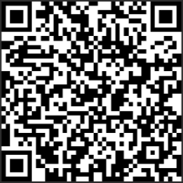
Thank You
Please feel free to take a survey of this presentation Your feedback helps us deliver better training. You can use the link or QR code to access the survey.
WAVES July 2025 Work Study Presentation Survey
Notes:
Thank you for your commitment and service to the Work Study program.
Please feel free to take a survey of this presentation.

