Slide 1
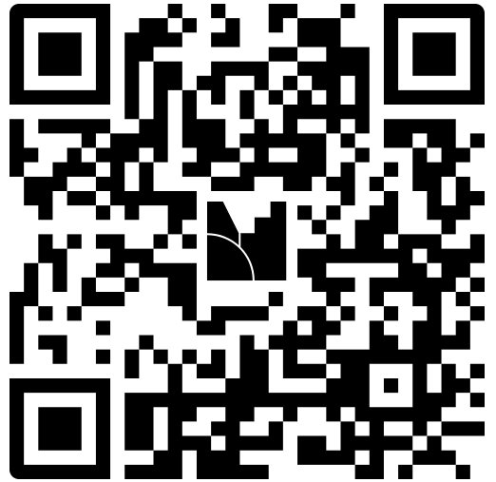
Welcome
Pleas scan QR code to complete a survey

Slide 2

A Day in the life of a School certifying official
Where's my money?

Slide 3
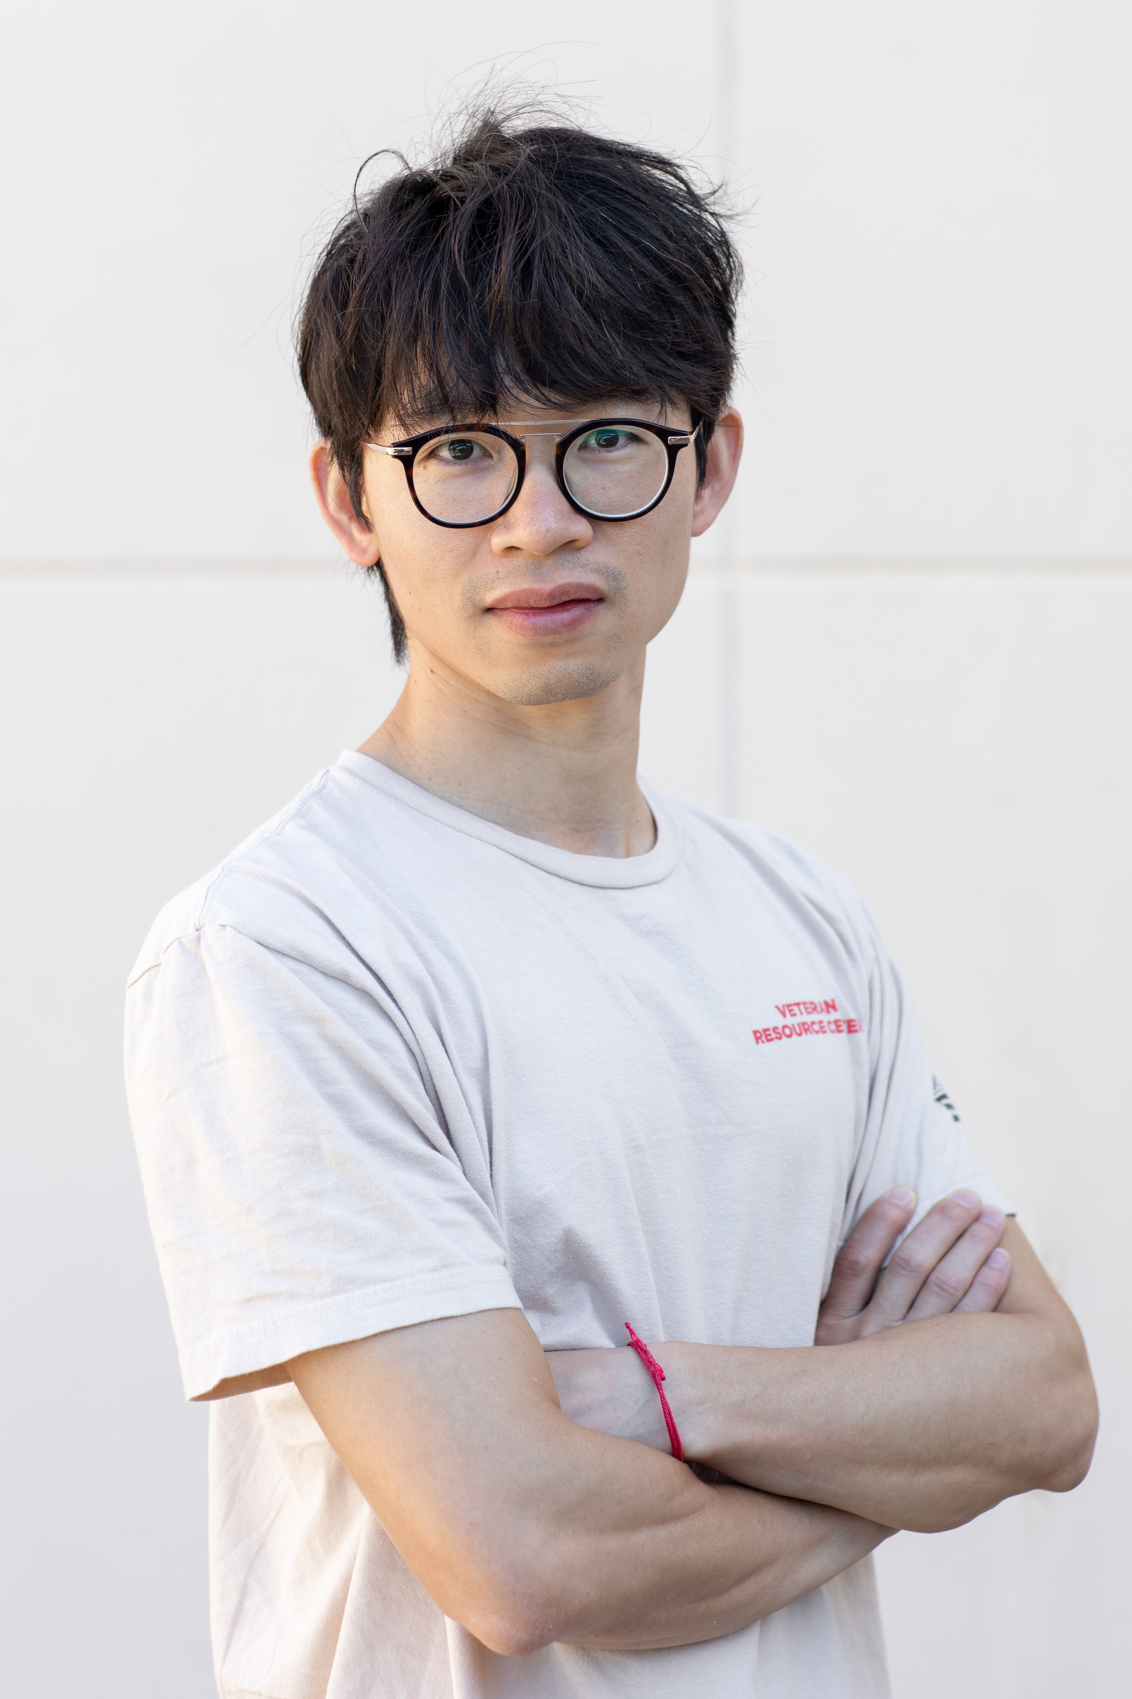
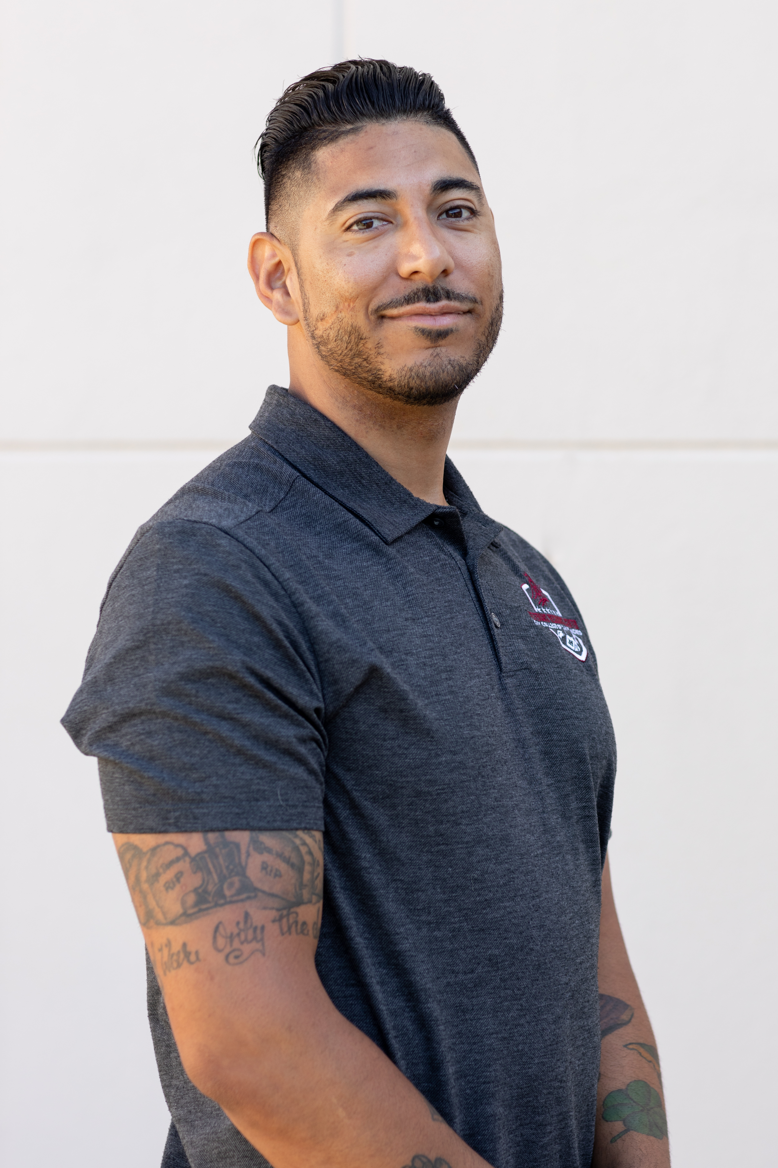
Presenters
Ray Wen, SCO
(4.5 years)
Brian Vargas, MSW VRC Manager
(5.5 years)
Target Audience:​ New/Beginner (1-3 years) School Certifying Officials

Slide 4

Goals & learning objectives
Gain Confidence
Gain Perspective
Learn how to maximize technology
Learn how to leverage your resources
Create your own network of SCOs and VRC professionals to call on at any time for support

Slide 5

Agenda
Introduction
Building confidence-Know your Stuff: SCO handbook & Title 38
Engaging the Veteran Community-Using tech & ditching paper
Two requirements must be completed to ensure compliance (Technology, ITS & ORP are your friends)
Report changes to enrollment information
Tips on changing program in EM
Final tips & takeaways/Q&A Time

Slide 6
INTRODUCTIONS
Who we are
  Brian Vargas, MSW
    VRC Manager
  Ray Wen
    SCO
Why we care, more IMPORTANTLY why we think you should care
  We care because from the top down and from the bottom up we believe our veterans are the future leaders and captions of industry this nation needs
  As the leader of our VRC, I have been through the gambit our DoD and VA have to offer. I knew the resource center I was stepping into had a lot of potential and needed leadership that: a) had lived experience in dealing with the complexities of navigating VA education benefits and b) was willing to try new tactics and be comfortable failing but a tenacity and relance that could earn the trust of the veteran population.
  I care because, when I sit across from a veteran who is physical and emotionally at their breaking point dealing with the VA, I remember all the Marines who don’t have the opportunity to achieve their academic goals because their gone.

Slide 7

Building confidence-Know your Stuff: SCO handbook & Title 38
Confidence-building strategies

Slide 8
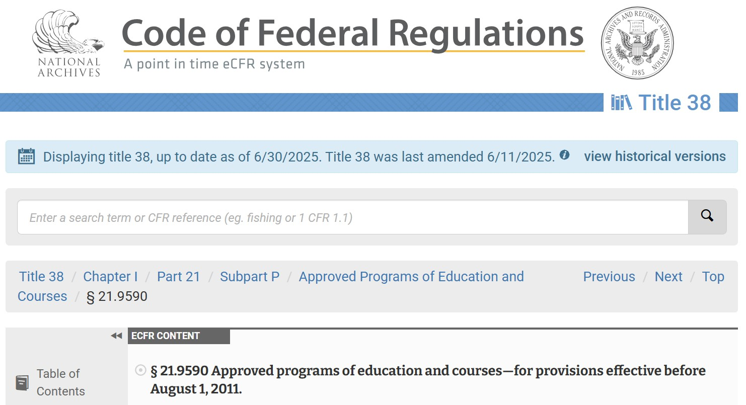

We have the va's playbook...use it!
Techniques for conveying confidence when working with an upset veteran
Keep your SCO handbook and CFR as saved tabs on your most used web browser (keep it a click away)
  School Certifying Official Handbook (On-line)
  eCFR :: 38 CFR 21.9590 -- Approved programs of education and courses.
Notes:
When communicating with your veterans make eye contact. This creates a sense of intimacy and confidence, trust us a veterans can sense "BS" a mile away. So, if you don’t know what you are talking about say to them, "you know I don’t have the answer for you, but I will find out".
There inevitably will be times when you are going to be face-to-face with an angry vet. Stay calm, be ready to pull up your SCO handbook or your eCFR. Veterans like to think we know everything, especially if another vet got a particular benefit other veterans will think, "I was a Marine also, I was that MOS and did this and that just like this guy. Why don't I get the say pay?" Its not a one size fits all benefit.
If you are on zoom, turn on your camera!
Listening to their needs may seem trivial or like a waste of time but remember they are not the experts in VA Education benefits or the certification process, you are.

Slide 9

Engaging the Veteran Community-Using tech & ditching paper
(at ccsf we use Next Gen Dynamic forms)​
Find a way to centralize your data, this will help with MIS reporting as well. We use a digital system that allows all team members to access and collaborate seamlessly.
Pro Tip: Get to know your campus Institutional Research Office
Collect certification requests
Collect documents
Allow student veterans to check their own certification status
Notes:
Brian: If you are still using paper forms, sorry but you're wrong.
Ray:

Slide 10
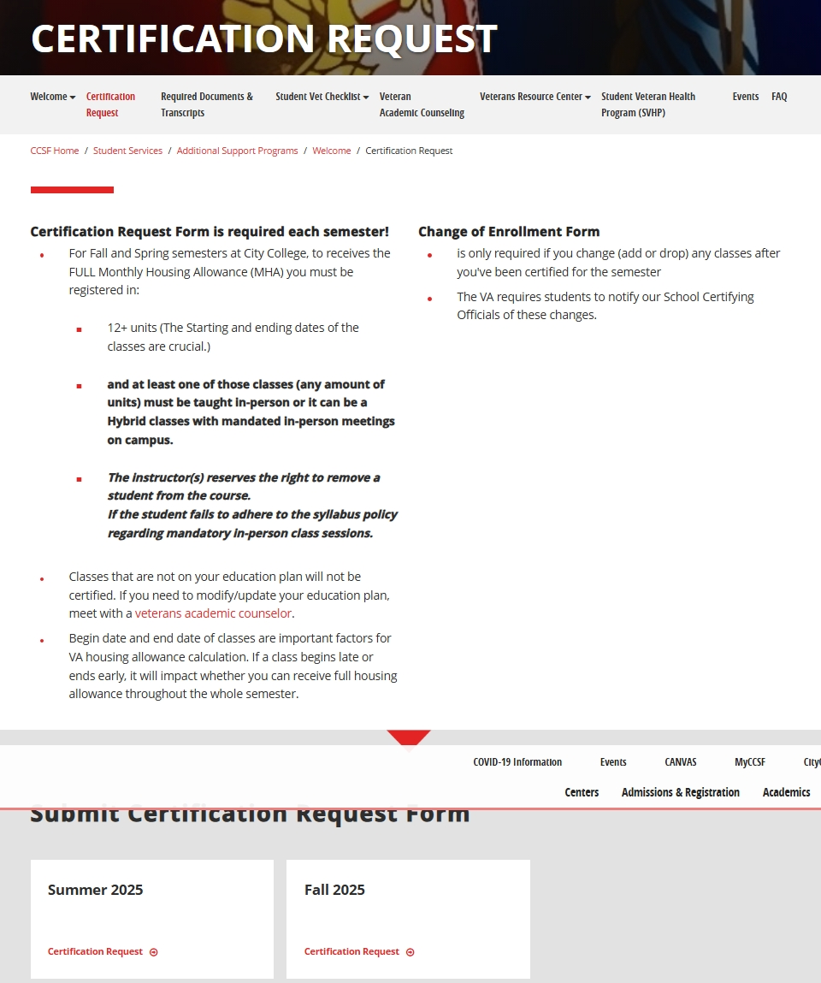
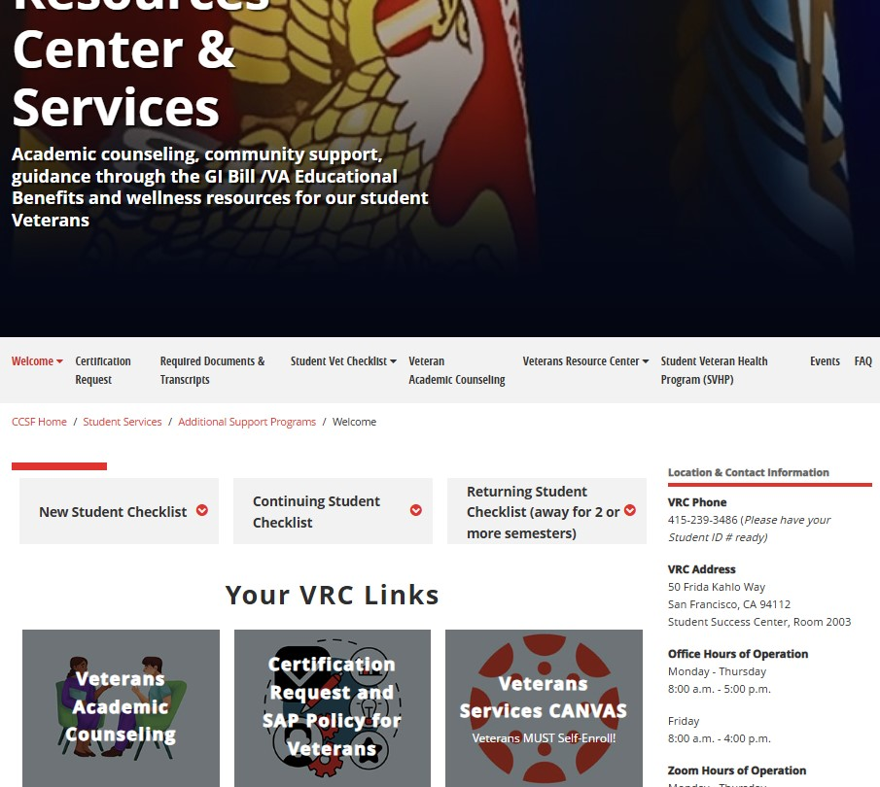
Softwrae that just works...Barney style your process
Collect certification requests​ with ease

Slide 11
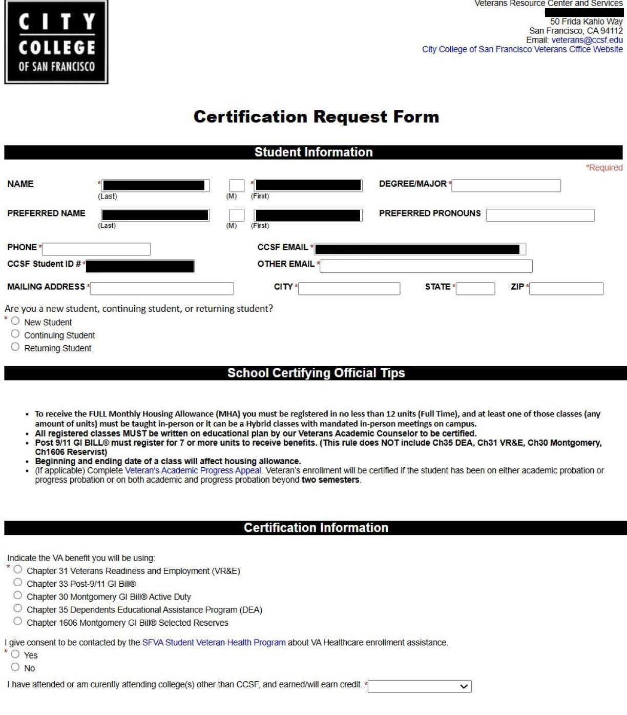
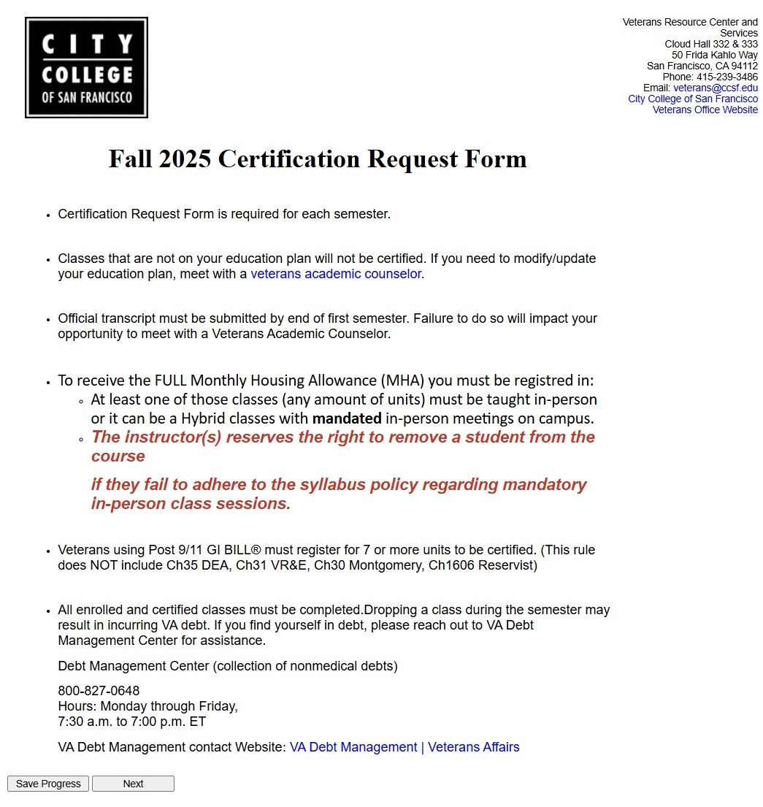
Collect certification requests

Slide 12
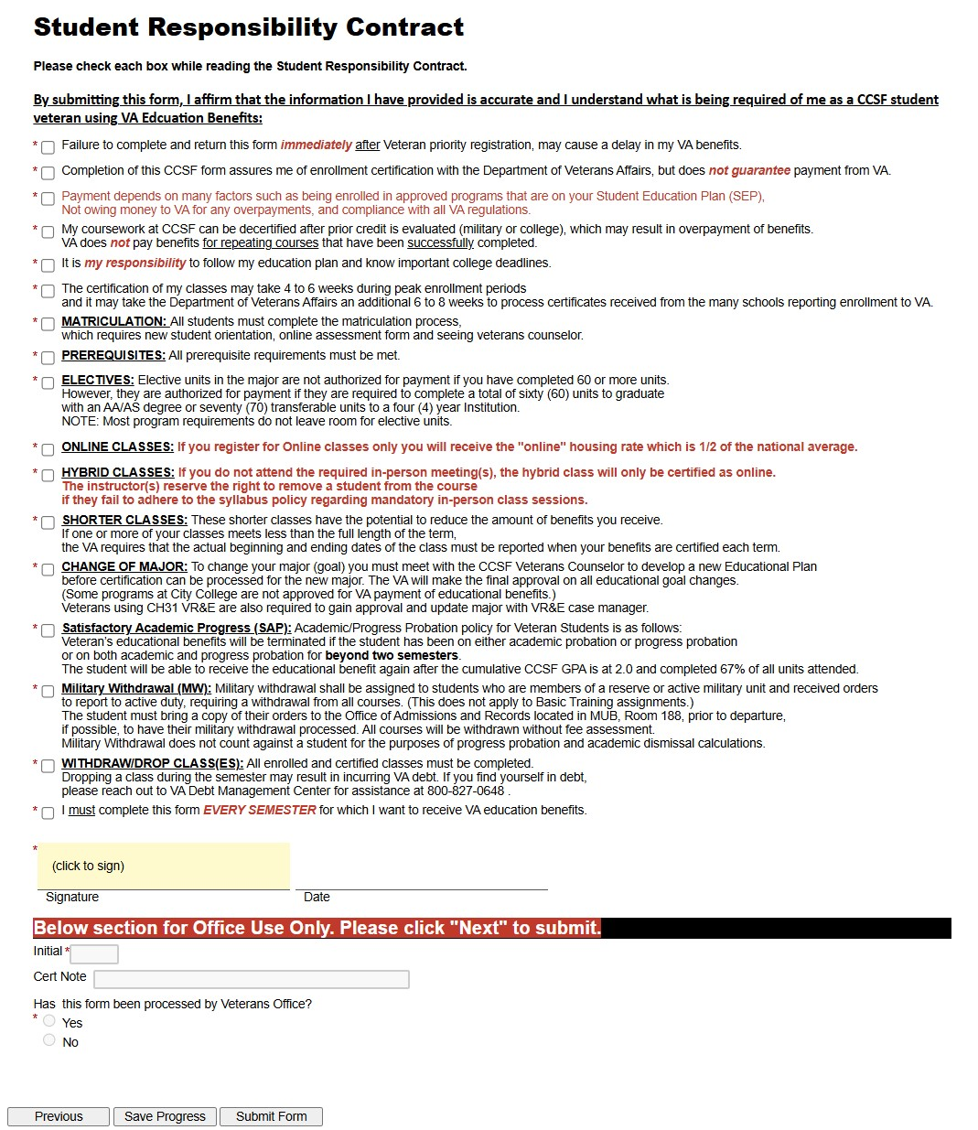
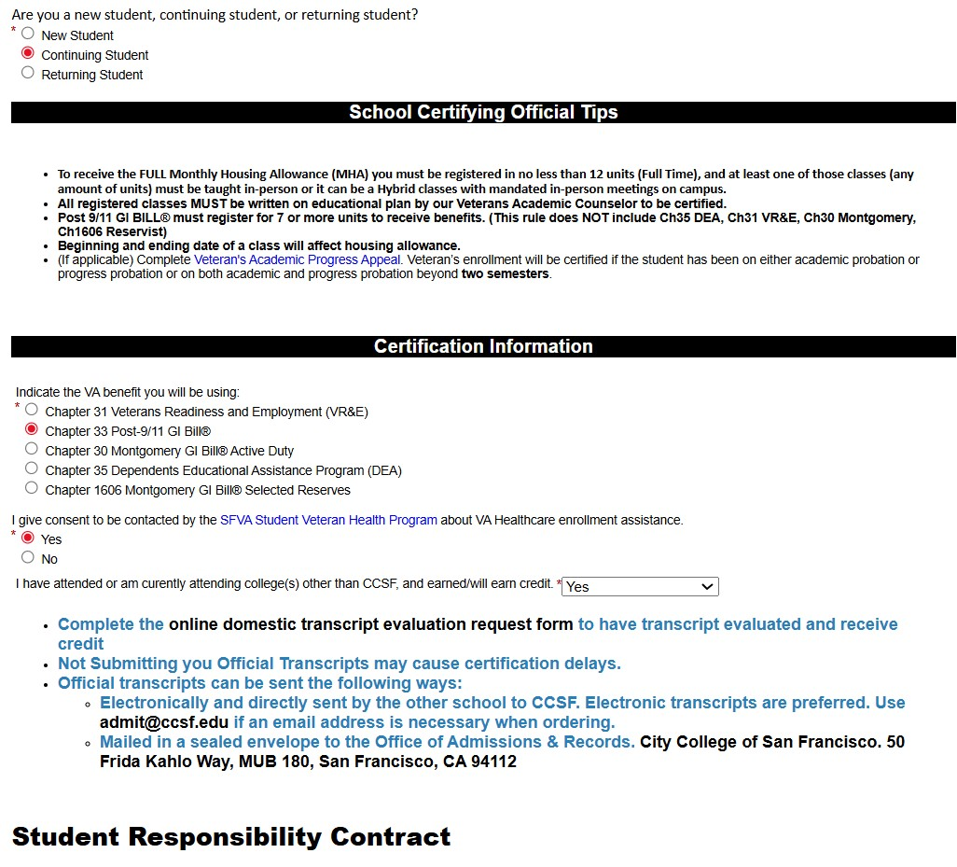
Combine the student responsibility contract with your cert request

Slide 13
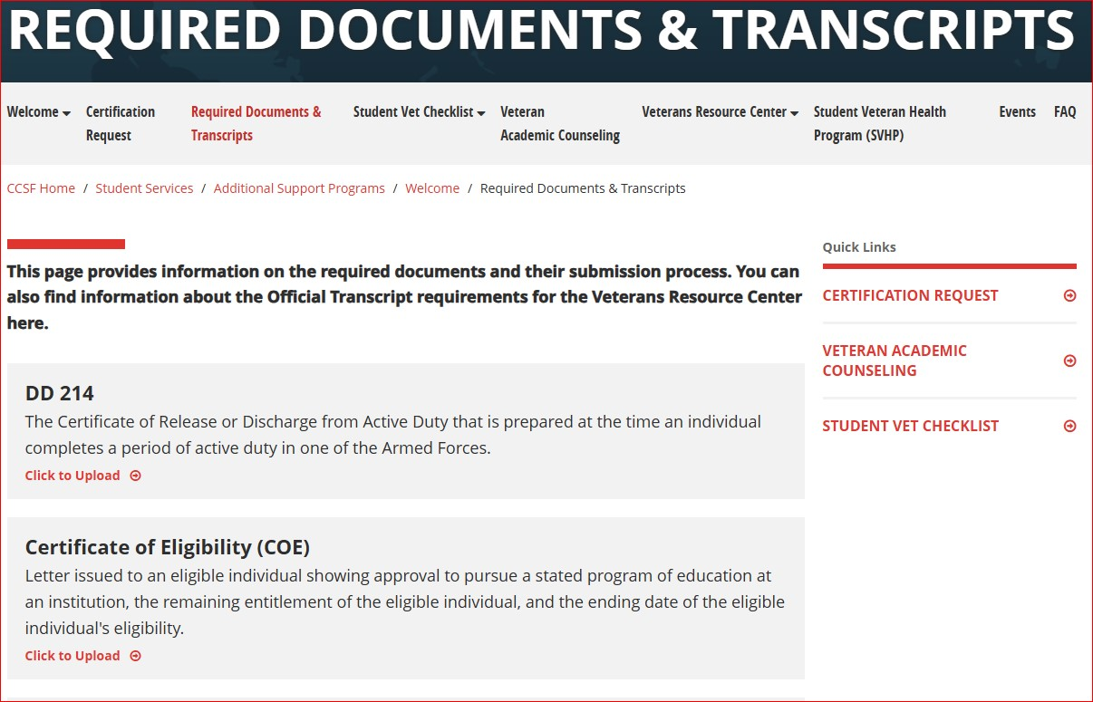
Don’t hold onto physical documents let the students upload a copy for you to store digitally

Slide 14
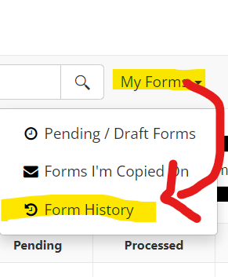
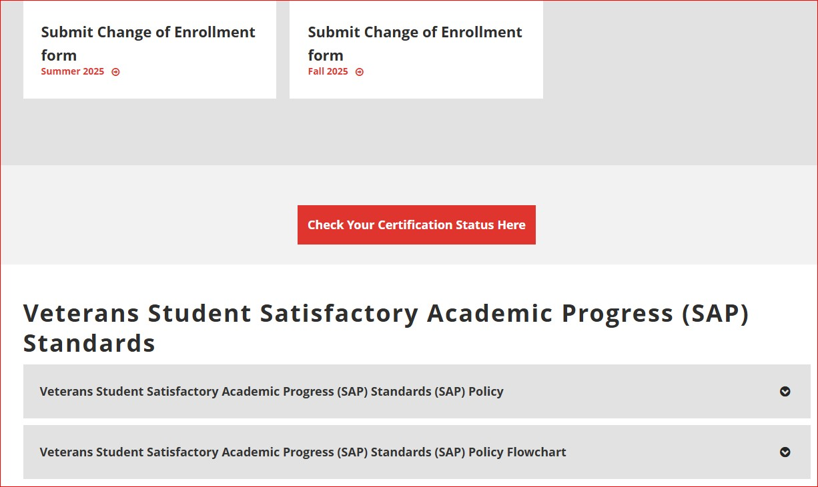
Let them have some autonomy- the power to check the status of their Cert

Slide 15

Two requirements must be completed to ensure compliance
Report changes to enrollment information
The Two (Dual) Certification Requirement
Notes:
All we learn in training/conference help you understand regulation and under compliance, data entries need to as accurate as possible
In order to not make your SCO life harder, use the data to help you
Make sure data entry not take up too much of your time. So, you can have more time for individual services

Slide 16

Report changes to enrollment information
Data needs to be collected
Class beginning date
Class ending date
add/drop date
deadline for 2nd cert
whether is CH33
units was certified
current units
certification date
Student last registration date
Our IHL uses Banner and ARGOS systems to monitor students and track if they make a change to their enrollment. This keeps us in compliment with the 30 days requirement.
Our SCOs compare the certified date to the enrollment activity date in the school system
Notes:
If your school has multiple terms (different starting dates and ending dates), this will be a good tracking system. Because one student may need to be, 2nd cert for multiple times. If your school open enrollment that student can add drop anytime and classes have multiple starting and ending, you need a system to keep track of 2nd cert. Or even better that you have a system to tell you when the 2nd cert is needed.

Slide 17
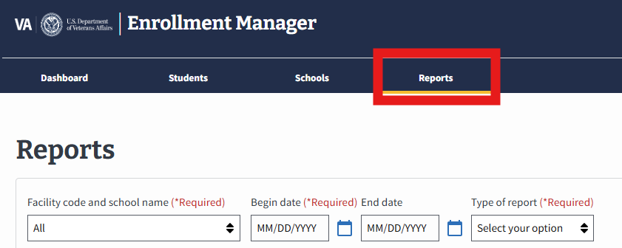
Two (Dual) Certification Requirement
Utilize reports that you can generate from EM to make sure you have subsequent enrollment certification for each initial enrollment within 30 days after drop-add period (without penalty as either an academic penalty or a financial penalty, whichever occurs first ).
Notes:
When you have a good system, it can be used to cross check your work to make sure you certify correctly

Slide 18
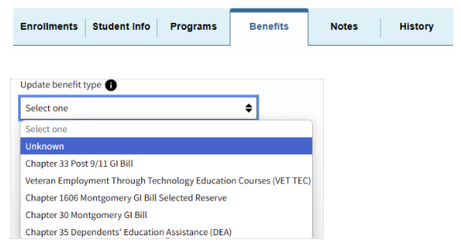
Tips on changing program in EM
When you are not able to change the program for a student veteran in EM, there is a workaround to change.
Change the benefit to Unknown first. After you change the program, change the benefit back to whichever the student is using.

Slide 19
Final tips & takeaways/Q&A Time
Continue improving
  Seek feedback from your vets
  Reflect on your performance
  Explore new techniques
  Set personal goals
  Adapt
PRACTICE MAKES PERFECT
  Consistent rehearsal
    Strengthen your familiarity
  Refine delivery style
    Confidence, tone, and emphasis

Slide 20

Thank you
Brian Vargas, MSW
Bvargas@ccsf.edu
Ray Wen, SCO
Rwen@ccsf.edu

