Slide 1

U.S. Department of Veterans Affairs
Veteran Readiness & Employment 101
Briefed by: Nick Pamperin, Executive Director
Date: July 9, 2025
Pre-Decisional

Slide 2
VR&E Mission and Vision
Mission:
  Assist Service members and Veterans with service-connected disabilities and an employment handicap prepare for, find, and maintain suitable careers, or maintain a life of independence.
Vision:
  Provide personalized world-class services empowering Veterans to achieve meaningful employment and independence.

Slide 3
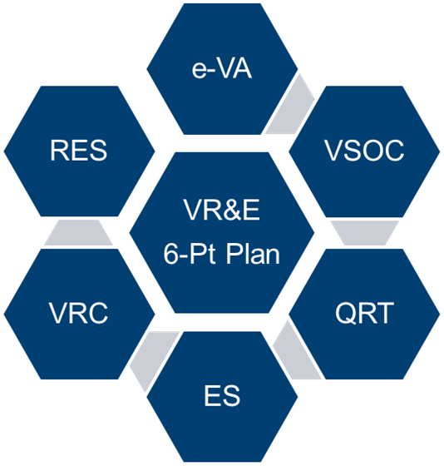

VR&E Modernization
Readiness and Employment System (RES)
Electronic Virtual Assistant (e-VA)
Quality Review Teams (QRT)
Employment Services (ES)
VRC/VRS
VSOC
Training Modernization
Strategic Roadmap
VR&E 5-Year
Strategic Roadmap

Slide 4
VR&E 6-Point Plan Overview
Project/Initiative | Overview
Readiness & Employment System (RES) | RES integrates modernization improvements, reengineers processes to support a digital and paperless environment, and allows for streamlined case management.
Electronic Virtual Assistant (e-VA) | National Program and Implementation Team (NPIT) proposed a new workflow process to leverage e-VA for automation of Chapter 31 letters and forms.
VetSuccess on Campus (VSOC) | Transition the VSOC Counselor role, allowing the VSOC Specialists to spend more time performing adjustment counseling, benefits coaching, educational/career counseling, and outreach activities to include events and referrals.
Vocational Rehabilitation Counselor (VRC) Recruitment | VR&E has worked to develop a comprehensive approach to VRC recruitment and retention.
Employment Services (ES) 2.0​ | VR&E developed a new and consistent means of delivering employment services at each regional office. The pilot aims to ensure consistent roles and responsibilities of employment coordinators and increase employment opportunities for Veterans.
Quality Review Team (QRT) | VR&E’s new Internal Review Team and Quality Review Team will improve consistency and error trend analysis to deliver targeted training for VRCs by using dedicated Quality Review Specialists.

Slide 5
Veteran Readiness and Employment
The Veteran Readiness & Employment program, Chapter 31, helps Service members and Veterans with service-connected disabilities and a barrier to employment prepare for, find, and maintain suitable jobs through counseling and case management.
For Veterans and Service members who meet the criteria for entitlement to services, VR&E provides:
Interest and aptitude testing, and career counseling
Job training, job-seeking skills, resume development, and work-readiness assistance
Special employer incentives, on-the-job-training, and non-paid work experiences
Post-secondary training at a college, vocational, technical or business school
Independent living services for individuals who are not currently able to work because of the effects of service-connected disabilities and who require intensive and frequent rehabilitation support to become more independent in their homes and communities
Service members with disabilities participating in the Integrated Disability Evaluation System (IDES) under the National Defense Authorization Act (NDAA) receive automatic VR&E entitlement.

Slide 6
Key Services Provided
Over 1,100 professional VRCs and over 2,000 employees serve Veterans through a network of nearly 350 office locations to deliver over $2.0B annually to over 174,000 Veterans.
The service delivery model works to support Veterans where they are located and includes operations at 56 regional offices, the National Capital Region Benefits Office, approximately 142 out-based offices, 70 IDES installations, and 104 VSOC schools/sites.
VSOC
    The program collaborates with 104 schools across the country to provide educational/vocational counseling and other on-site services to an available population of nearly 86,000 student Veterans on campus.
IDES
    The program expanded early intervention counseling and other available services for wounded, ill, injured, and other transitioning Service members at 70 military installations.

Slide 7
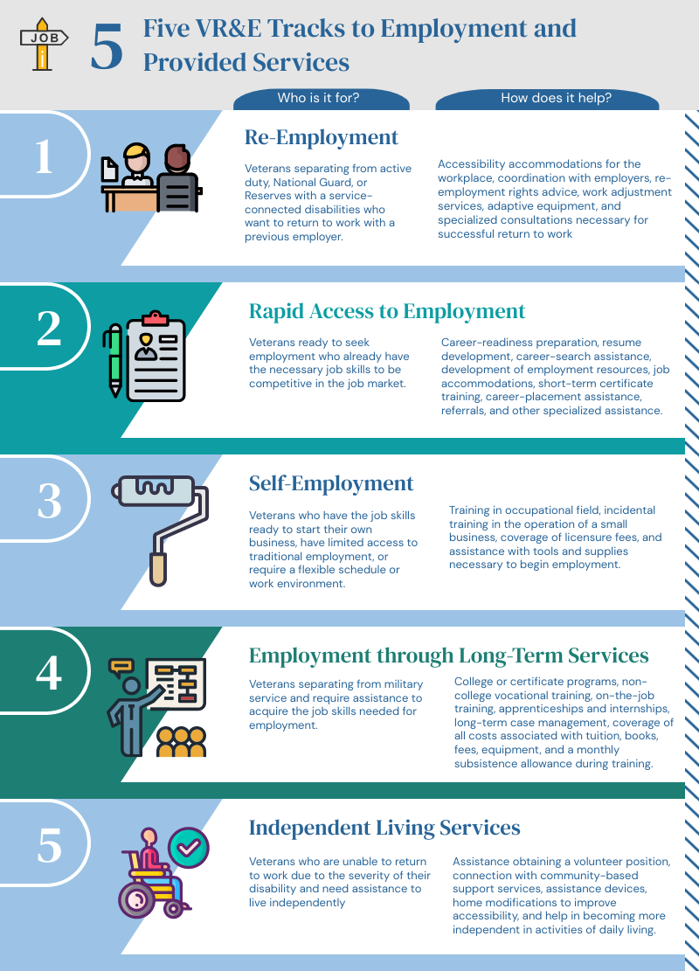
Five Tracks to Employment
Program participants receive services through one of the Five Tracks to Employment, which include:
Track 1: Re-Employment
  194 participants
Track 2: Rapid Access to Employment
  2,972 participants
Track 3: Self-Employment
  367 participants
Track 4: Employment through Long-Term Services
  110,233 participants
Track 5: Independent Living Services
  575 participants
Data from July 1, 2025.

Slide 8
Chapter 31 Eligibility and Entitlement – Veterans
Eligibility:
  Honorable or other than dishonorable discharge.
  Department of Veterans Affairs (VA) service-connected disability rating of at least 10% or a memo rating of 20%.
  Apply for VR&E services.
  Entitlement:
  Entitlement based on establishment of employment handicap resulting from a service-connected disability.
  Serious employment handicap needed to establish entitlement for Veterans rated 10%.

Slide 9
Chapter 31 Eligibility and Entitlement – Service members
Eligibility:
  Expect to receive an honorable discharge upon separation from active duty.
  Apply for VR&E services.
  Obtain a memorandum rating of 20% or a proposed IDES rating from VA.
  Automatic Entitlement:
  Service members who meet eligibility have automatic entitlement.
  Sec. 1631(b) of the NDAA (PL 110-181) established VR&E eligibility and automatic entitlement for severely injured active-duty individuals before a VA rating is issued. This became a permanent law on September 30, 2018.

Slide 10

On-Campus Assistance through VSOC
VSOC Counselors provide:
  Adjustment counseling to resolve problems interfering with completion of education programs and entrance into employment
  Vocational testing
  Personalized Career Planning & Guidance (PCPG), formerly known as Educational and Career Counseling, or Chapter 36
  Expedited Veteran Readiness & Employment services
  Support and assistance to all Veterans with VA benefits regardless of entitlement, benefit usage, or enrollment status

Slide 11
Integrated Disability Evaluation System (IDES)
  IDES VRCs help wounded, ill, or injured Service members smoothly transition from the military to civilian life.
  IDES assists Service members to enroll in VA and apply for benefits.
  IDES VRCs guide Service members to education or training and viable post-military careers.
  Sec. 1631(b) of the NDAA (PL 110-181) established VR&E eligibility and automatic entitlement for individuals going through IDES before a VA rating is issued. This became a permanent law on September 30, 2018.
  In FY 2024, IDES VRCs interacted with 19,078 Service members going through the IDES process.

