Slide 1
SCO Workshop
SHARED EXPERIENCES WITH THE CEVSS -
CENTERS OF EXCELLENCE FOR
VETERAN STUDENT SUCCESS GRANT
Thursday, July 18, 2024
3:30-5 pm

Slide 2

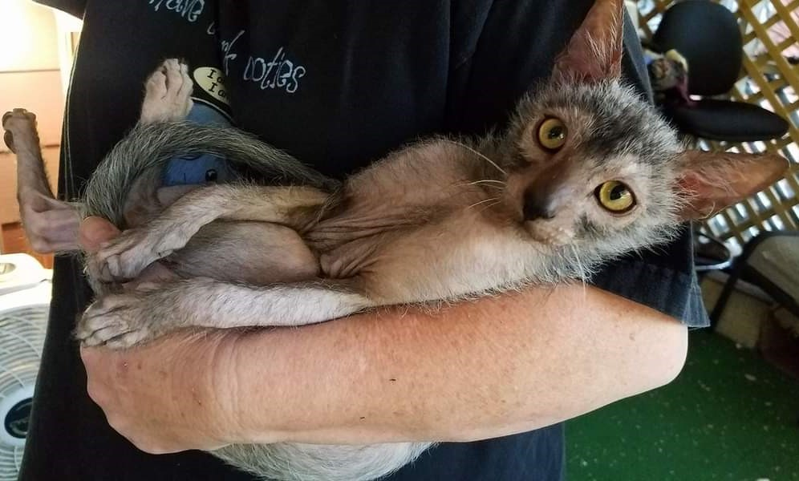
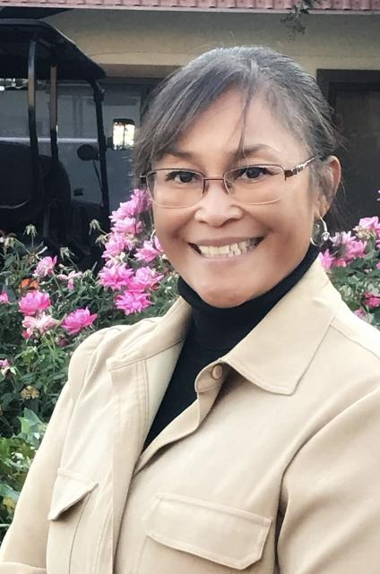

Panel Presenters
Dominic Barnes - Kansas State University
I served 27 years in the Army and retired as a Sergeant First Class (E7) in 2015. Most of my time was as an MP but I did serve in the artillery early in my career. I have two combat deployments to Iraq and one peacekeeping deployment to Bosnia-Herzegovina under my belt.
Currently I work for K-State as the Military Student Services Coordinator. In this role I recruit and support military affiliated students. My office is located in the Fort Riley Education Center so I primarily interact with active-duty soldiers, spouses, and veterans.
I am also a PhD Candidate studying the experiences of active-duty service members who volunteer their time in community non-profit organizations.
Best yet, I am the proud grandfather of 3 great kids!
I have several Lykoi cats living with me.
Evelyn Andrew - Las Positas College
I am the daughter of a Navy Veteran - Korean war, and daughter-in-law of a Marine Corps Vietnam Veteran.
I oversee the mission, vision and goals of the Veterans First Program at Las Positas College in Livermore, California. Working on a Doctorate in Educational Leadership at St Mary's College-California, I also have a master's degree in counseling, and bachelor's degree in communications. I have over 25 years of experience serving students in higher education - private and public institutions. I am excited to assist veterans and military affiliated students in achieving their educational goals.
Veterans Program Supervisor
Phone: 925.424.1572
Email: eandrews@laspositascollege.edu

Slide 3
What is the CEVSS Grant?
CEVSS is the Center of Excellence for Veteran Student Success
funded by the Department of Education
Required grant activities include:
Establishing a Center of Excellence for Veteran Student Success on the campus of the institution to provide a single point of contact to coordinate comprehensive support services for veteran students;
Establishing a veteran student support team, including representatives from the offices of the institution responsible for admissions, registration, financial aid, veterans benefits, academic advising, student health, personal or mental health counseling, career advising, disabilities services, and any other office of the institution that provides support to veteran students on campus;
Providing a coordinator whose primary responsibility is to coordinate the model program;
Monitoring the rates of veteran student enrollment, persistence, and completion; and
Developing a plan to sustain the Center of Excellence for Veteran Student Success after the grant period.

Slide 4
What is the CEVSS Grant?
CEVSS is the Center of Excellence for Veteran Student Success
funded by the Department of Education
Other authorized activities for support of veteran students:
Outreach and recruitment of such students;
Supportive instructional services for such students, which may include--
  personal, academic, and career counseling, as an ongoing part of the program;
  tutoring and academic skill-building instruction assistance, as needed; and
  assistance with special admissions and transfer of credit from previous postsecondary education or experience.
Assistance in obtaining student financial aid;
Housing support for veteran students living in institutional facilities and commuting veteran students;
Cultural events, academic programs, orientation programs, and other activities designed to ease the transition to campus life for veteran students;
Support for veteran student organizations and veteran student support groups on campus;
Coordination of academic advising and admissions counseling with military bases and national guard units in the area; and
Other support services the institution determines to be necessary to ensure the success of veterans in achieving educational and career goals.

Slide 5

Kansas State University
Background
Located in North East Kansas - Manhattan and Salina
We are the nations’ first operational Land-Grant University
Host to military students since 1863 starting with 6 students from Fort Riley, KS
Our military affiliated student population support activities are decentralized.
We are located 10 miles from Fort Riley, home to the 1st Infantry Division (Big Red 1).
K-State has school liaisons located at Fort Riley, KS and Fort Leavenworth, KS
Partnership with the US Army Command and General Staff College
Enrollment:
Largest military-affiliated student population in Kansas
Approximately 20,000 students on campus and online
Veterans & Military Families: Over 12% of the student body
1,000 certified for VA education benefits
80 active-duty students using Federal TA
  Mostly Army. Then Air Force, Navy, Marine Corps, and Coast Guard.
  Large number of KS National Guard. KS pays for a bachelor’s degree for guard members
Military Affiliated Resource Center (MARC) positions
CEVSS-funded staff
FT: MARC Director. Hired in 2023
FT: MARC Academic and Career Engagement Coordinator. Interviewing.
FT Therapist for Veteran & Military Affiliated. Position open.

Slide 6
Kansas State University
CEVSS Goals & Grant Outcomes
Year 1: Hire three funded positions.
Year 2: Build cross-campus teams and integrate support
Year 3: Sustained funding and impact recruiting and retention
The Kansas State University Center of Excellence for Veteran Student Success is a marketing tool and proof of mission

Slide 7
Kansas State University
Teachable Moments
Submit CEVSS application. Do not wait.
Money is a change agent.
Funded positions may not guarantee applicants.
Integrate of CEVSS positions into Org Charts

Slide 8
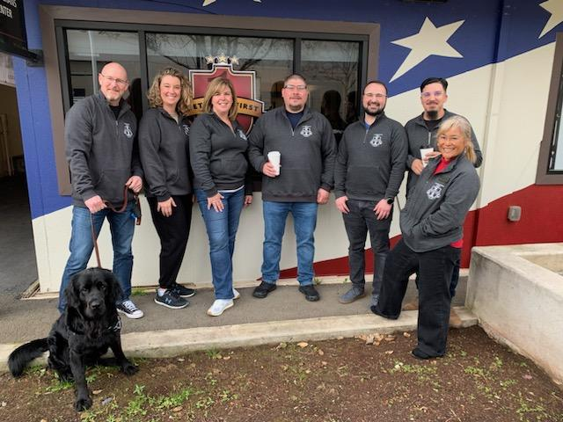

Las Positas College
Background:
Located in Northern California -
Livermore, California
Enrollment:
Approximately 8,000
Veterans & Military Families:
Over 400 self identified; approximately 160 certified for VA education benefits
Veterans Resource Center Staffing:
FT: Veterans Program Supervisor; FT: Veterans Specialist; FT Veterans Counselor: PT Veterans Counseling Assistant; PT Veterans Outreach Specialist; 2 PT Veterans Success Coaches - GRANT FUNDED

Slide 9
Las Positas College
8 Keys to Veterans’ Success
Executive Order, 13607, Principles of Excellence
Dept of Education - "8 Keys to Veterans' Success" are steps that postsecondary institutions can take to assist Veterans and Service members in transitioning to higher education, completing their college programs, and obtaining career-ready skills.
1. Create a culture of trust and connectedness across the campus community to promote well being and success for Veterans.
2. Ensure consistent and sustained support from campus leadership.
3. Implement an early alert system to ensure all Veterans receive academic, career, and
financial advice before challenges become overwhelming.
4. Coordinate and centralize campus efforts for all Veterans, together with the creation of a
designated space (even if limited in
5. Collaborate with local communities and organizations, including government agencies, to align and coordinate various services for Veterans.
6. Use a uniform set of data tools to collect and track information on Vete rans, including
demographics, retention and degree completion.
7. Provide comprehensive professional development for faculty and staff on issues and
challenges unique to Veterans.
8. Develop systems that ensure sustainability of effective practices for Veterans.

Slide 10
Las Positas College
Veterans Success Coaches
CEVSS Grant Goals
Year 1: Increase Academic Success
**Mission Ready Veterans Learning Community
Year 2: Increase Diversity Amongst Veterans
**Outreach opportunities in the community
Year 3: Increase career search opportunities for Veterans

Slide 11
Las Positas College
Teachable Moments - draft
Identify signature events and document outcomes
Be ultra organized with scanning and saving documents or evidence in a shared folder
Work closely with Business Office to ensure grant budget is spent down (use or lose)
Share “veterans success coach” video recap.

Slide 12
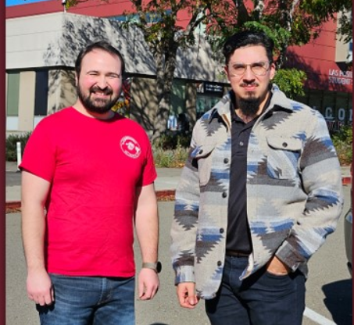
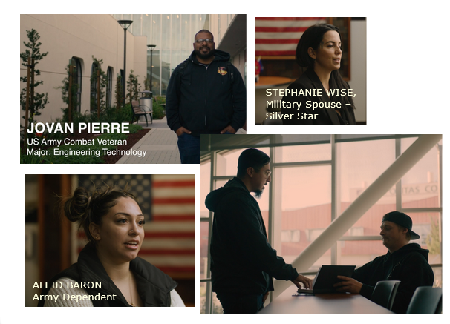
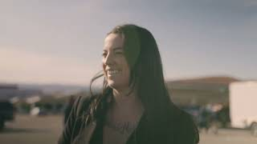
Las Positas College
“Sense of Belonging” Video
Veterans Success Coaches
Gino Marquand &
Edgar Reyes
Both USMC veterans
Both LPC Alumni
Both Transfer to 4 yr universities

Slide 13
Questions & Answers
Open Discussion, Conversation
Thank you for attending!

