Slide 1
U.S. Department of Veterans Affairs
Muskogee VA RPO
Education Update July 2024
Notes:
Introduction.

Slide 2
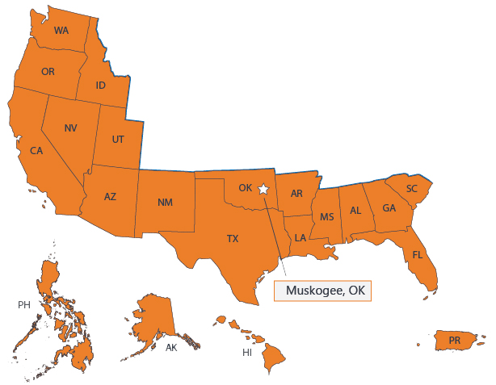
Jurisdictional Information
The Muskogee RPO is one of two offices that process Education benefit claims, Buffalo being the second.
Muskogee manages about 52 percent of the nation’s workload overseeing 20 states and the Trust Territories/Philippines.
Muskogee is also home to the Education Call Center (ECC).
Muskogee’s Education division is staffed at 548 employees (to include management), and the ECC is currently staffed at 328 employees.
Notes:
With a ceiling of 567 for the RPO and 384 for the ECC. EDU and ECC have a total of 876 with a ceiling of 951.

Slide 3
Workload
Original Claims received for the period October – June
FY23 – 144,395
FY24 – 162,009
A 12% increase in original claims
this fiscal year
Notes:
For the FY24 period October 23- May 24, we see a 12% increase with original claims.

Slide 4
Workload
Supplemental Claims received for the period October – June
FY23 – 1,809,235
FY24 – 2,133,525
A 17% increase in supplemental claims
this fiscal year
4
Notes:
These numbers do include automation. This FY, we’ve advanced to see almost a 16% increase in automation.

Slide 5
Original Claims Processing Highlights
Original Claims Processed
FY22 – 181,435
FY23 – 198,432
FYTD | Muskogee | Automation | Total
FY22 | 181,435 | 0 | 181,435
FY23 | 182,149 | 16,283 | 198,432
FY24 | 122,962 | 24,552 | 147,514
*FYTD= Oct 1- Jun 30
5
Notes:
FYTD data includes automation numbers.
We do not see a significant change from FY22 to FY23 (.39% increase). However, automation (to process those claims with very basic service data) of Original claims processing began in FY23. We can see that during FY23, automation handled about 8% of original claims. All claims automated were manually reviewed for accuracy. So far this FY, automation efforts have increased to 16% as we advance the DGI rules as to what can / can’t be automated. VA is continuing to review 100% of all automated originals.

Slide 6
Supplemental Claims Processing Highlights
Supplemental Claims Processed
FY22 – 1,712,592
FY23 – 1,815,190
FYTD | Muskogee | Automation | Total
FY22 | 1,028,607 | 683,985 | 1,712,592
FY23 | 1,020,143 | 795,047 | 1,815,190
FY24 | 710,027 | 702,334 | 1,412,361
FY24= Oct 1- Jun 30
6
Notes:
We continue to increase our output year over year, and we are currently outpacing our totals from prior years, with the help of automation.

Slide 7
Performance Targets - Timeliness
Original ADP Months Met: 9 Target: 11
Supplemental ADP Months Met: 9 Target: 10
Original ADC Months Met: 9 Target: 12
Supplemental ADC Months Met: 8 Target: 11 Without Automation
Notes:
Data does not include automation.
Over 30 and over 60 days are minimal.

Slide 8
Quality
National QA Review
 | OCT | NOV | DEC | JAN | FEB | MAR | APR | MAY | JUN | JUL | AUG | SEP | FYTD
MUSK | 96% | 99.5% | 100% | 95.9% | 97.6% | 92.8% | 100% | 99.5% |  |  |  |  | 97.6
USA FYTD | 98.3% | 98.4% | 98.5% | 98.5% | 98.4% | 98.1% | 98.1% | 98.1% |  |  |  |  | 98.3
MUS FYTD | 97.9% | 98.1% | 98.4% | 98.3% | 98.4% | 97.8% | 97.8% | 97.9% |  |  |  |  | 98
Training Focus:
EQTS is performing refresher training weekly in the team huddles. National and local error trends are covered, as well as any changes in policy and procedures. ​
Completed Training:​
Quality & Wellness Stand-down
Release 6
Rudisill
Upcoming/Ongoing Training:
Ongoing New VCE/Upstream/Work Study Training
eMPWR Training
Error Trend Analysis Training
Notes:
Muskogee does weekly team training to keep us apprised of all policy and procedural changes, and any trends that are identified on the processing floor and in the ECC.

Slide 9
Veteran Rapid Retraining Assistance Program (VRRAP)
Muskogee RPO VRRAP Team began processing VRRAP applications effective, May 5, 2021.
As of June 2024:
Enrollment
Total Enrolled: 13,653 (change due to information received allowing veteran back into VRRAP)
Currently enrolled in a program: 298
Completed: 13,355
Graduation: 7,980
W/D or Terminated: 3,554
No report of Graduation: 1,821 or Termination received: 1,863
Employed in related field: 2,217
Payments Released
Total payments released – $320,413,347.04
MHA payments - $163,273,038.73
T&F payments - $157,140,308.31
Pending Completion
Based on current data:
2024 – 263 scheduled to graduate
2025 – 34 scheduled to graduate (change due to school changing program end date)
2026 –1 scheduled to graduate May 30, 2026

Slide 10
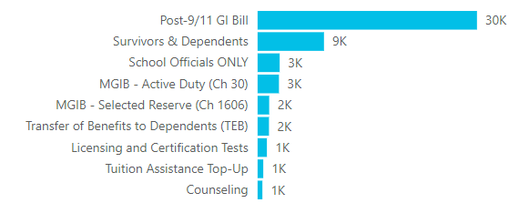
Ask VA Inquiries
Ask VA Receipts & Inventory
Topics by Inquiry Type
Notes:
Ask VA replaced the Ask a Question portal in October of 2021. Ask VA continues to be a useful and reliable resource in that claimants can send and receive timely responses relating to their Education questions. Currently this fiscal year, Muskogee has received a total of 53,895 inquiries relating to GI Bill Education benefits. On average submitters can expect to receive a response within 24 to 48 hours– and our average response time for this fiscal year is currently 1.7 days. Keep in mind this response time does vary depending on workload volume.
EM- Ask VA does not have the ability to assist with Enrollment Manager issues. Please make sure you are using the SCO Matrix or contacting the ECC SCO line if you have issues relating to that. Ask VA can assist with specific questions as it relates to the enrollment itself, but not the EM platform.
VA Hotline inquiries- This FY, Education has received 209 inquiries relating to Ch33 and Non33 benefit questions. Response time averages 5 to 7 business. Reminder to direct students to ECC and or Ask VA for Education related questions. Claimants may be able to get quicker responses through these avenues.
We continue to review Ask VA to improve customer experience. In the near future, submitters can expect to see fewer required fields to complete when submitting an inquiry. As a reminder– a submitter must be authenticated in order to submit and receive a response when selecting the Education category.

Slide 11
Work Study Highlights
Claims Processed Participating Facilities Participating Students
73,375 1,524 8,700
Applications
Time Records
Contract Extensions
11
Notes:
During the period October – June of this fiscal year, WS has processed a total of 73,375 claims (applications, extensions, and time records). We currently have 1,524 active work sites and roughly around 8700 students participating in the VA Work Study program.
FYTD- VA has paid a total of $36,759,751.29 in Work Study benefits.
The graphs provide a view at the work load completed each month and the average days it took to complete.
Work Study’s timeliness requirement is 7 days to process applications and contract extensions and 5 days for processing time records. As illustrated, our timeliness goals for this fiscal year are under the 7- and 5-day requirement.

Slide 12
Education Call Center
Notes:
Total incoming calls for FY24 to date (through May 31) is 1,627,607 calls with a 97% answer rate.
Current average quality through May is 97.2%. Our goal is 96% or higher.

Slide 13
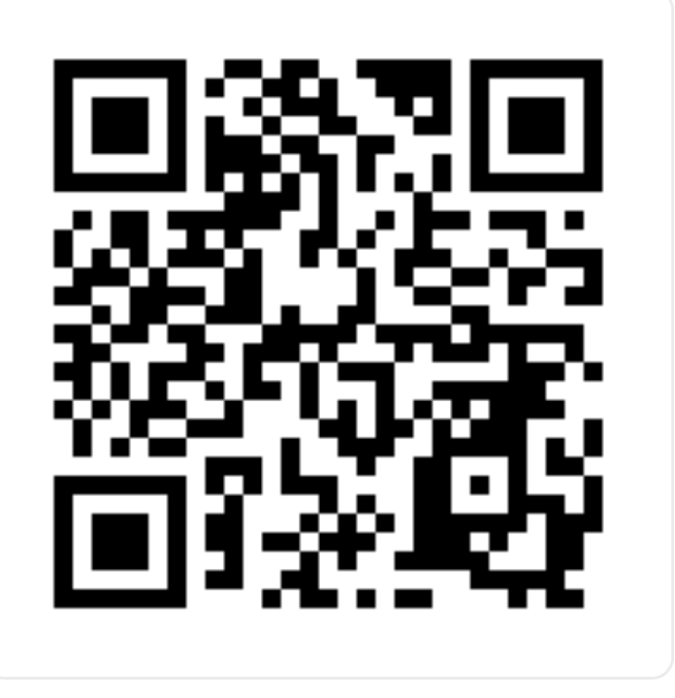
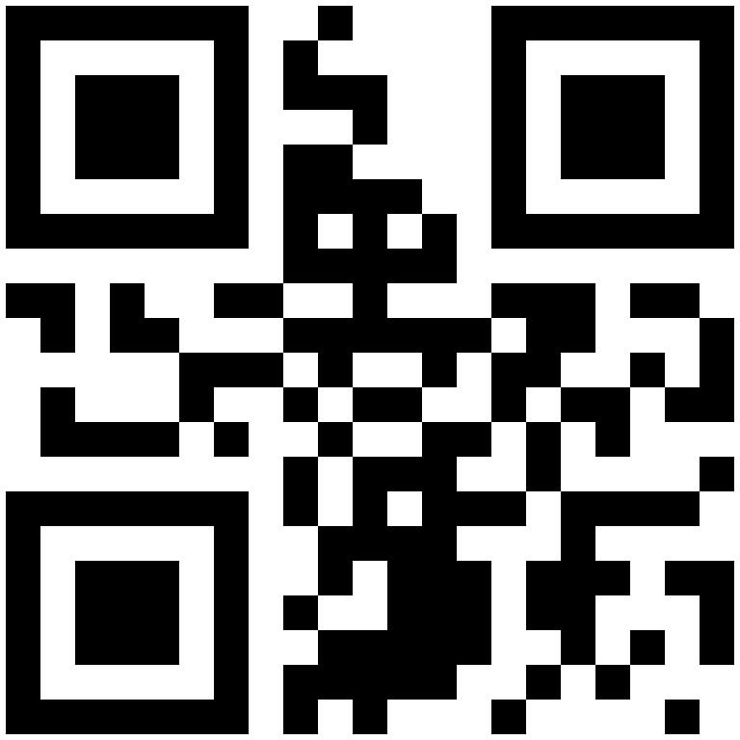
Resources and Contact Information
Phone: 888-GIBILL-1 (888-442-4551). Call between 7 a.m. - 6 p.m. CST, Monday-Friday
School Representatives: 855-225-1159, Option 1
Gov Delivery: https://public.govdelivery.com/
GI Bill Website: https://benefits.va.gov/gibill/ QR Code#1
Ask VA website: https://ask.va.gov/ QR Code#2
QR#1 QR#2

