Slide 1
Creating a Successful Student Veterans of America Chapter
Olivia Brinsfield, Outreach Coordinator
Notes:
KW: Don’t’ forget to include your student’s name as well!! ☺

Slide 2
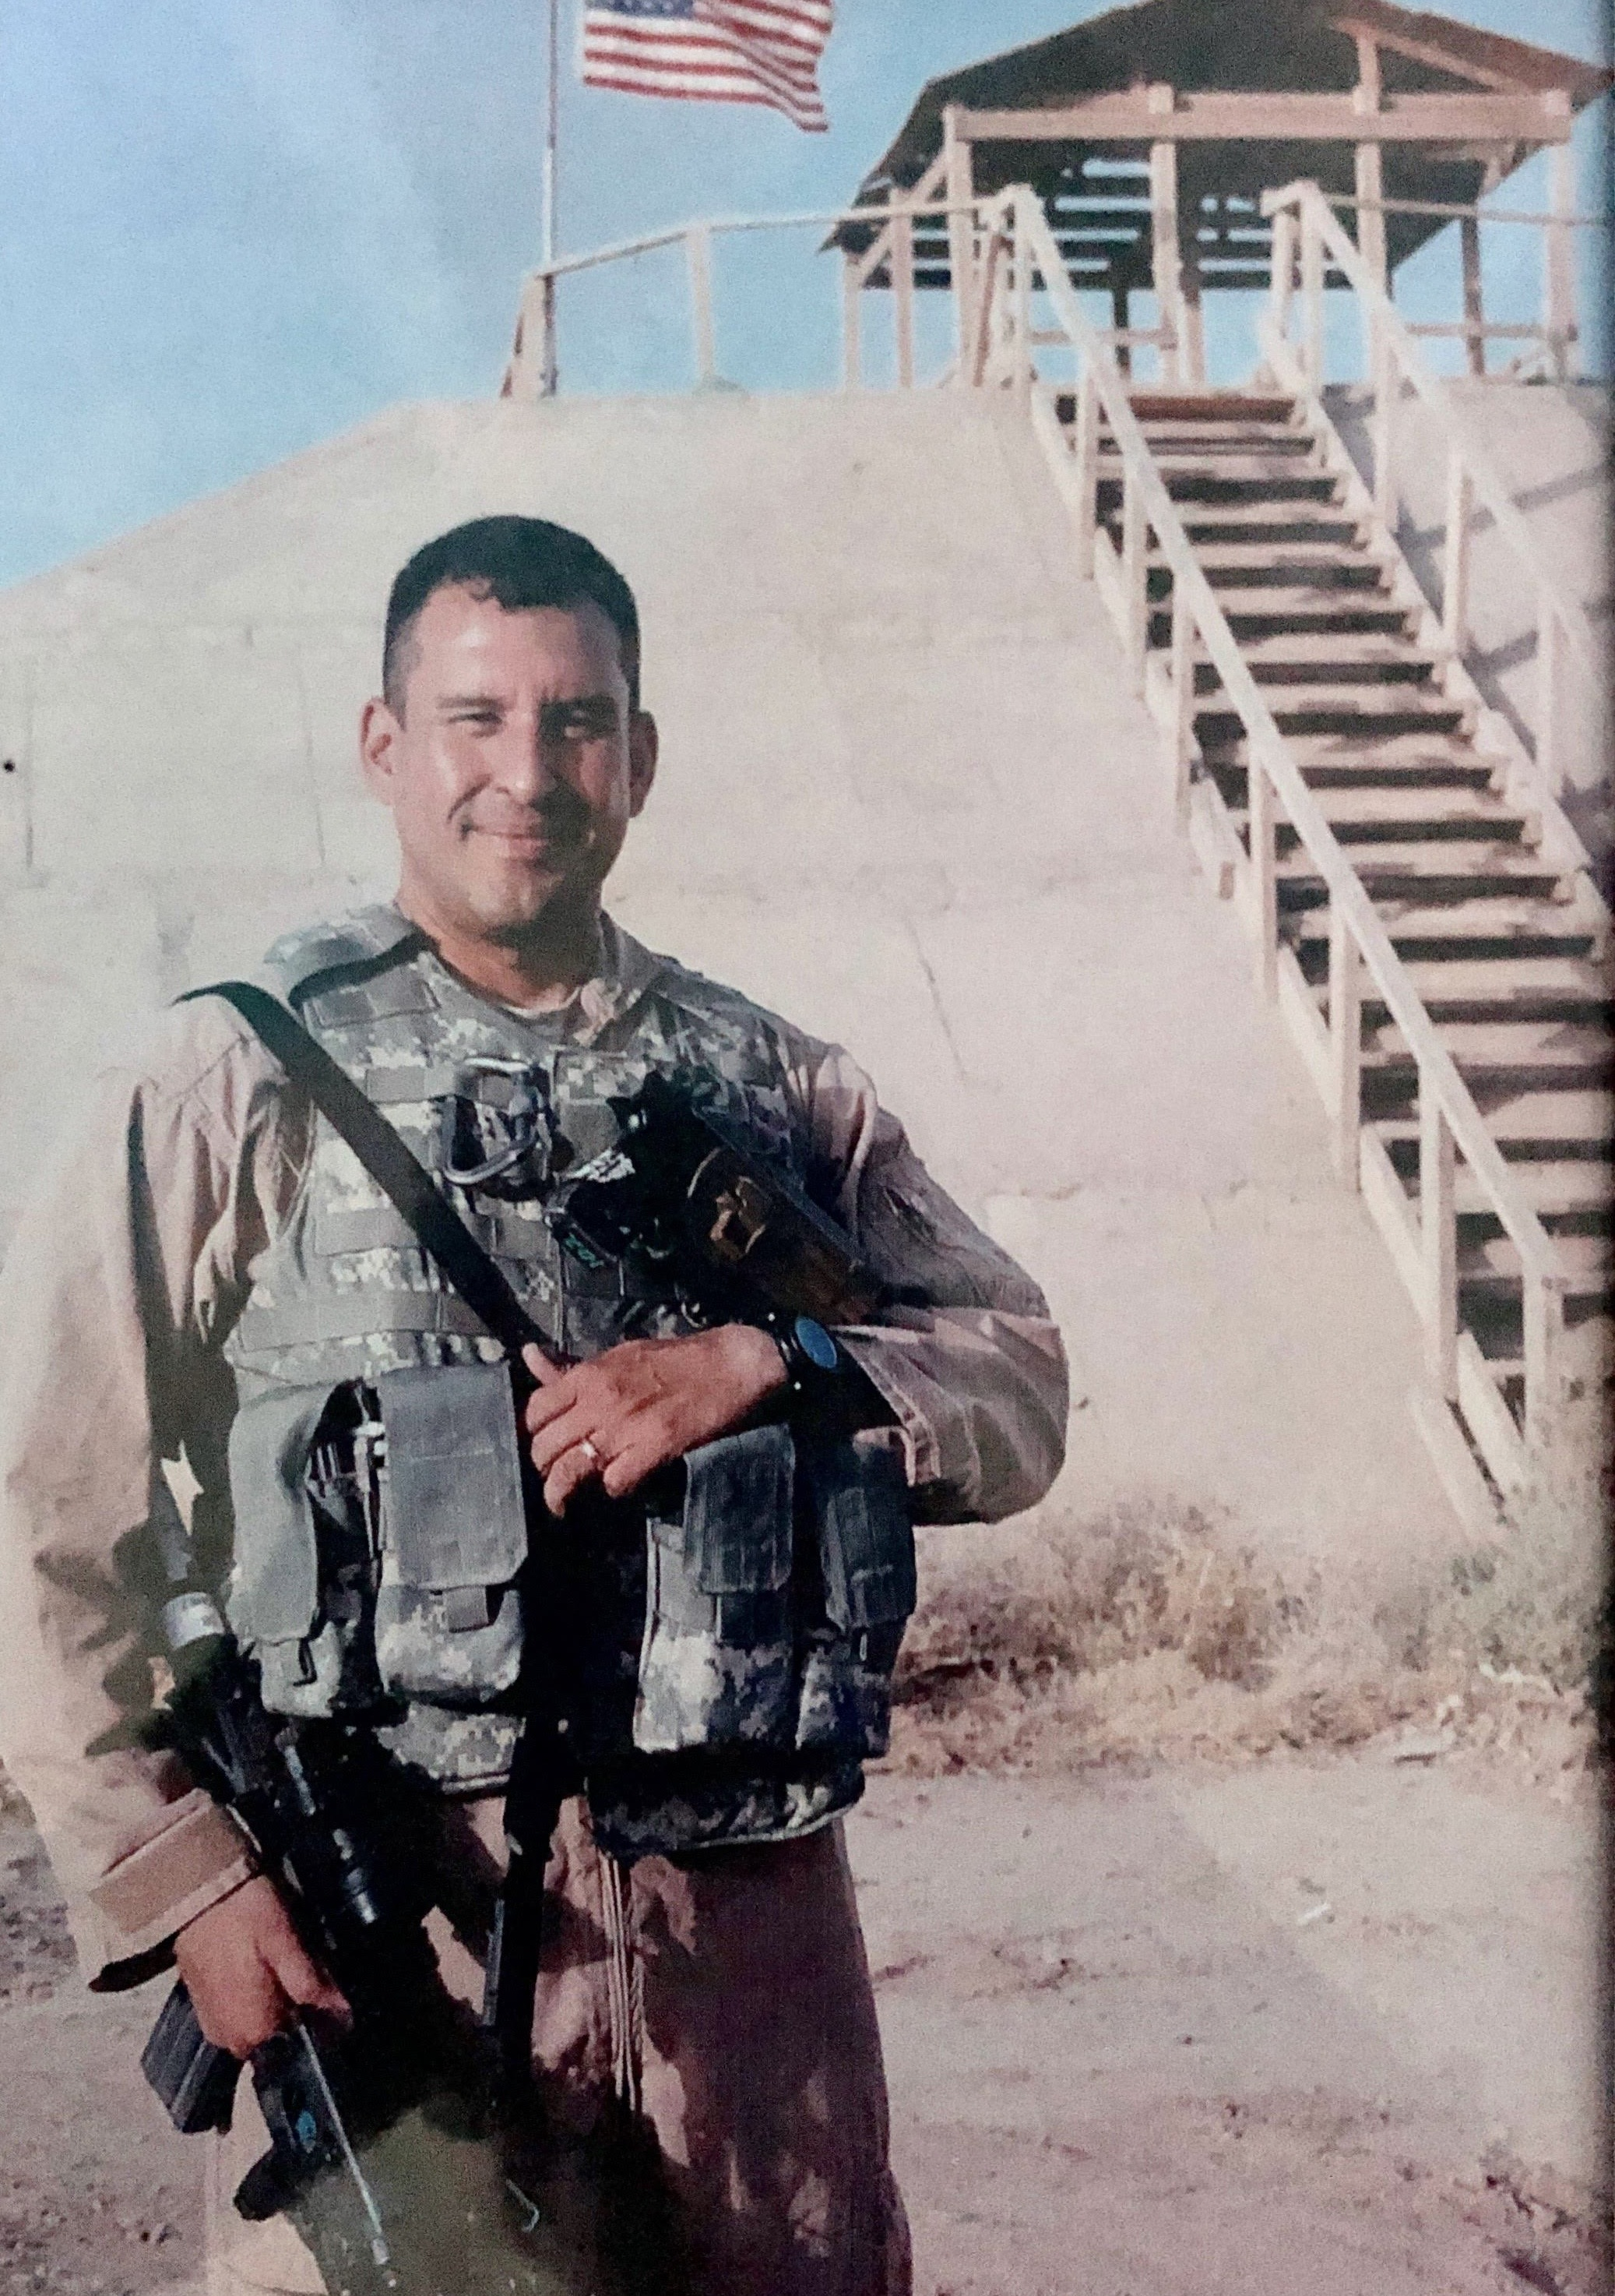
About Me: Why I’m Here!
“If we want to feel an undying passion for our work, if we want to feel we are contributing to something bigger than ourselves, we all need to know our WHY.” - Simon Sinek

Slide 3
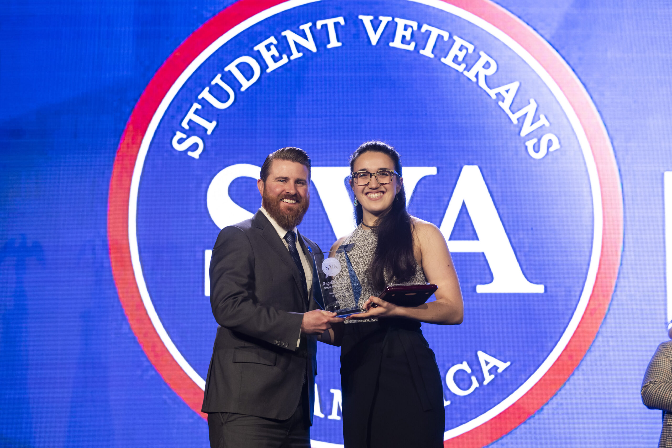
Overview: What You Want to Know
What is SVA?
Benefits of a chapter
The resources and opportunities within SVA
Tips for establishing a chapter
Angelina Trillo, Student Veteran of the Year
“SVA has been a great resource to give a voice to and advocate for student veterans. When I left the Army, I had no idea what I wanted to do. My campus had a strong SVA chapter, and it let me find my people.” – SVA Chapter Network Survey
Notes:
Now, telling you all about how SVA supports student veterans to, through, and beyond higher education would certainly take more than the 30 minutes we have today. So instead, we’re going to cover just three main things: first, I want to talk to you about how truly simple it is to establish a chapter of SVA on your campus. Then, I want to scratch the surface of the many resources, opportunities, and benefits SVA can provide your campus, and finally, we want our most important speaker, our current chapter president from USF to tell you about the way SVA has impacted her and what it means to her.

Slide 4
What is Student Veterans of America?

Slide 5
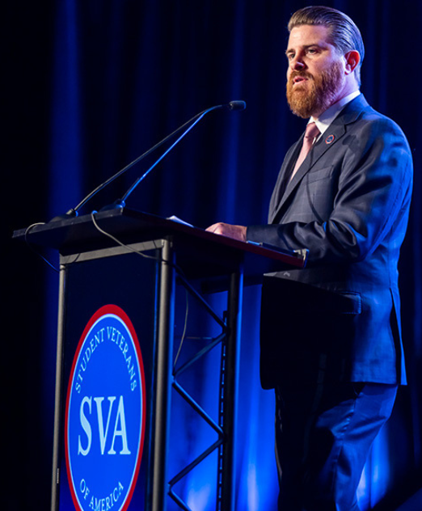
Introduction to Student Veterans of America
Through a network of nearly 1,600 on-campus chapters SVA connects student veterans with a community of dedicated chapter leaders through consultations, national and regional programming, and higher education centered resources
Our mission is to act as a catalyst for student veteran success by providing resources, network support and advocacy to, through, and beyond higher education

Slide 6
SVA Core Functions
Research: SVA peer-reviewed original research informs programs, policy work, and direction as we aim to support the needs of the modern student veteran on campus
Programming: SVA events provide student veterans with the opportunity to grow their network, interface with potential employers, champion veteran issues on Capitol Hill, and expand their leadership potential
Advocacy & Policy: as an organization actively engaged with policymakers in Washington, D.C. and on campuses around the country, SVA shapes the national landscape for the military-connected community
Notes:
Programming: SVA’s National Headquarters oversees the provision of programs and services that empower student veterans to succeed to, through, and beyond higher education by focusing on the chapter-centric life cycle of student veterans.
Advocacy & Policy: Among the many topics we focus on, our team has testified on the Transition Assistance Program (TAP), student debt, and Veteran Success on Campus program (VSOC); we have advised the administration on the GI Bill Comparison Tool, intergovernmental policy such as the agreement with the Federal Trade Commission, and numerous proposals affecting the Post-9/11 GI Bill. We are constantly informing and advocating for new legislation that may positively impact a student veterans’ quality of life while keeping our community informed about changes in laws and regulations.
Research: By investing in research, SVA is filling the void in data collection showcasing student veteran success. We also use surveys and program evaluations for data collection and improving programs. SVA’s research team conducts an annual SVA Census and the Veterans Opinion Survey during election years.

Slide 7
What Challenges Do We Seek to Address?
Challenges
SVA vision
College Access
Affiliation & Support
Academic Transition
Post-Graduate success
Sense of Belonging
Equitable Employment
Alleviation of Student Veteran Debt
Economic Opportunity & Success
Notes:
Challenges:
College Access: Navigating bureaucracy and accessing available resources to include Post 9/11 GI Bill benefits; choosing the best-fit school and figuring out self-identity and next steps; navigating the application process and other on-campus systems​
​
Affiliation & Support: Finding community and peer support; difficulty connected socially with traditional students; coping with service-related challenges such as disability and mental health; balancing both family and employment responsibilities ​
​
Academic: Trouble associated with transitioning to a new learning style and communication styles; need for academic counseling and advice on degree requirements; possible need for tutoring resources; sometimes, a reluctance to ask for assistance and difficulty managing time as a result of the transition from a hierarchical, structured environment ​
​
Post-graduate success: Access to job and networking opportunities; help with practical job seeking skills ​
SVA Vision:
Sense of Belonging: Connecting the military-affiliated community through shared experience, peer support, and networking. Over twenty studies from the last fifteen years have explored the predictive ability of sense of belonging on a variety of educational outcomes, including but not limited to those published in the Journal of Further and Higher Education, American Psychological Association, Sociology of Education, Educational Psychology Review​
​
Equitable Employment: Supporting student veterans in the pursuit of earning an equitable wage commensurate to their experience​
​
Alleviation of Student Veteran Debt: Providing students with quality academic advising through the military-affiliated lens to minimize changing majors, with the overall goal to accurately translate skillsets from the military to civilian jobs. ​
​
Economic Opportunity and Success: Maximizing success and closing the opportunity gap by helping student veterans find the right program, providing them with community, and connecting them to a degree-aligned job​
Demographics:
Student veterans today are older than traditional students, with the majority being between 24-35.
Student veterans are more likely than their traditional student counterparts to be Black and Hispanic or Latin American.
More than 50 percent are married, and more than 50 percent have children – 20 percent are single parents.
Two-thirds are first-generation college students.
Almost that many have a service-connected disability, but only about a quarter seek academic accommodations.
And three-quarters work full- or part-time.
Yet they are succeeding in higher numbers than traditional students with a 72 percent success rate and carry
higher GPAs than traditional student, 3.35 compared to 3.15.
Student veterans are largely removed from their high school guidance counselor, who would have
walked them through many of the decisions they are making for their education:
Career planning.
Major selection.
Program/school selection.

Slide 8
So, where does SVA fit in?

Slide 9
What Student Veterans Gain from a Chapter
Build a meaningful support community of veterans, military-affiliated individuals, and military supporters
Networking, leadership, and professional development opportunities
Resources to help achieve academic & professional goals
“The legislative work is awesome. We deal with the government relations office in Austin weekly and we can connect them to SVA leadership and allies in D.C.” - SVA Chapter Network Survey
Notes:
As higher education professionals, we know that community is critical to retention rates. This is why, at our very foundation, SVA seeks to help veterans, a typically post-traditional group of students, meet their social needs by connecting them to others who can understand their stories and backgrounds
We build upon this baseline function by also hosting networking & professional development opportunities to assist with connecting members to both leadership and employment opportunities
To assist students to college, through college, and beyond college, we offer an array of meaningful resources that help members achieve academic and professional goals

Slide 10
Chapter Services & Resources
Dedicated support team to assist with virtual chapter consultations, lead roundtable discussions, and deliver best practices
Over $140,000 in scholarships distributed to student veterans annually
Personalized academic & career coaching, tools, and support for transitioning service members, veterans, and their families
Career resources to connect veterans with meaningful & sustainable employment upon graduation
Notes:
To be very frank with you all, I’m so passionate about these next two slides that I could talk about them forever, but I will spare you that and simply be giving you a very quick overview – if you would like to hear the long winded version, set up a meeting with me!
We support our 1,600 chapters through a plethora of services and resources. Not only do we give scholarships, we also provide personalized academic and career coaching to get you through college, career resources to help connect you with jobs upon graduation, AND even have an entire Outreach Coordinator team - that yours truly is apart of – (PAUSE) think of us as your own personal SVA mentors to help coach your chapter along the way! We help YOU help veterans on your campus!
we know YOU have a lot going on – let US connect your students to these resources that will help them as individual students and, in turn, help chapters be successful on your campus”.

Slide 11

Programs & Events
National Conference is the largest gathering of student veterans in the world
Washington Week allows chapter members to share their stories with elected officials and attend a joint hearing of Congress
The Leadership Institute is an immersive experience that develops personal leadership ethos to bring back to your campus & community
“Washington Week is an opportunity for you to go directly to the people who make a difference in your healthcare, education, benefits, and everything that affects directly as a veteran.”
– SVA Chapter Vice President, Jake Slocum
Notes:
On this slide you’ll see the names of our various programming events that round out our to, through, and beyond motto; these events connect chapter members not only with each other, but also with our corporate supporters, elected officials, mentors, and many more. Our events help chapter members build an expansive and diverse network!

Slide 12

Programs & Events (cont.)
Regional Summits are the definitive experience for building a world class chapter
Visibility Exchanges are “on-your-campus” relationship building programs teaching attendees how to cultivate a supportive and inclusive campus environment for student veterans
“It was nice to learn about experiences from other SVA Chapters and to share some of the resources that my university has to offer military-connected students and veterans.” - Sierra Fraser, Old Dominion University

Slide 13
That sounds great! How do I start a chapter?

Slide 14
Our Chapters
No national dues
Chapters set their own direction, mission, and goals
Our chapter members are veterans, caregivers, family-members, and more!
“The 2023 Regional Summit in Philadelphia was phenomenal! My student veterans left the summit feeling empowered and sufficiently ready to start and grow an SVA chapter!” – SVA Chapter Network Survey
Notes:
We aim to keep a low barrier to access – we want every student veteran across the U.S. to be a part of SVA if they want to be! That means we do not require our members to pay any national dues, and we make it easy to start a chapter. Four requirements to start a chapter here
We know that you and your chapter leadership understand the needs of your constituents best – for this reason, we let chapters set their own directions! I like to say that SVA allows you to “pick your own adventure”, whether it’s political advocacy, service projects, or building community for vets on your campus!
A common misconception is that our services are just aimed towards the veteran – my favorite fact to share is that SVA is for everyone! Our chapters consist of not only veterans, but caregivers, spouses, dependent children, and military supporters. While the veteran is at the center of what we do, we understand the unique challenges that the network surrounding the service-member faces, too! We seek to help fill the gap here
almost all of our chapters are created out of a desire to create a sense of belonging among the student veteran community++ on campus. And from there, many choose to infuse other goals/missions
we know YOU have a lot going on – let US connect your students to these resources that will help them as individual students and, in turn, help chapters be successful on your campus”.

Slide 15
Starting a SVA Chapter
Visit studentveterans.org to submit a chapter development inquiry
Create a MySVA account
The four requirements are a chapter advisor, chapter president, bylaws, and a letter of recognition from your institution’s student life division
Upload documents and edit your institution information in mySVA
“If you are on the fence about applying for an SVA program, I highly recommend looking into it. You only get out of it what you put into it. I recommend going full force. There’s wonderful individuals and it’s a life changing experience.” – Jamie Springston, Marshall University

Slide 16
Starting a SVA Chapter: Pro-Tips
Engagement
Operations
Clearly highlight the benefits & resources affiliated with chapter membership
Include SVA as part of your veteran orientation
Ensure that chapter members act as SVA ambassadors to the community
Connect students using Post 9/11 Benefits to SVA at various touchpoints
Ensure that chapter meetings and events are widely accessible
Collaborate with Student Government Association on your campus
Connect with veteran service organizations in your community
Send chapter delegates to various SVA programs throughout year

Slide 17
Where do I fit in as a school administrator?

Slide 18
Chapter Advisor: Roles & Responsibilities
Empowerment & Advocacy
Belonging & Engagement
Organizational Sustainability & Growth
Operational Excellence & Compliance

Slide 19
Chapter Advisor: Roles & Responsibilities (cont)
Communicate with chapter members, veterans, families, caregivers, and survivors, making them aware of programs, opportunities, and benefits available to them
Educate the campus and community about veteran experiences and perspectives to foster a more inclusive environment
Establish regular communication with SVA headquarters to ensure the chapter aligns with national objectives and core values

Slide 20
The Advisor Impact
Advisors are the foundation of our 1,600+ chapters
Advisors mentor the next generation of student veterans on their path to becoming industry leaders
Chapter advisors are the continuity of the organization, thus ensuring tomorrow’s veterans will benefit from the same resources and opportunities

Slide 21
Key Takeaways
SVA provides an abundance of resources and opportunities to support the military-affiliated community getting to, through, and beyond higher education
We offer countless ways for chapter members and advisors to get involved in our mission
SVAHQ is here to support you, the higher education administrator, in your campus role serving veterans

Slide 22
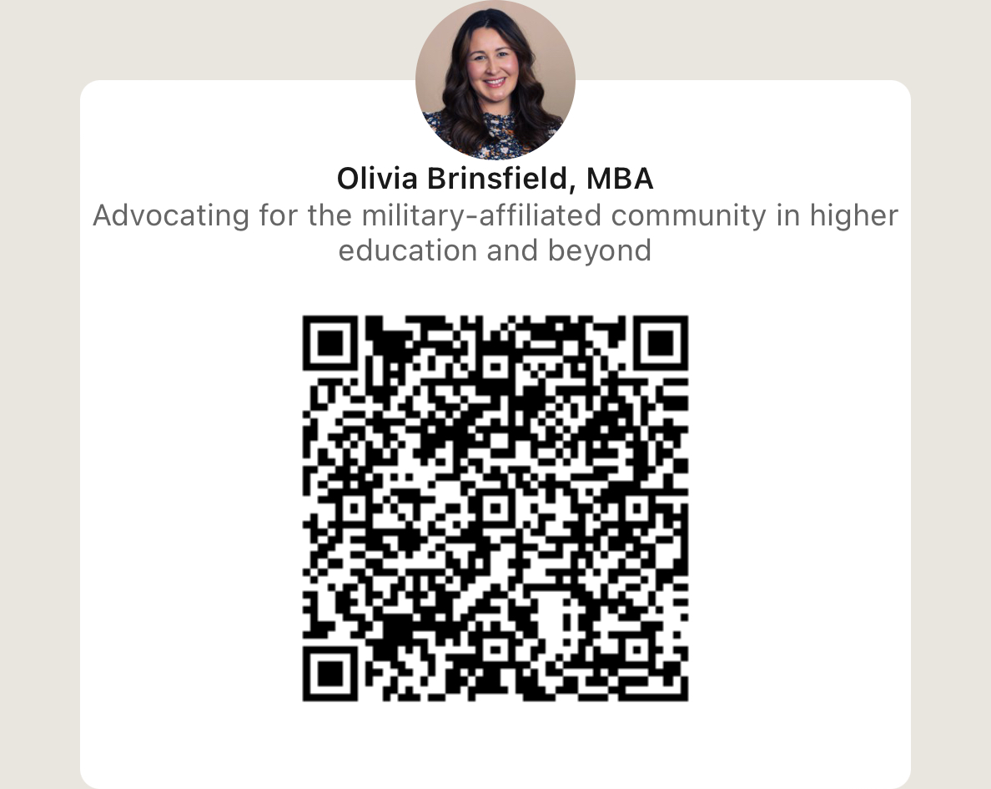
Contact Information
Olivia Brinsfield, MBA
Outreach Coordinator, Programs & Chapter Services
Phone: 202-601-8567
Email: Olivia.Brinsfield@studentveterans.org

Slide 23
Questions?

Slide 24
SVA- Legislative Landscape
Faisal Sulman

Slide 25
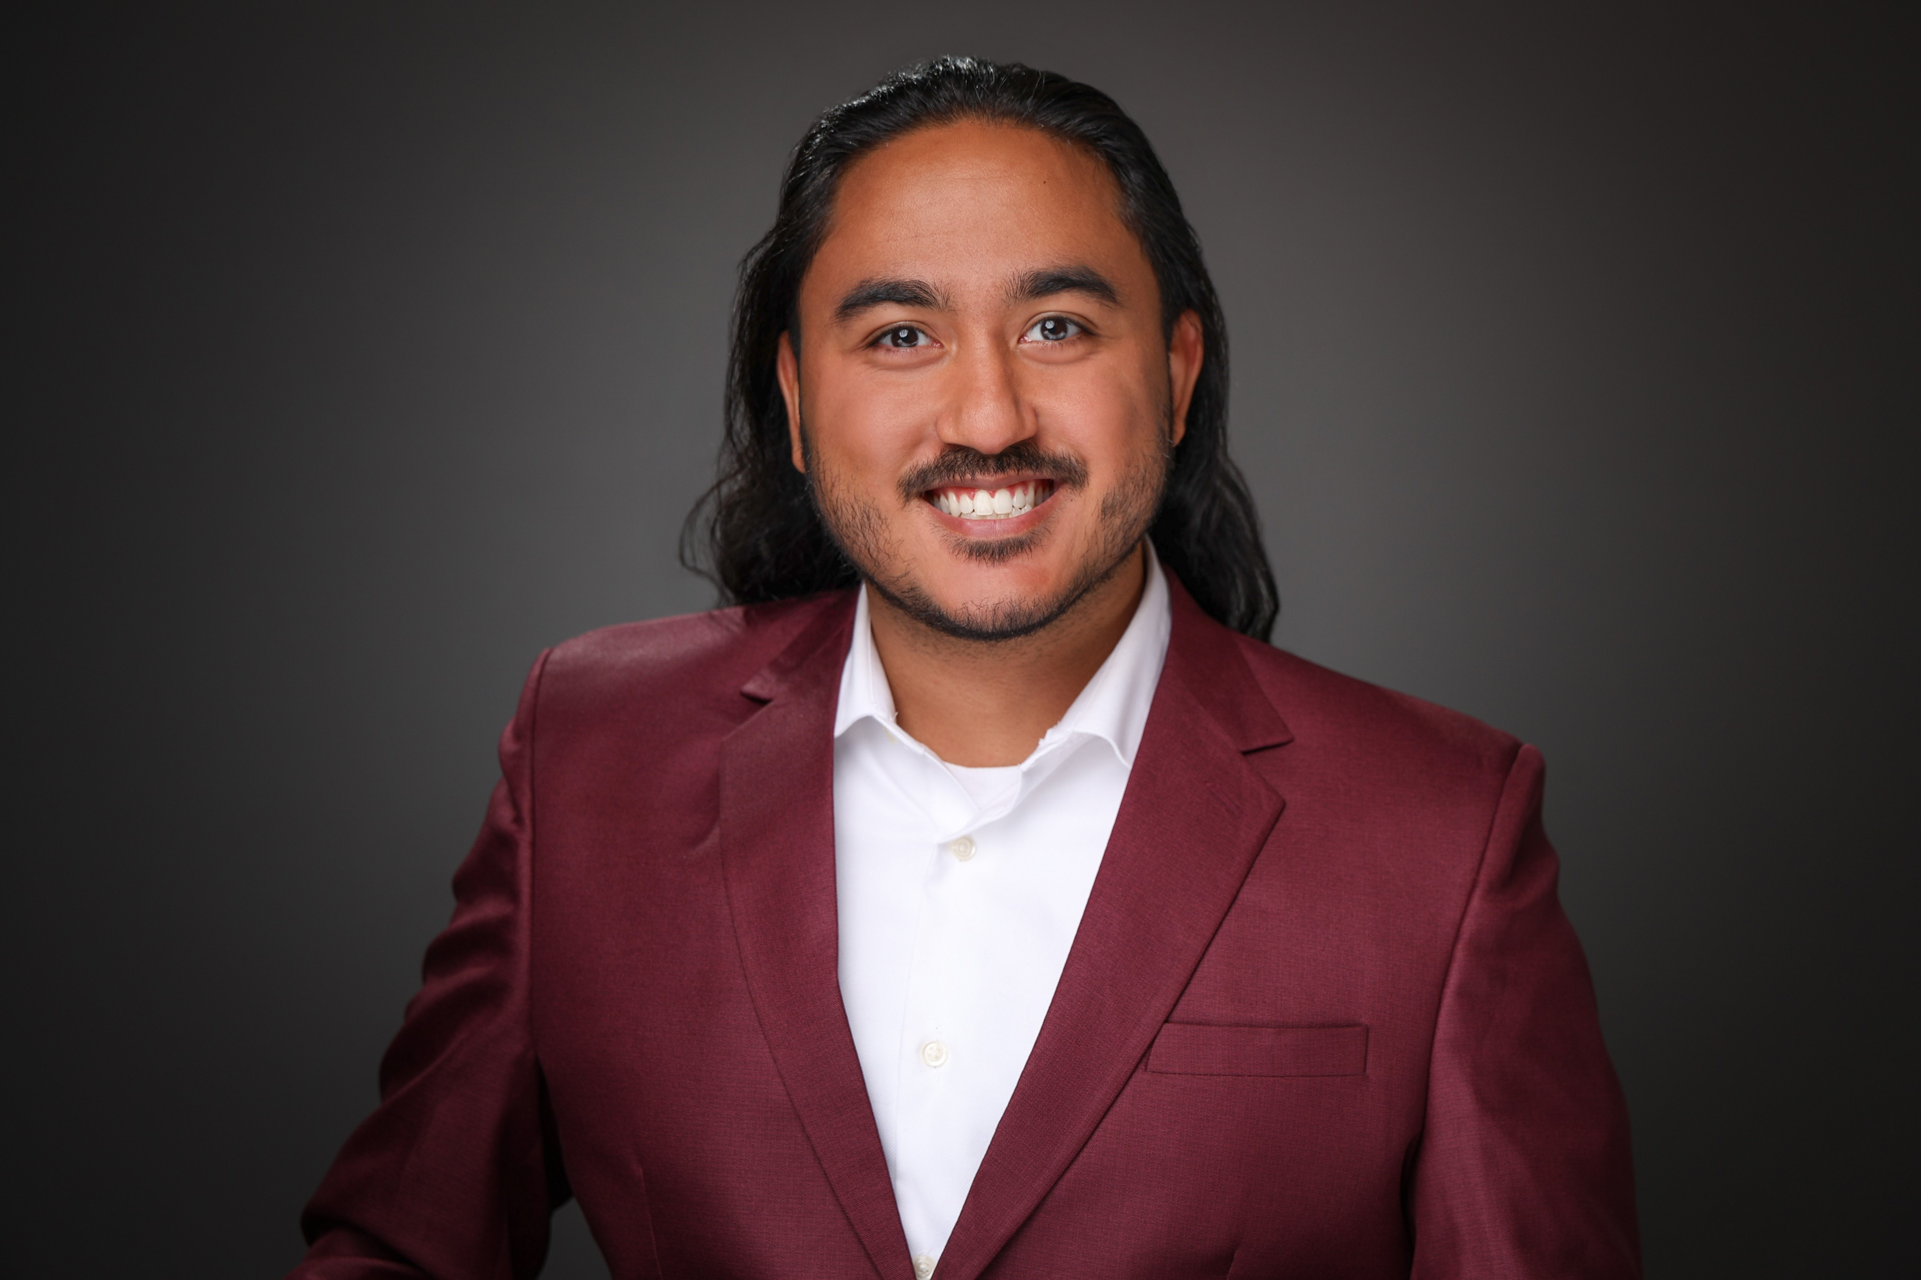


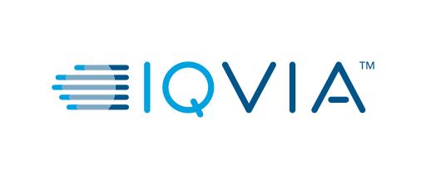

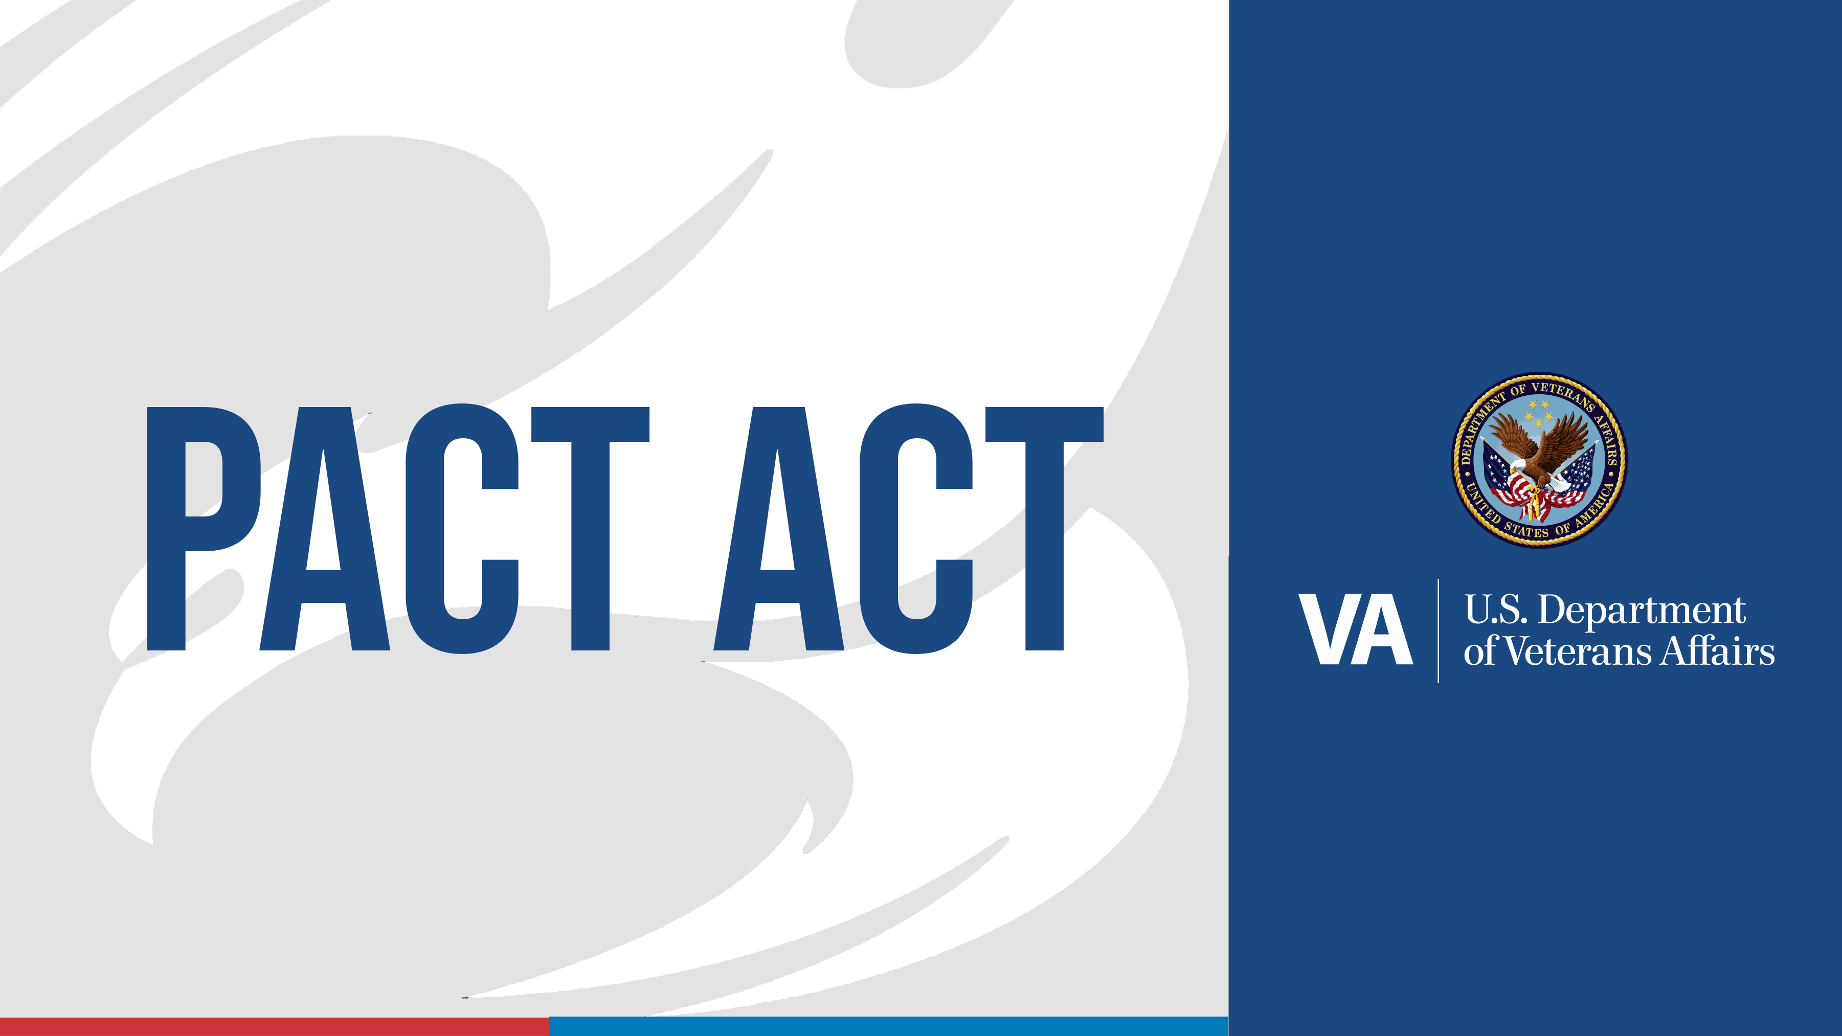



About Me!

Slide 26
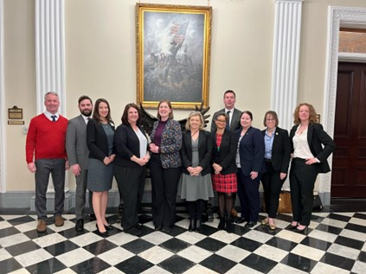
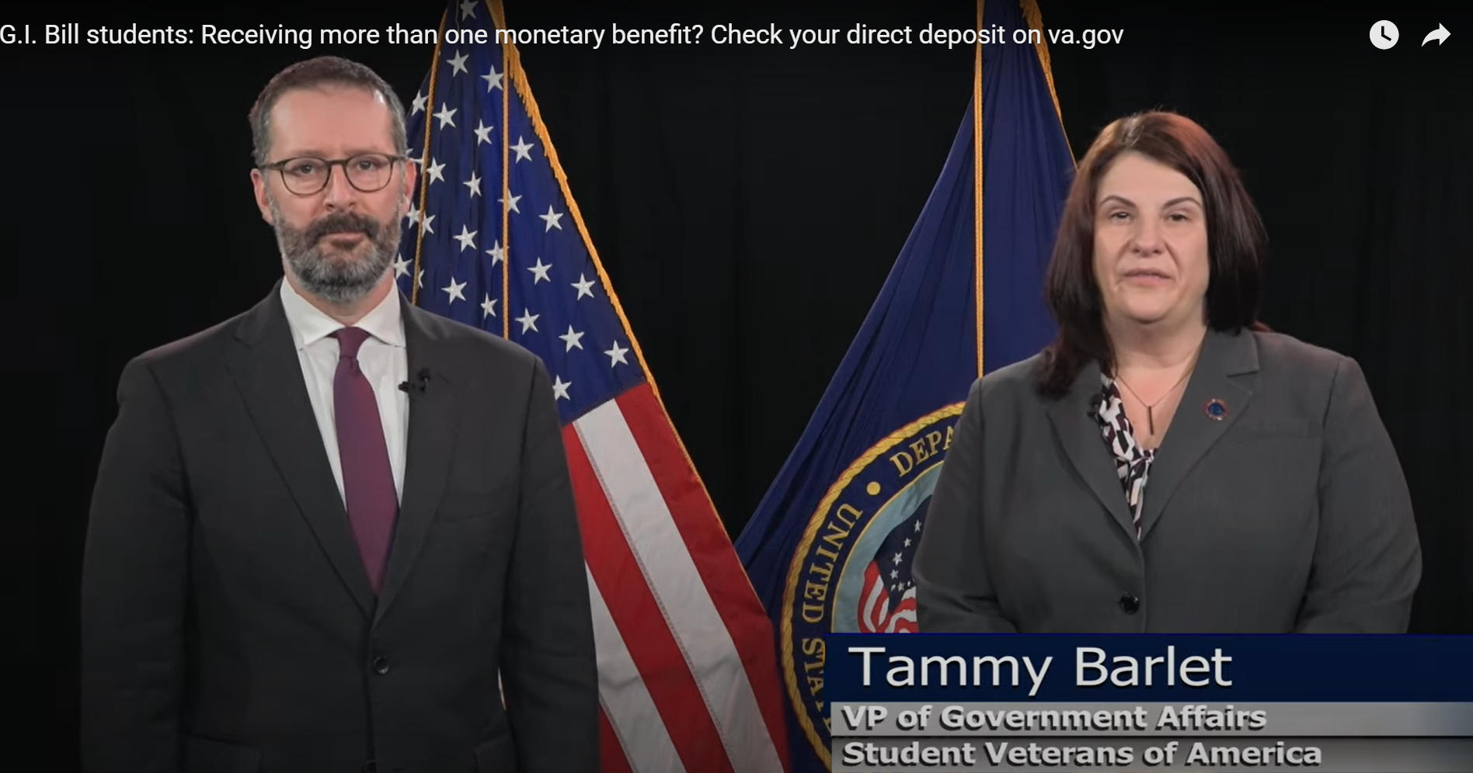
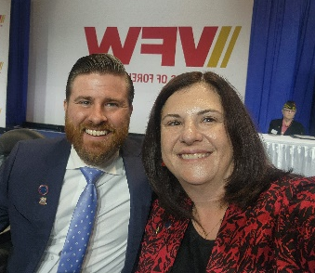
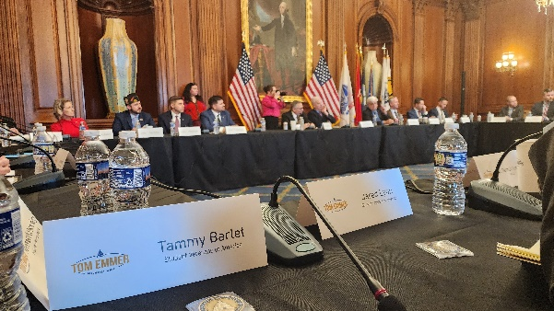
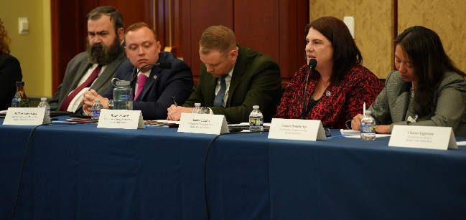
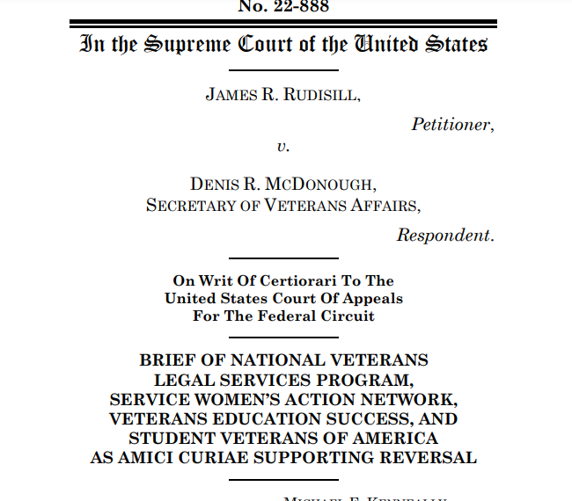
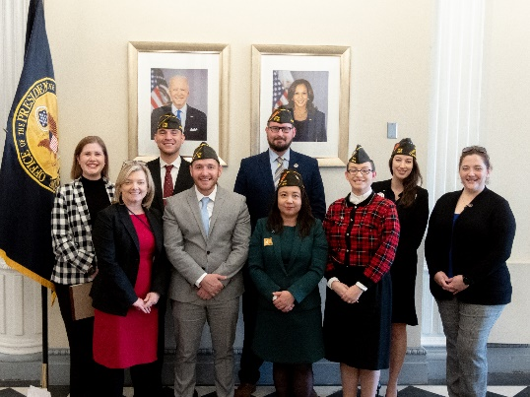
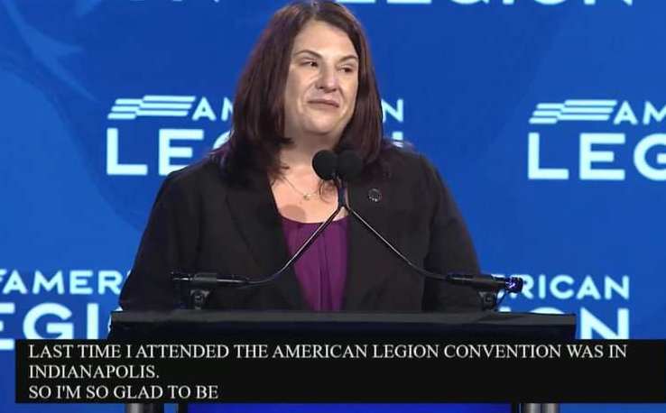
SVA Government Affairs
Executive Branch
Legislative Branch
Judicial Branch
VSOs/MSOs
Coalitions/Partnership
VFW-SVA Fellowship
Research- surveys/reports
Programs/Outreach
Notes:
Executive Branch
White House--Quarterly VSO/MSO meeting with the Special Assistant to the President/Domestic Policy Council
VA- VBA to VEO and all that in-between– SVA sits on the Veterans' Advisory Committee on Education
ED- Quarterly meeting with Secretary Cardona, Advocates for ED- Centers of Excellence for Veteran Student Success Federal Register :: Applications for New Awards; Centers of Excellence for Veteran Student Success Program
Applications Available: May 28, 2024.
Deadline for Transmittal of Applications: July 29, 2024.
DOL-Vets- quarter call
DOD- Army and Air Force, although SVA is connected with all branches of the uniform services.
Legislative Branch
SVAC/HVAC (Senate and House Veteran Affairs Committee)
SASC/HASC (Senate and House Armed services Committee) NDAA--
Judicial Branch
Supreme Court (Rudisill v. McDonough)
VSOs/MSOs
Conventions VFW, Legion
NatCon (who attends NatCon- AVECO had a table las year)
Coalitions/Partnership
CEF (Committee on Education Funding), PSLF, White Oak, and many more
FAVES, WAVES, and AVECO
VFW-SVA Fellowship
Not just a Number Act
Application open in end of July
Research- surveys/reports (Data supports legislation)
Annual Census
Basic Needs Survey
VA VITAL white paper (by a raise of hands, how many people know about the VA Vital program, how many know how many VA Vital sites are in Florida? 0
Programs/Outreach
GA request – WH, Congress, and HVAC keeping bipartisanship

Slide 27
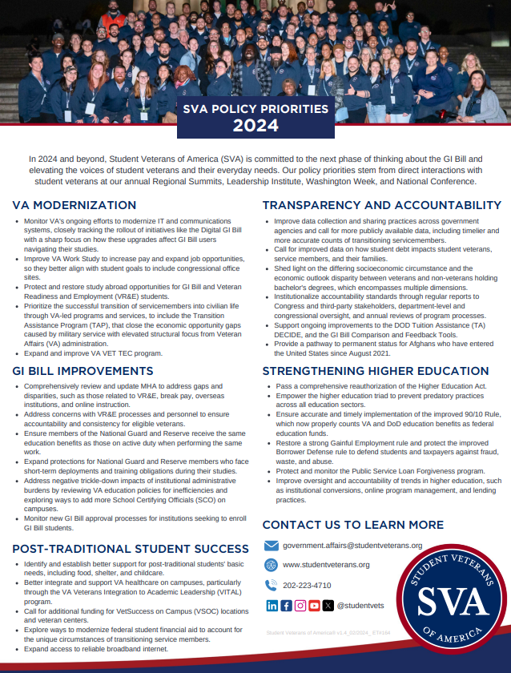
2024 SVA Policy Priorities
Conceived through conversation
  NatCon
    Policy Think Tank
  Washington Week
  Regional Summits
  Leadership Institute
  Opportunities throughout the year
SVA 2024 Policy Priorities
VA Modernization
GI Bill Improvements
Post-Traditional Student Success
Transparency and Accountability
Strengthening Higher Education
Notes:
Conceived through conversation with student veterans, military –connected students, their families, caregivers, survivors, advisories, and SCOs
NatCon
Policy Think Tank
Washington Week
Regional Summits
Leadership Institute
Opportunities throughout the year… like FAVES/WAVES/AVECO
VA Modernization
Increase VA Work Study Pay and expand job opportunities (include Takano bill)
VR&E
Improve TAP and VA VET TEC
GI Bill Improvements
Update MHA
Ensure members of National Guard and Reserve receive same benefits as those on active duty
Post-Traditional Student Success
Better support for VA VITAL
Additional funding for VSOC
Transparency and Accountability
Improve data collection and sharing across gov’t agencies
Shed light on the differing socioeconomic circumstance and the economic outlook disparity between veterans and non-veterans holding bachelor's degrees, which encompasses multiple dimensions.
Strengthening Higher Education
Improve oversight and accountability of trends in higher education, such as institutional conversions, online program management, and lending practices.
Protect and monitor the Public Service Loan Forgiveness program.

Slide 28
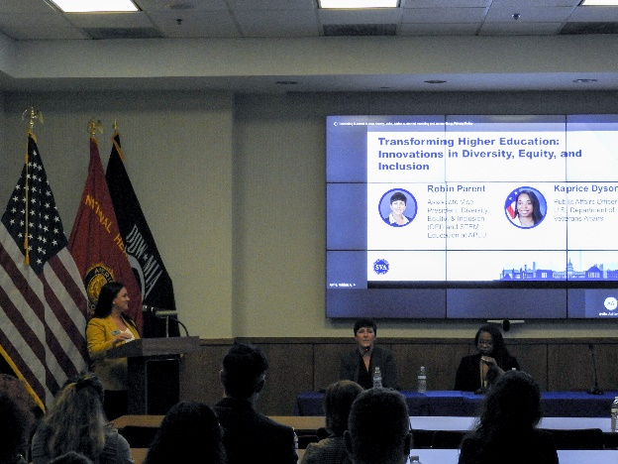
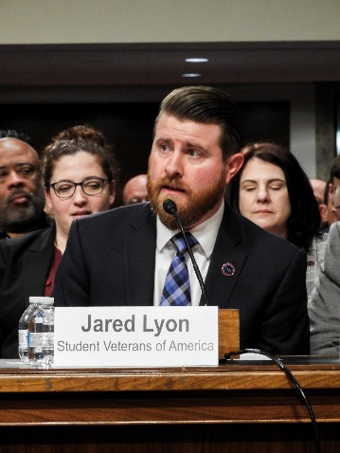
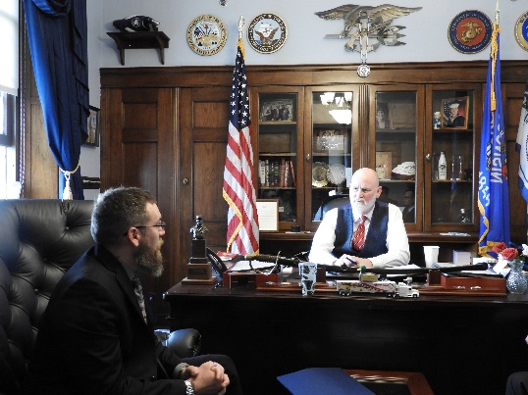
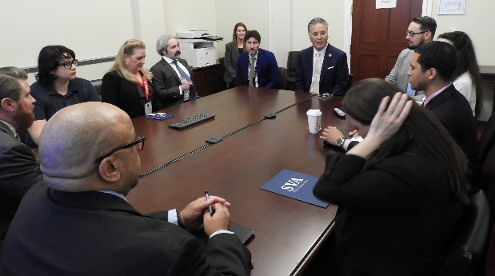
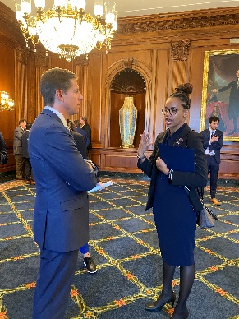
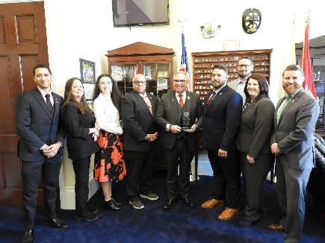
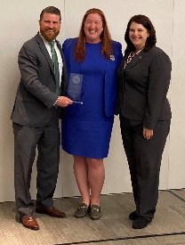
Washington Week
Higher Ed Symposium at The American Legion
  Career Innovations: Maximizing Opportunities While in College
  The Path to Prosperity: Financial Literacy for Student Veterans
  Transforming Higher Education: Innovations in DEI
  Research Revolution: Innovating Student Veteran Studies
SVAC/HVAC hearing – 2024 Policy Priorities
SVA member congressional office visits
Evening event with AMVETS
SVA WW Reception and Awards at Boeing
  Sonny Montgomery Student Veteran Champion
    HVAC Chairman – Mike Bost (IL-12)
    HVAC Ranking Member – Mark Takano (CA-39)
  Dwight D. Eisenhower Distinguished Public Service Awards
    Senior Advisor to the Undersecretary for Benefits at VA - Maureen Elias
Notes:
Higher Ed Symposium at The American Legion
FourBlock, DOL, Higher or Heroes, Federal Trade Commission, IRS, Consumer Financial Protection Bureau, Association of Public and Land-grant Universities, RAND, and Pew
SVAC/HVAC hearing – 2024 Policy Priorities
SVA member congressional office visits
To tell their stories, leave the SVA Policy Priority behind
Evening event with AMVETS
SVA WW Reception and Awards at Boeing
Sonny Montgomery Student Veteran Champion
HVAC Chairman – Mike Bost (IL-X)
HVAC Ranking Member – Mark Takano (CA-X)
Dwight D. Eisenhower Distinguished Public Service Awards
Senior Advisor to the Undersecretary for Benefits at VA - Maureen Elias
Tentative date for Washington Week 2025 will be the week of March 3

Slide 29
118th Congress 2nd Session
H.R. 8371, Sen. Elizabeth Dole 21st Century Veterans Healthcare & Benefits Improvement Act (Introduced in the House on May 2024)
  Omnibus EO Sections
    Section 149 – Based on H.R. 4157 and S. 928, Not Just a Number Act.
    Section 201 & 202 – Based on H.R. 3651 and S. 1266, Love Lives On Act.
    Section 203 – Based on H.R. 1798, Protect Military Dependents.
    Section 209 – Based on H.R. 2830 and S.656, Veteran Improvement Commercial Driver License Act.
    Section 210 – Based on H.R. 1169, VA-E Notification Enhancement Act.
    Section 214 – Based on S. 1090, Direct VA to allow ETF of educational assistance to foreign institutions of higher education.
    Section 215 – Based on H.R. 5956, Transparency for Student Veterans Act, and S. 1309, Student Veterans Transparency and Protection Act of 2023.
Notes:
H.R. 8371, Sen. Elizabeth Dole 21st Century Veterans Healthcare & Benefits Improvement Act (Introduce in the House on May 14th)
Omnibus EO Sections:
Section 149 - National Veteran Suicide Prevention Annual Report. Based on H.R. 4157 and S. 928, Not Just a Number Act.
Section 201 - Temporary Expansion of Eligibility for Marine Gunnery Sergeant John David Frye Scholarship. Based on H.R. 3651 and S. 1266, Love Lives On Act.
Section 202 - Removal of Expiration on Entitlement to Marine Gunnery Sergeant John David Fry Scholarship for Surviving Spouses. Based on H.R. 3651 and S. 1266, Love Lives On Act.
Section 203 - Sole Liability Transferred Educational Assistance by an Individual who Fails to Complete a Service Agreement. Based on H.R. 1798, Protect Military Dependents.
Section 209 - Modification of Rules for Approval of Commercial Driver Education Programs for Purposes of Educational Assistance Programs of the Department of Veteran Affairs. Based on H.R. 2830 and S.656, Veteran Improvement Commercial Driver License Act.
Section 210 - Provision of Certificates of Eligibility and Award Letters Using Electronic Means. Based on H.R. 1169, VA-E Notification Enhancement Act.
Section 214 - Payment of VA Educational Assistant Via Electronic Fund Transfer to a Foreign Institution of Higher Education. Based on S. 1090, Directs the VA to update the payment system to allow for electronic fund transfer of educational assistance to a foreign institution of higher education.
Section 215 - Improving Transparency and Accountability of Educational Institutions for Purposes of Veterans Educational Assistance. Based on H.R. 5956, Transparency for Student Veterans Act, and S. 1309, Student Veterans Transparency and Protection Act of 2023.

Slide 30
118th Congress 2nd Session (cont’d)
  Passed the House Floor
    H.R. 5914 – Veterans Education Transparency and Training Act (VETT Act)
    H.R. 1767 – Student Veteran Benefit Restoration Act
    H.R. 3738 – Veterans Economic Opportunity and Transition Administration Act
    H.R. 1669 – VET–TEC Authorization Act of 2023
  FY25 NDAA
    H.R.7477/ S. 2949 - Ensuring Military Access to Higher Education Benefits Act of 2024
    H.R.1282/ S. 344 - Major Richard Star Act
    Quality of Life Report- Junior Enlisted Pay Increase, Increase Basic Allowance for Housing (BAH), Increase Basic Needs Allowance (BNA) to 200% of Federal Poverty Guidelines, Expansion of Child Care Access to Military Spouses Seeking Employment
  Others
    S.4208 - Affordable Connectivity Program
    H.R.8336 - To amend title 10, United States Code, to establish a counseling pathway in the Transition Assistance Program for members of the reserve components of the Armed Forces
    H.R.8467 - Farm, Food, and National Security Act of 2024 - Section 4303
    HVAC EO – Legislative Hearing on June 12, 2024
      H.R.7543/S. 3873 - Guard and Reserve GI Bill Parity Act of 2024
Notes:
Bills we Supported from the 2nd session of the 118th Congress
H.R. 5914 – Veterans Education Transparency and Training Act (VETT Act) - which requires the VA to establish and regularly update a website as a central location for school certifying officials training regarding VA educational benefits.
H.R. 1767 – Student Veteran Benefit Restoration Act - which will restore VA education benefit entitlement to veterans who are unable to complete their program due to information collected by a VA risk-based survey, harmful actions by educational institutions, or shutdown to fraud investigations.
H.R. 3738 – Veterans Economic Opportunity and Transition Administration Act – 4th Admin, which SVA testified in support of in the 1st session
FY25 NDAA
H.R.7477/S. 2949 - Ensuring Military Access to Higher Education Benefits Act of 2024 – Bridging the data gap between DOD and ED in regards to PSLF verification
H.R.1282/ S. 344 - Major Richard Star Act - concurrent receipt, Under current laws, such medically retirees are not eligible for concurrent receipt, meaning their military longevity pay is reduced by the amount of VA disability compensation they receive. make up only a small portion of the total veterans ineligible for concurrent receipt, however.
Quality of Life Report- Junior Enlisted Pay Increase, Increase Basic Allowance for Housing (BAH), Increase Basic Needs Allowance (BNA) to 200% of Federal Poverty Guidelines, Expansion of Child Care Access to Military Spouses Seeking Employment
Others
S.4208 - Affordable Connectivity Program
H.R.8336 - To amend title 10, United States Code, to establish a counseling pathway in the Transition Assistance Program for members of the reserve components of the Armed Forces.
H.R.8467 - Farm, Food, and National Security Act of 2024 - Section 4303, SNAP and students (FARM bill)
HVAC EO – Pending Legislation Hearing June 12
H.R.7543/S. 3873 - Guard and Reserve GI Bill Parity Act of 2024
Book Stipend increase from $1000 to $1400 a year
“Warriors to Workforce Act” – increase the amount of education assistance amount from 80% to 90% during stage two of the program
“Reforming Education for Veterans Act”
“Student Veteran Debt Relief Act of 2024”
“VSOC” – VSOC employee can hold a bachelors degree, to more than one campus, not more than 25 individuals at a time

Slide 31
SCOTUS Developments to Follow
City of Grants Pass v. Johnson, 603 U.S. __ (2024)
  Held: Local government have the power to criminalize homeless people for sleeping in public places.
  H.R. 8560 – End Vet Homelessness Act
Loper Bright Enterprises v. Ramaido, 603 U.S. __ (2024)
  Held: Federal Courts do not have to defer to a federal agency’s interpretation of an unclear statute that Congress delegated to the agency to administer.
  Story of Thomas Buffington
Notes:
Story of Thomas Buffington (in the opinion page 24)
US Air Force Veteran injured in line of duty
Was paid benefits by the VA due to him by law
Gov’t called on him to re-enter service – which he did. Additionally, caused his disability payments to be suspended.
Served his time and left service.
Unbeknownst, to Buffington – the VA adopted a self-serving regulation where the veteran had to file a form asking for their disability benefits to resume after a second stint in active service.
Because Buffingon didn’t know, he did not fill out that form immediately. Eventually, he learned and reapplied. The VA resumed his disability payments, but refused to issue any of the ones he missed.
Buffington challenged the VA’s action was inconsistent with Congress direction that VA may suspend payments only for those periods when a veteran returns to active service.
The VA used Chevron to defeat his claim by deferring to the ambiguous agency rules. Still not entitled to their withheld pay.

Slide 32
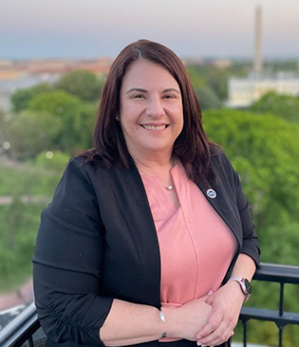
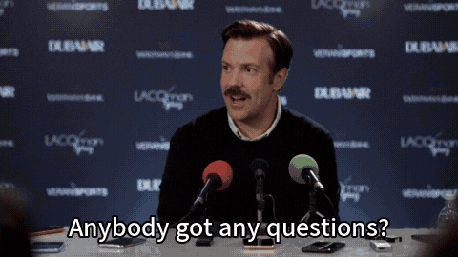
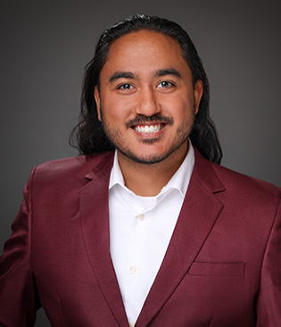
Tammy Barlet, MPH (she, her, hers)
Vice President of Government Affairs
Student Veterans of America
202-573-7770 | tammy.barlet@studentveterans.org
Faisal Sulman, JD, MBA (he, him)
Legal Fellow
Student Veterans of America
202-350-2063 | faisal.sulman@studentveterans.org

