Slide 1
Enrollment Manager
Veterans Benefits Administration
Education Service
Summer 2024

Slide 2
Agenda
01
Digital GI Bill (DGIB) Overview
02
EM Outcomes
This presentation provides an overview of Enrollment Manager (EM) updates and helpful resources for School Certifying Officials (SCOs).
03
New EM Features and Enhancements
04
EM Tips
05
Navigating EM: Updated Resources and FAQs
06
Additional Resources
07
Q&A

Slide 3
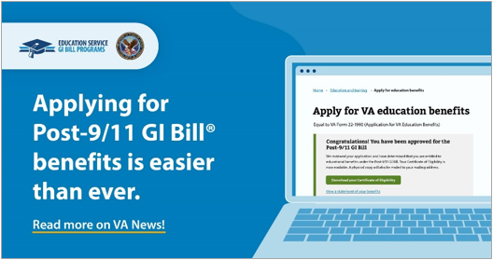
Digital GI Bill (DGIB) Overview
The U.S. Department of Veterans Affairs (VA) is on a mission to modernize GI Bill® systems and processes. Enhancing the Enrollment Manager experience and optimizing the beneficiary application and payment process are important parts of that mission.
Transform
DGIB is a major modernization effort to transform GI Bill operations into a digital platform.
Improve
We are on a mission to improve education benefits and customer service delivery.
Support
DGIB impacts nearly one million GI Bill students each year, and the thousands of EM staff who support them.
“I honestly didn't even realize the [GI Bill application] process had changed, it was so smooth and instantaneous! I've already told a few of my friends who are out/getting out soon how easy the process was to apply for the Post-9/11 GI Bill and get the go ahead to apply for classes.”
- Post-9/11 GI Bill Veteran

Slide 4
Enrollment Manager Outcomes

Slide 5
Enrollment Manager Outcomes
In just one year, Enrollment Manager has seen high rates of engagement and facilitated submission of millions of enrollment certifications for all chapters.
22,554+
Cumulative count of distinct users who have accessed the Digital GI Bill system. 99.9% of users who have attempted to log in are in the system.
15,359+
Institutions have submitted enrollments.
5,851,651+
Enrollment certifications for all chapters have been submitted since Enrollment Manager go live.
738+
Active Enrollment Manager internal users (VA)
224
Enrollment Manager emails sent to SCOs, State Approving Agencies (SAAs), EDU staff, and relevant stakeholders.
98%*
Of SCOs have completed at least one online training.
*Based on the assumption of 20,000 total active SCOs
18,851+
Active Enrollment Manager external users (SCOs and other users with distinct roles)
Data as of May 17, 2024

Slide 6

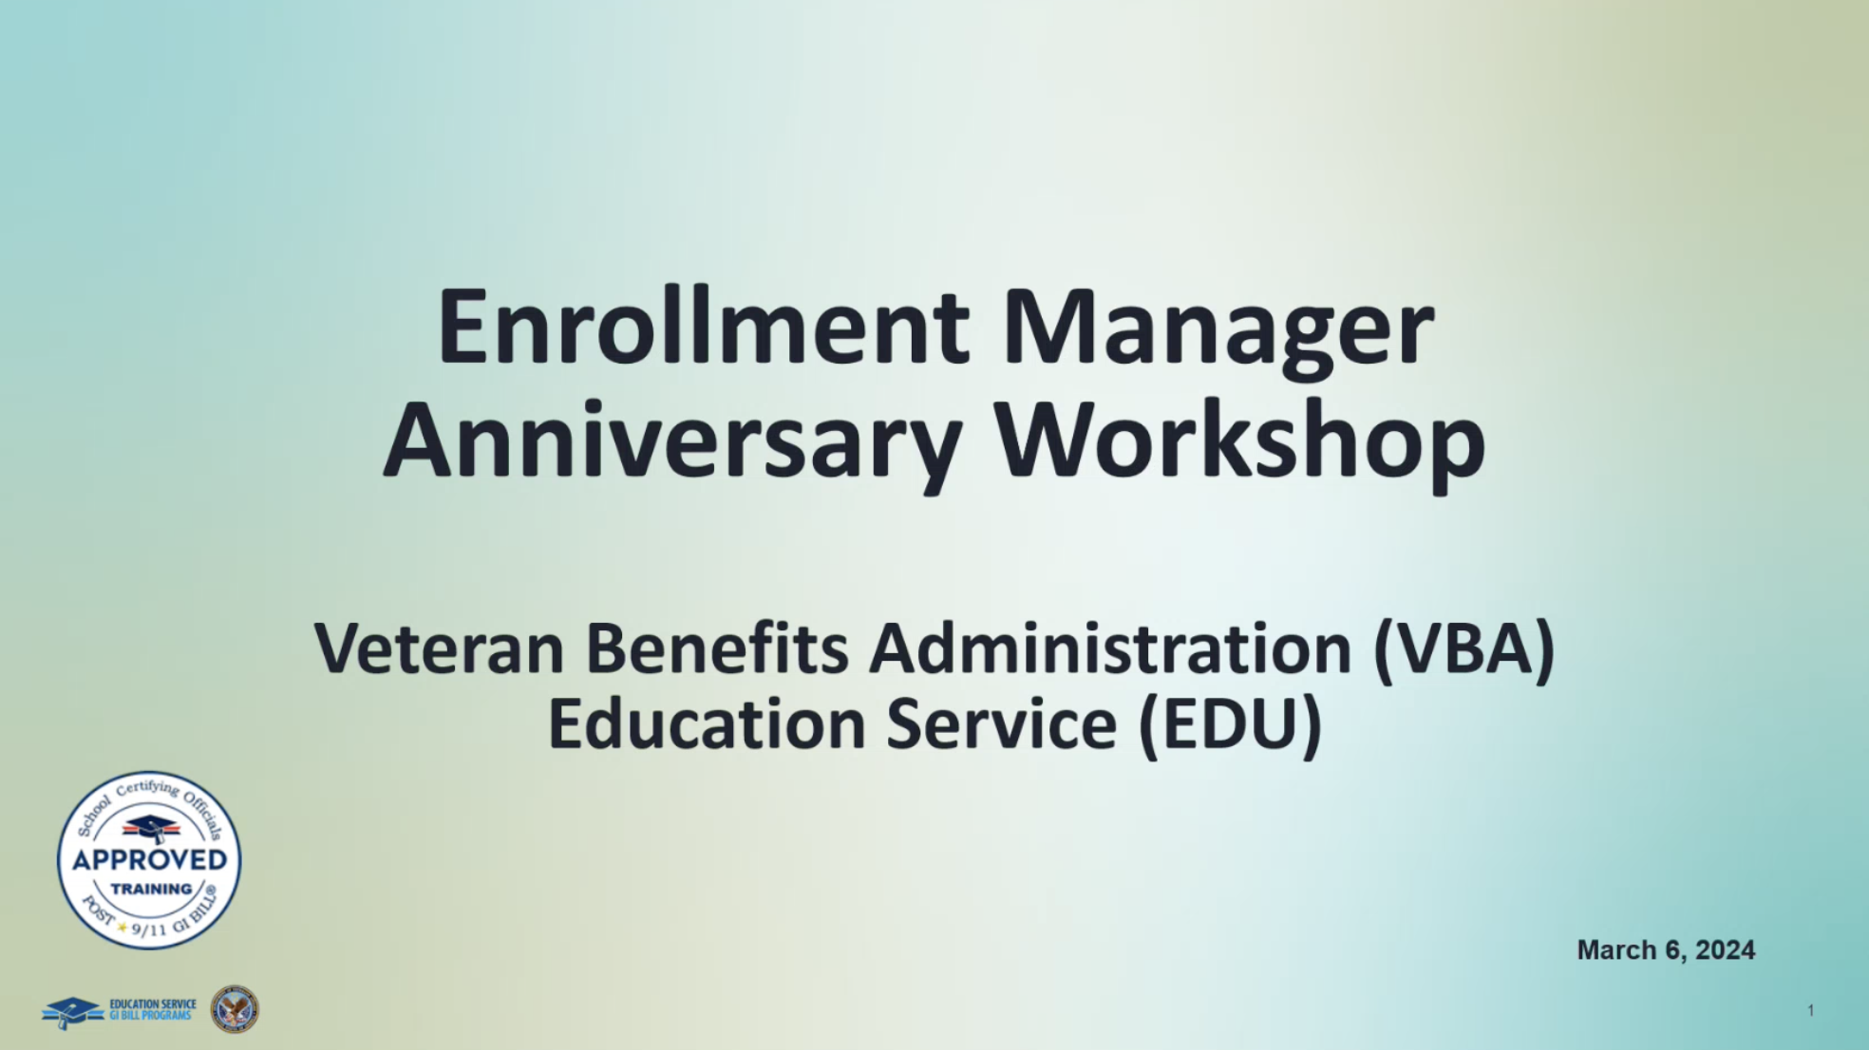
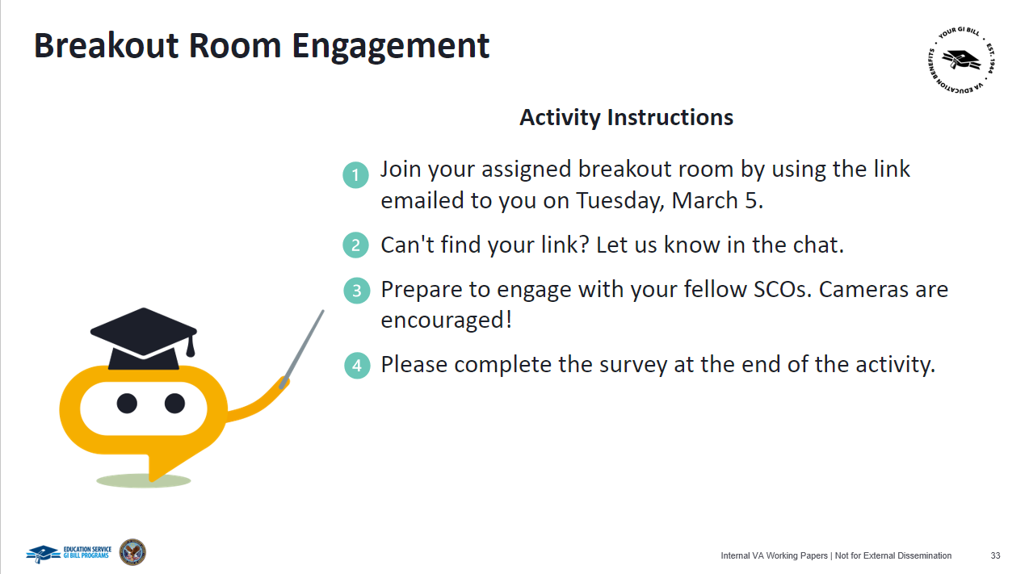


Celebrating One Year with Enrollment Manager
On March 6, 2024, VA held an Enrollment Manager Anniversary Workshop to celebrate a year of EM successes, discuss upcoming system updates, and facilitate EM feedback sessions to drive continuous improvement.
Key Metrics
Event Highlights
Workshop Presentation
SCO Engagement Activity
Main Presentation
750 SCOs attended
1-hour presentation
50 states represented
SCO Engagement Activity
85 SCOs attended
10 breakout sessions
Discussed EM progress to date, shared tips and resources for using EM.
Provided an opportunity for SCOs to provide EM feedback through a facilitator-led activity.
If you missed it, the presentation was recorded, and can be viewed at https://youtu.be/bZ9fsBMDhyc.
.

Slide 7
New Enrollment Manager
Features and Enhancements

Slide 8






Iterative Improvement Starting Day One
This timeline presents key Enrollment Manager system updates since March 2023.
SCOs can select the correct amendment reason when amending an enrollment with a future begin date.
Improved Chatbot Billie functionality.
Introduced the ability to discard draft enrollments.
Ability to add parent school information for guest students.
Enhancements to the View Details tab, including the ability to see the Objective, Program, Benefit Type and Enrollment ID on the View Details page without going to the Print page​​.
Alphabetically sorted the “Students Tab” filter dropdown fields.
Added an inactivity
warning message two minutes prior to SCOs’ EM session expiring.
Made enhancements to Student Profile and Benefits Tab.
Benefits tab clarifications.
Introduced the ability to
save, edit, and delete a new Student ID on students’ profiles​.
Introduced ability to submit new enrollments and amendments for pre-existing Veteran Rapid Retraining Assistance Program students​.
Data security enhancements.
Migrated historical enrollments data at extension campus from VA-ONCE to EM.
Pre-populated the facility dropdown with associated schools.
Introduced ability to filter students based on a date range and school facility name.
Conducted data population effort for actual birth dates for students with default birth date of 01/01/1900.
Expanded capabilities for updating additional student academic information.
Ability to submit amendments with term dates that start in the future.
Introduced ability to switch between CH35 benefit type sources.
Introduced Enrollment Manager.
Mar 6, 2023
February 4,
April 16,
June 11, 2024
Mar 8, 2023
March 18, 2023
March 25, 2023
April 8, 2023
May 21, 2023
June 17, 2023
July 15, 2023
Aug 19, 2023
Oct 8, 2023
Nov 4, 2023
Nov 17, 2023
Dec 16, 2023
Feb 3, 2024
March 11, 2023
Notes:
.

Slide 9
Spring 2024 Updates
VA deployed multiple rounds of EM updates in Spring 2024. The following system updates are now available in EM as we continue to improve the SCO experience.
Initiated data population efforts for birth dates that previously defaulted to 1/1/1900; only 41,000 remaining
Added a pop-up notification two minutes prior to the system timing out, giving SCOs the option to stay logged in
Note: The log out feature is required by VA security and is not expected to change.
Enhancements to the Enrollments tab, adding the ability to use filters
Ability to amend future terms – This was a bug fix.
Update to Programs dropdown to display list of all available programs at a facility, regardless of training type selected

Slide 10


Future Updates
The following features and updates are planned system updates.
Updates Released in R6 (7/1/24)
Future Updates
Allow for hyphenation in First Name and Middle Name fields.
Update Clock Hours VBA remark for NCD schools.
  Was: "Clock Hours for this student are approved to be taken online"
  Now: "All reported clock hours are taken online. The SAA has approved this modality.”
Ability to deactivate a student at your school.
The ability to terminate all future terms in one step when terminating one term.
Pre-set enrollment tab enhancements.
  Facility Code and Name listed
  Ability to Deactivate

Slide 11
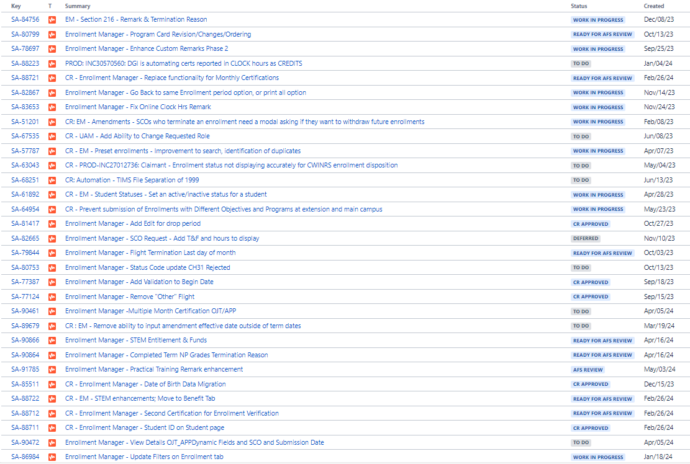
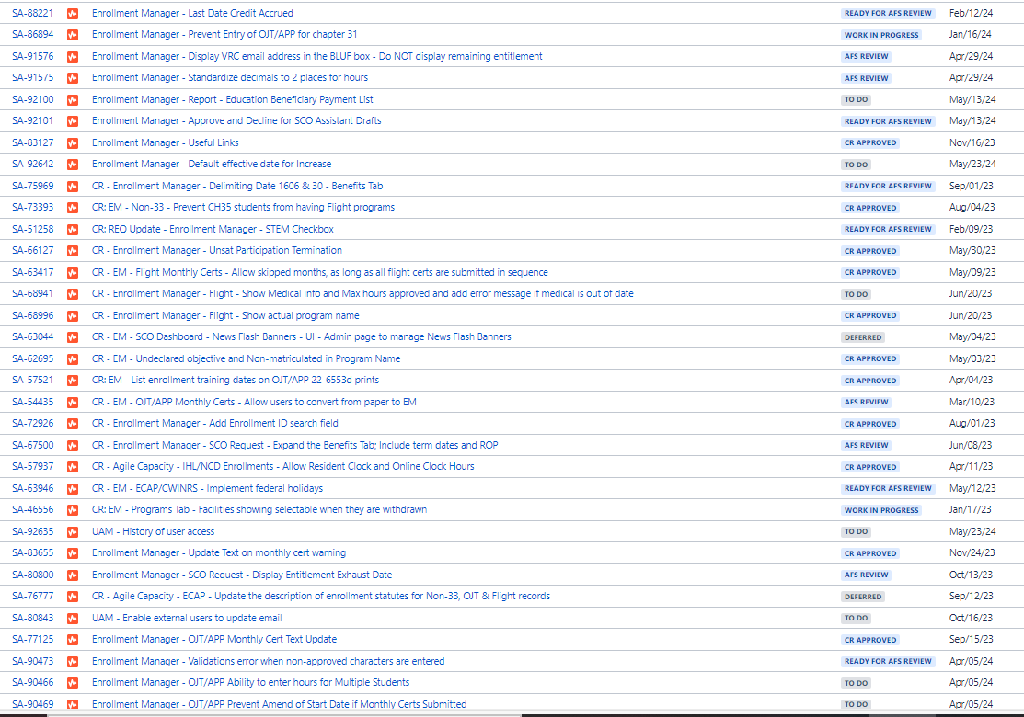
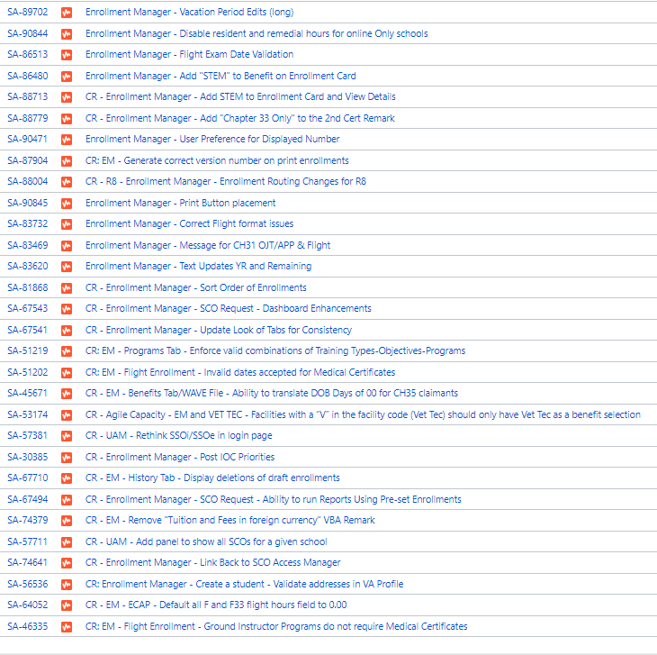
Future Updates
The following is a list of all updates in our backlog – 94 as of 6/10/24; 99 as of 7/8/24; 96 as of 7/15/24

Slide 12

Future Updates
These are changes requested by SCOs that we’re giving high priority.
Ability to go back to same Enrollment Period
Approve or decline for Assistant Drafts
Adding STEM to the Enrollment Card & display entitlement &
  funds remaining
Adding an “ALL” to the Dashboard
Display the VR&E Counselor email all the time while utilizing
chapter 31
Better remark to handle practical training
Handling of Leave of Absence (NCD only)

Slide 13



Known Bugs
These are (SOME of the) bugs we are aware of and that we are working on.
Student ID not updating at the top of the page
VR&E Counselor erased when changing program
Parent school name not transmitted to VCE
Chapter 35 source name not being pulled
Chapter 33 delimiting date not shown
Exporting Reports print 1 page at a time

Slide 14
Policy Update – EM Change
For IHLs – Increases will now be reported effective the first
day of the term. This is to prevent pro-rated charges and
reimburse the school for the full tuition and fees charged.
EM change – when resident, online, or remedial hours are
  changed, and the reason selected for change is “Increase”,
  The effective date will default to the first day of the term.

Slide 15
Enrollment Manager Tips

Slide 16


Student Search and Identity Verification
The Student Search and Identification EM Microlearning is featured in the February Office Hours recording.
Indicators for Verifying a
Student’s Identity
Tips to Find Students in EM
If you are unable to locate a student in EM, even when you are certain they are in the system, widen your search through the following:
  Search for a student without the Date of birth field *only for Search all students
  Use 01/01/1900 in the Date of birth field
  Remember to search by both maiden and married last names
Once you have found a student, there are several indicators you can use to confirm the student’s identity:
  Date of birth
  Previous schools
  Email
  Mobile or home phone number
  Mailing address
  SSN on previous enrollments

Slide 17
VBA Remarks
Custom Remarks for Chapter 33 enrollments at Institutions of Higher Learning and Non-College Degree facilities are no longer available in most cases.
Guidance for non-CH33 SCOs:
Refrain from using Custom Remarks whenever possible and use VBA remarks instead.
Check the SCO Handbook to know when a remark may be required.
If one of the below VBA Remarks is selected, SCOs will be required to provide additional information in the Custom Remarks field.
1
2
3
Dual Degree Program
Incarcerated Students
Compliance Survey
Custom Remark : Enter name of second degree not selected during certification
Custom Remark: Enter itemized costs, i.e., “Books = $1000, Equipment = $300”
Custom Remark: Enter the email of the compliance survey specialist

Slide 18






General Tips and Reminders
Be mindful of what goes into student identification fields
Never input false numbers in the Social Security Number (SSN) field for students who do not have an SSN. You must use paper/PDF enrollments for these students.
Personal email or incorrect/misspelled name displaying in EM?
SCOs can correct this by calling the Education Call Center (ECC) and being routed to the SCO Hotline. Provide your full name, your facility code(s), the incorrect name or email address showing, and the correct name or email address. The correct information must be the same as what is in the Web Enabled Approval Management System (WEAMS).
Review Program tab
Make sure tab displays the correct Training Type, Objective Type, Academic Program, and Benefit Type.
Review Benefit tab
Ensure you have the correct benefit type selected BEFORE adding a term.
Remind your students about the single payment requirement
Make sure your students are aware that they must have only one single payment address on file, in accordance with the recent EDU payments policy update.
Correcting a previously terminated enrollment?
When necessary, to correct the terminated enrollment, re-submit the enrollment period with the VBA remark, "Correcting Previously Terminated Enrollment" and then submit the corrections via amendments.
No more paper, PDF, or hardcopy enrollments
Exceptions may apply for programs or training types not supported by EM, including Correspondence Training, Chapter 32, restricted foreign school locations, students without a social security number and facilities permitted to teach-out of existing students.

Slide 19
Navigating Enrollment Manager:
Updated Resources and FAQs

Slide 20
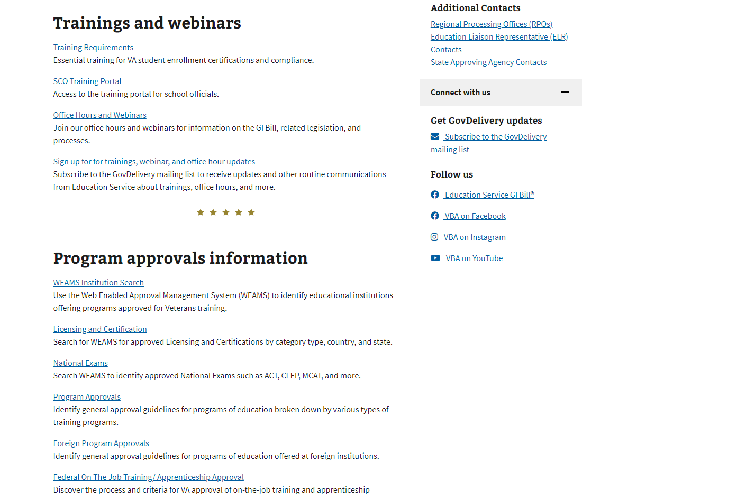
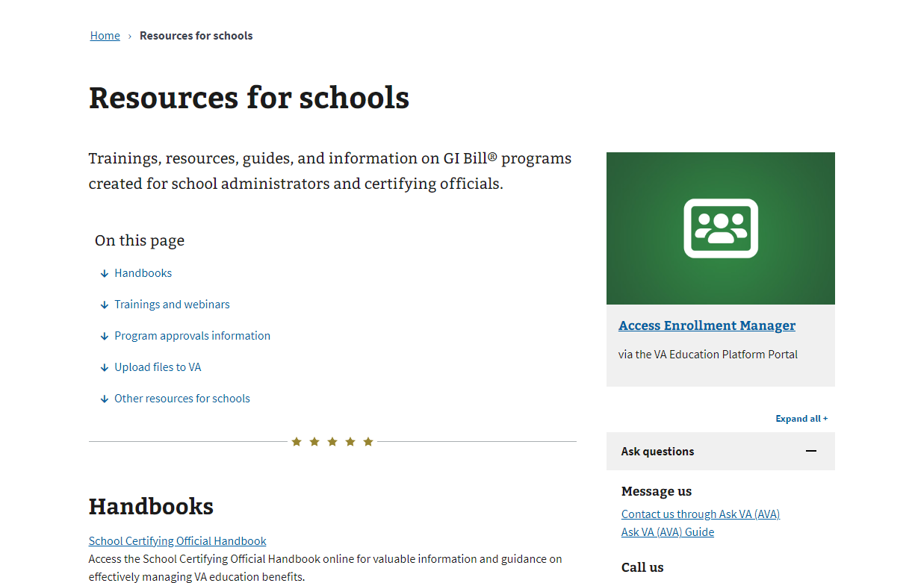


Updated Resources for Schools Page
On March 21, 2024, VA launched the revamped Resources for Schools page — a one-stop-shop for
SCOs to get their information.
Key Updates
Reimagined based on SCO feedback
Easily find applicable materials with resources grouped by topic
Directly access links to relevant sites such as EM and the SCO Portal

Slide 21
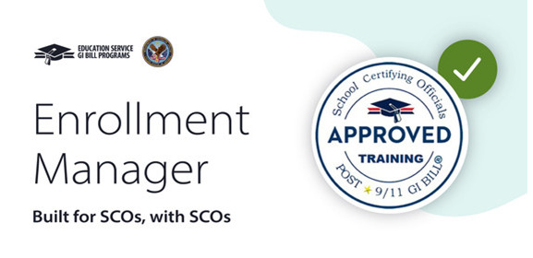
Updated Enrollment Manager Courses in SCO Portal
Improvements based on your feedback
Simplified notifications on system updates
Enhanced system simulations
What’s New?
Core Course Concepts:
Sign into EM
Request first-time access
Manage access and facilities
Find/add student
View/manage student profile
Use Chatbot Billie
Use EM based on facility type
EM 100
EM 101
EM 102
Review Your Completed Courses!
You can review content from completed courses in "Revise Only" section of the SCO Training Portal
Note: Updates are still in progress. Some references may, at this time, continue to reference VA-ONCE, but these references are being actively updates and should be corrected soon.

Slide 22

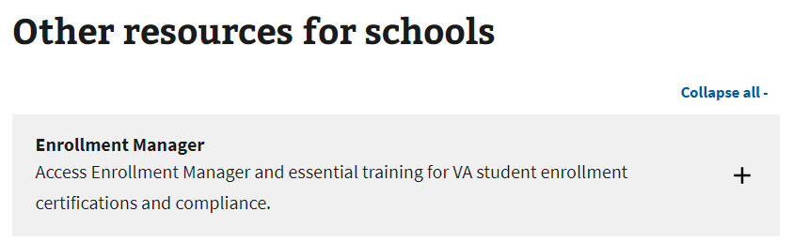
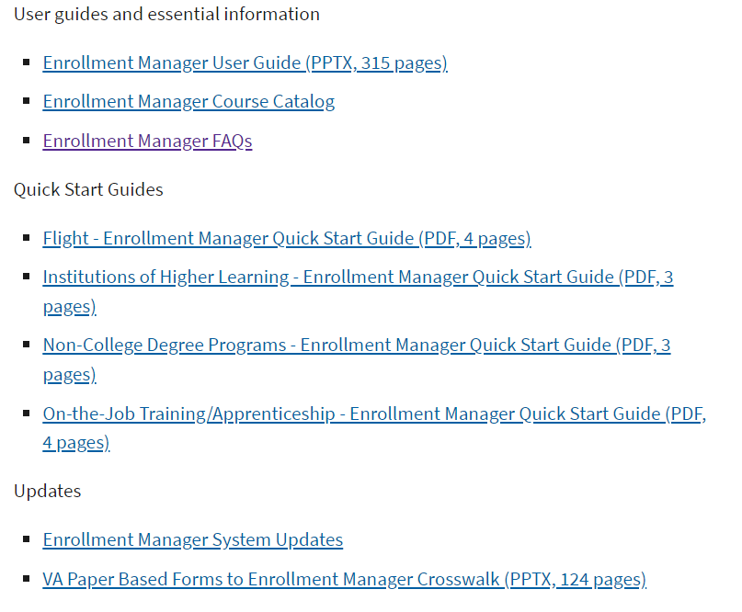
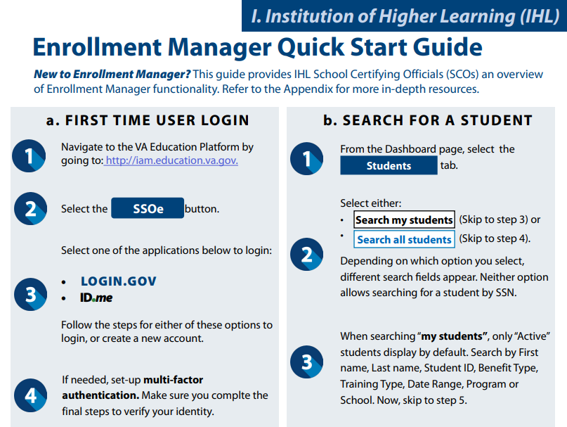
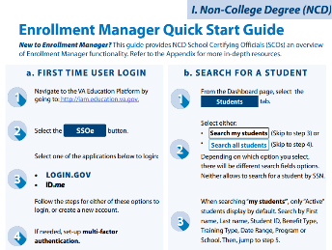
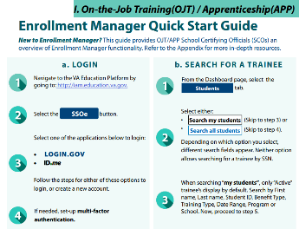
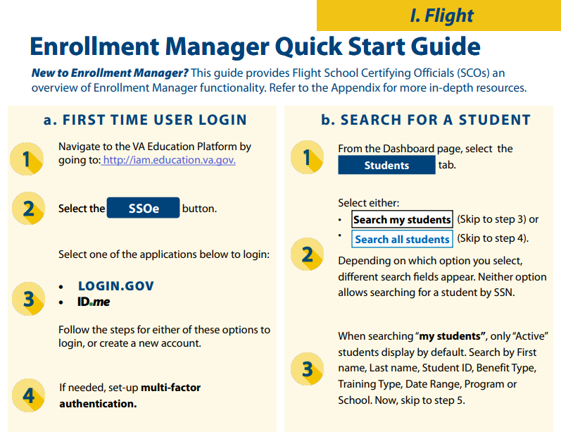

Quick Start Guides and Paper-Based Crosswalk
We’ve updated existing materials based on EM system updates to provide you with the latest information!
Navigate to the Resources for schools page “Other resources for schools” section to view EM training resources.
Looking for a step-by-step crosswalk from VA Paper-Based Forms to EM? Check out the resources below.
Find what you need in the recently updated EM Quick Start Guides!
Institutions of Higher Learning
Non-College Degree Programs
On-the-Job Training/Apprenticeship
Flight

Slide 23
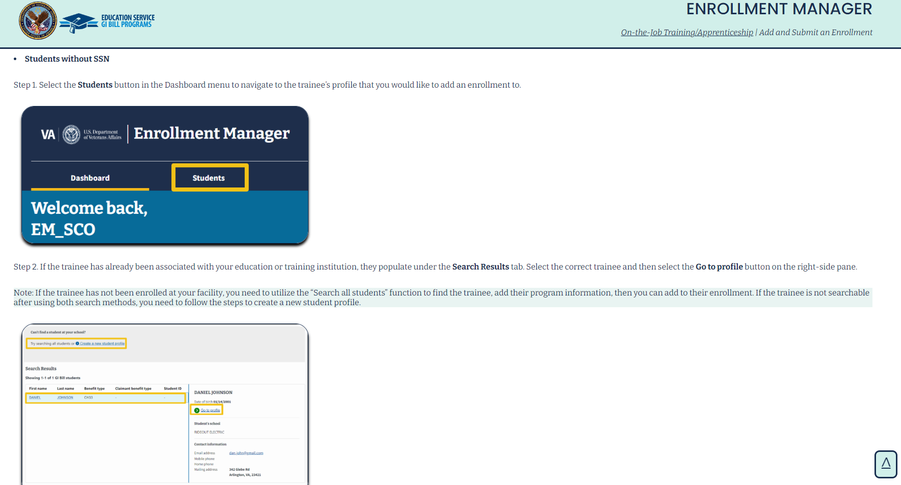
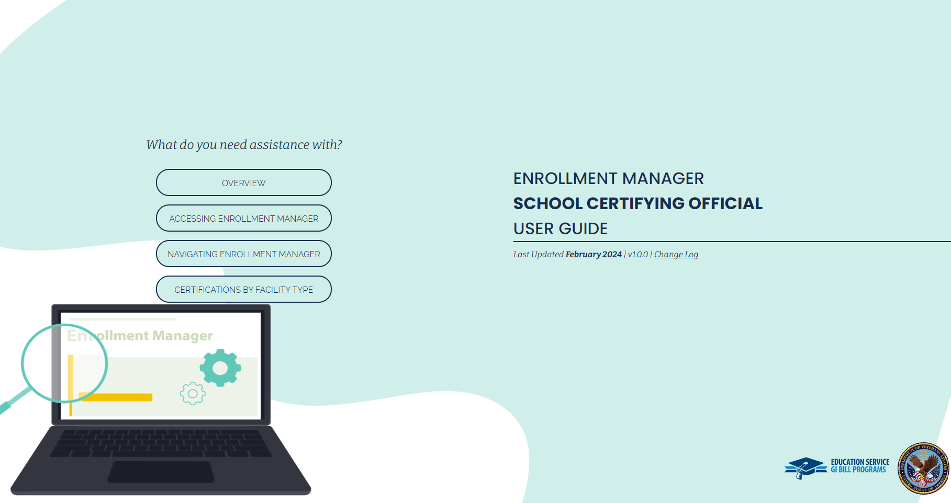


Updated Enrollment Manager SCO User Guide
Coming Soon!
Below is a sneak peak of the digital EM SCO User Guide launching Summer 2024!
Key User Guide Updates
Guidance for updating student and trainee benefit source when using Chapter 35 benefits
Visuals to reflect user interface and functionality updates
Direct access to additional SCO resources for continued learning

Slide 24
Enrollment Manager | Frequently Asked Questions
Why is there down-time after submitting enrollment certifications and creating an amendment?
SCOs need to wait 10 minutes between submitting enrollment certifications, and 24 hours between creating amendments.
These wait times are necessary to allow for automation batch processing within EM, which speeds up claims processing time.
Can I edit student contact information directly?
No, SCOs are not able to edit this type of information directly. This helps safeguard student information and mitigates erroneous entries.
Students can request to have their information updated through Education Call Center or AskVA.
Why are reporting capabilities limited to one week?
Reporting by week remains the same as it was in VA-ONCE, with the added option of being able to select the start date. The filters can be used to generate custom reports. These can be exported into an Excel spreadsheet using the export results button.

Slide 25
Enrollment Manager | Frequently Asked Questions
Is "Benefit Remaining" information also be available for non-CH 33 students (30, 1606, 35, etc.)?
Yes, excluding CH 31, you can find this information on the Student Profile Page in Enrollment Manager. The Benefit Remaining shown reflects the student's remaining entitlement as of the End date of the last processed term.
Why does EM time out after 15 minutes of inactivity? ​
To keep Personal Identifying Information (PII) secure, EM times out in 15 minutes of inactivity to align with VA’s security requirements. An inactivity warning message appears two minutes prior to timeout for users to save work and opt to stay logged into the system.
Can SCOs add programs manually?
There is not a way for SCOs to add programs in EM. The Web Enabled Approval Management System (WEAMS) feeds all programs to EM. Once a program is added to WEAMS it should be available in EM the next day.
If you have a program that is not listed in WEAMS that has received approval in the past, contact the Education Liaison Representative (ELR) of jurisdiction. If you have a new program that needs to be approved, contact the State Approving Agency (SAA) of jurisdiction.

Slide 26
Additional Resources

Slide 27



Resources Based on SCO Feedback
Below are available steps and resources for SCOs that address common questions identified in recent feedback sessions, including EM Workshop.
“My personal email is being printed on the Forms printed from EM.”
Contact the Education Call Center (ECC) to request that a Call Center Representative sends the information to their coach for action. When speaking to the representative, please provide the representative with the following:
Facility code
Incorrect email address
Correct email address
Contact the ECC at 1-888-442-4551. SCO Hotline representatives are available 8 a.m.- 5 p.m. ET.
“Having social security number (SSN) makes the identification of students easier.”
To remain in compliance with a legislative mandate, SCOs cannot search by SSN in Enrollment Manager.
SSNs are still used to verify students and are associated to students in VA systems not visible in Enrollment Manager.
SSN is used to create a new student in VA systems and is printed on the Enrollment/Notice of Change in Status/Monthly Certs form.
The Student Search and Identification EM Microlearning is featured in the February Office Hours recording.

Slide 28


Resources Based on SCO Feedback
Below are available steps and resources for SCOs that address common questions identified in recent feedback sessions, including EM Workshop.
“Can custom remarks be reintroduced to EM?"
Custom remarks were removed in most cases to boost efficiency and allow for more automated claims, leading to faster benefits delivery.
View the VBA and Custom Remarks Guidance in the Enrollment Manager Frequently Asked Questions page for guidance on using VBA remarks.
Note: Non-CH33 OJT/APP and FLT SCOs should refrain from using custom remarks whenever possible and use VBA remarks.
​“I’m unable to edit Student Profile
information.”
​
To make changes to the Bio-Info, have the student/trainee submit a correction request through the AskVA system.​
​
To make any Contact Information changes, have the student contact the ECC or submit a correction request through the AskVA system.​

Slide 29
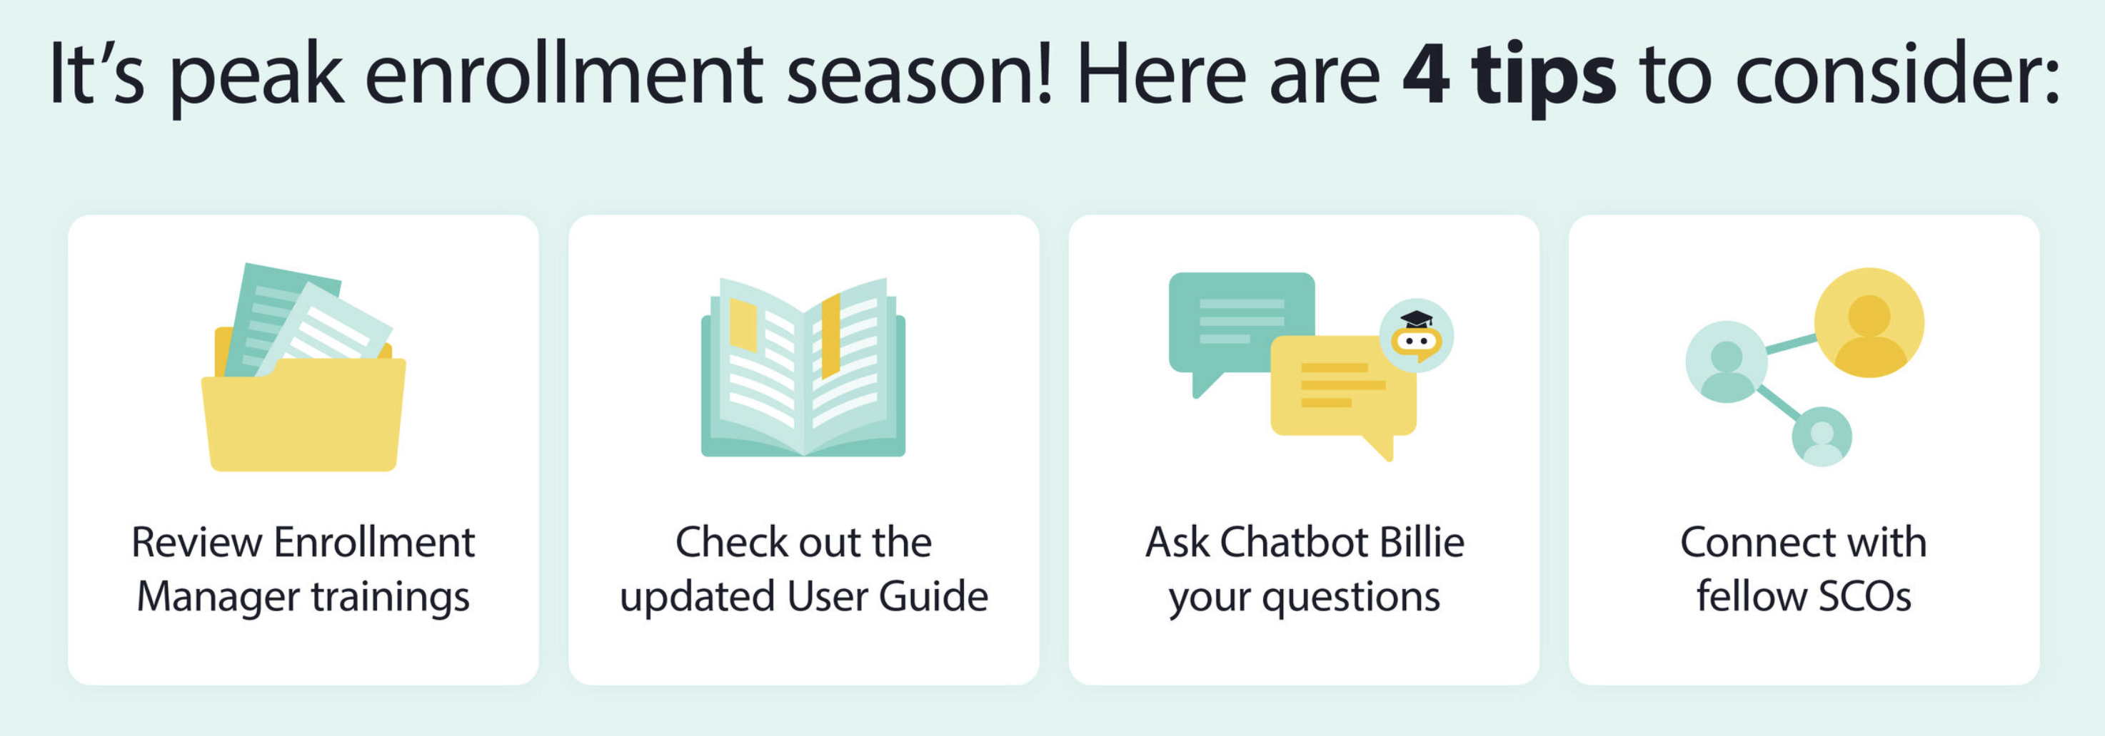


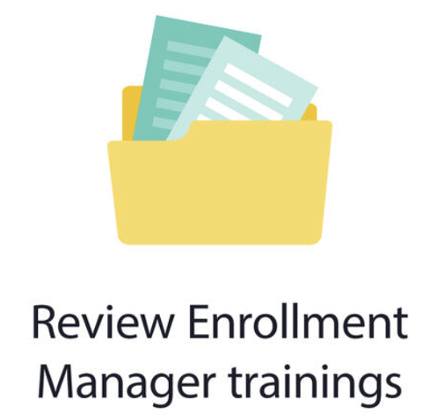




Top Four Tips
Top Four Tips for Staying in the Know
Sign up with GovDelivery
Subscribe to GovDelivery to receive direct informational messages from Education Service
Reference
EM User Guide
Review detailed instructions on how to navigate EM and perform actions
Tune into Office Hours
If you couldn't catch the Office Hours live, make sure to watch the recorded version on our YouTube page
Read the SCO Newsletter
Subscribe to the bi-monthly "SCO in the Know" Newsletter for the latest updates
29

Slide 30






Enrollment Manager Training Materials Overview
An array of EM training materials and resources are publicly available to you on VA’s Resources for Schools page.
Resources for Schools Page
Updated EM Training Modules
Office Hours and Webinar Recordings
Enrollment Manager System Updates
EM Frequently Asked Questions
GovDelivery Emails
SCO Resource Matrix

Slide 31
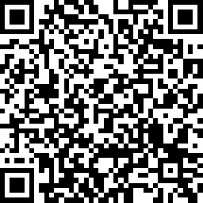
Questions?
Survey
Education Call Center:
1-888-442-4551
SCO Hotline representatives available 8 a.m.-5 p.m. ET

